Slide 1
TRAUMA INFORMED RE-ENTRY Through the Use of Our MTSS Structures and Practices: Introductory Considerations
RED CLAY CONSOLIDATED SCHOOL DISTRICT
OFFICE OF SPECIAL SERVICES
June 2020
Notes:
LM

Slide 2
LEARNING OBJECTIVES
Identify Trauma Sensitive School Characteristics
Understand Basic MTSS Structures
Recognize Common Crisis Reactions
Discuss how to Enhance MTSS Structures and Practices
Look at Existing Structures and Practices
Consider Trauma Informed Approaches
Incorporate Staff Self-Care
Notes:
LM

Slide 3
MTSS STRUCTURES & TRAUMA INFORMED PRACTICES
Notes:
LM

Slide 4
TRAUMA-SENSITIVE SCHOOL CHARACTERISTICS
Provide all students with a safe school environment
(socially, emotionally, academically & physically)
Increase staff understanding and ability to mitigate the potential impacts of traumatic experiences on students' learning & behavior
Encourage all school staff to work together to meet the needs of students in the school
Address student needs in relationship development, self-regulation, academic competency, and health & well-being
Ensure that all students are included in & connected to the school community
Adapt school planning and operations to the ever-changing needs & demands of the students
Include community resources & parents in the support network in addressing student needs
Supporting and Educating Traumatized Students: A Guide for School-Based Professionals (2012), By: Eric Rossen and Robert Hull
Notes:
LM
Provide all students with a safe school environment (socially, emotionally, academically, physically)
Increase staff understanding of and ability to mitigate the potential impacts of traumatic experiences on students' learning and behavior
Encourage all school staff to work together to meet the needs of students in the school
Address student needs in relationship development, self-regulation, academic competency, and health and well-being
Ensure that all students are included in and connected to the school community
Adapt school planning and operations to the ever-changing needs/demands of the students
Include community resources and parents in the support network in addressing student needs

Slide 5
BASIC MTSS STRUCTURES
ACADEMIC SUPPORTS
BEHAVIORAL SUPPORTS
SAFETY PRACTICES
https://www.pbis.org/pbis/tiered-framework
PBIS Rewards: What is MTSS?
Notes:
AG

Slide 6
MULTI-TIERED FRAMEWORK
A Multi-Tiered System of Support (MTSS) is a data-driven, problem-solving framework to improve outcomes for all students
MTSS relies on a continuum of evidence-based practices matched to student needs
https://www.pbis.org/pbis/tiered-framework
PBIS Rewards: What is MTSS?
Notes:
AG

Slide 7
THREE TIERS OF SUPPORT
MTSS emerged as a framework from the work conducted in public health emphasizing three tiers of prevention
Schools apply this model as a way to align to academic, behavioral, social, and emotional supports to improve education for all students
https://www.pbis.org/pbis/tiered-framework
PBIS Rewards: What is MTSS?
Notes:
AG

Slide 8
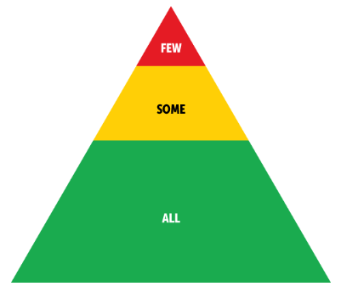
TIER 1: UNIVERSAL PREVENTION (ALL)
Tier 1 supports serve as the foundation for behavior & academics
Schools provide these universal supports to all students
For most students, the core program gives them what they need to be successful and to prevent future problems
https://www.pbis.org/pbis/tiered-framework
Notes:
AG

Slide 9
TIER 2: TARGETED INTERVENTION (SOME)
This level of support focuses on improving specific skill deficits students have. Schools often provide Tier 2 supports to groups of students with similar targeted needs
Providing support to a group of students provides more opportunities for practice and feedback while keeping the intervention maximally efficient
Students may need some assessment to identify whether they need this level of support and which skills to address
Tier 2 supports help students develop the skills they need to benefit core programs at the school
https://www.pbis.org/pbis/tiered-framework
Notes:
AG

Slide 10
TIER 3: INTENSIVE, INDIVIDUALIZED INTERVENTION (FEW)
Tier 3 supports are the most intensive supports the school offers
These supports require are the most resource intensive due to the individualized approach of developing and carrying out interventions
At this level, schools typically rely on formal assessments to determine a student’s need and to develop an individualized support plan
Student plans often include goals related to both academics as well as behavior support
https://www.pbis.org/pbis/tiered-framework
Notes:
AG

Slide 11
REMEMBER
It’s important to remember these tiers refer to levels of support students receive, not to students themselves
Students receive Tier 2 supports, they are not
Tier 2 students
https://www.pbis.org/pbis/tiered-framework
Notes:
AG

Slide 12
KEY COMPONENTS AT EVERY TIER
Each tier has its own set of systems and practices, but some key components appear across every level
Each of these features needs to be present in order for MTSS to be implemented with fidelity
https://www.pbis.org/pbis/tiered-framework
Notes:
AG

Slide 13
Practices are based on evidence to be effective in a similar context with similar populations
Practices are organized along a tiered continuum, beginning with strong universal supports followed by intensified interventions matched to student needs
Data are collected and used to screen, monitor, and assess student progress
Resources are allocated to ensure systems and practices are implemented with fidelity over time
https://www.pbis.org/pbis/tiered-framework
Notes:
AG

Slide 14
GLOBAL CRISIS & COMMON CRISIS REACTIONS
Notes:
GK

Slide 15
GLOBAL CRISIS
Notes:
GK

Slide 16
GLOBAL CRISIS
Make sure parents, teachers/educators, and other caregivers:
Know the Facts
Know Common Reactions
Know How to Respond
Know When to Seek More Help
Notes:
GK

Slide 17
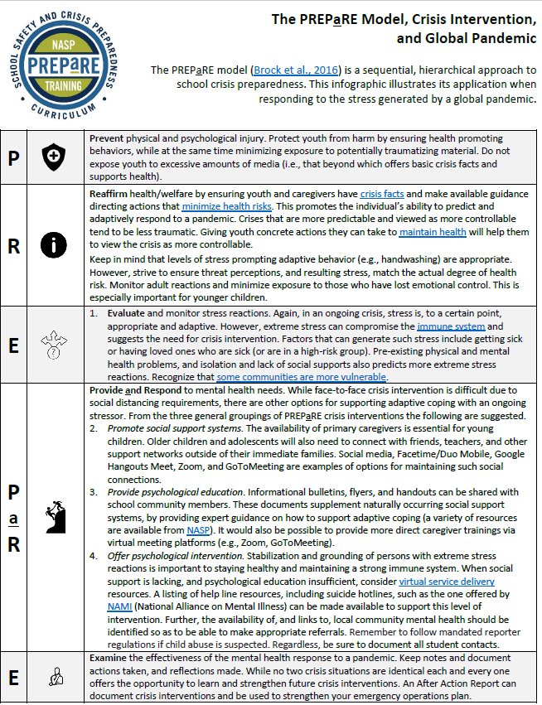
THE PREPARE MODEL
The PREPaRE Model (Brock et al., 2016)
is a sequential, hierarchical approach to school crisis preparedness
This infographic illustrates its application when responding to the stress generated by a global pandemic
NASP: The PREPaRE Model
Notes:
GK

Slide 18
Notes:
GK

Slide 19
Notes:
GK

Slide 20
COMMON CRISIS REACTIONS
Notes:
GK

Slide 21
COMMON STUDENT CRISIS BEHAVIORS ELEMENTARY SCHOOL
Anger, Aggressiveness & Outbursts
Separation Anxiety
Guilt
Sleep Difficulties & Nightmares
Discussing/Retelling of traumatic event repeatedly
Traumatic Play
Sadness & Crying
Increased Fears
Excessive Worry
Notes:
GK

Slide 22
COMMON CRISIS THOUGHTS & FEELINGS ELEMENTARY SCHOOL
Difficulty With Organization
Difficulty With Concentrating
Confusion
Difficulty With Recalling Information
Difficulty With Paying Attention
Notes:
GK

Slide 23
COMMON STUDENT CRISIS BEHAVIORS SECONDARY SCHOOL
Suicidal Ideation
Substance Abuse
Guilt & Shame
Feelings of Helplessness
Anxiety, Fears & Worry
Withdrawal
Anger & Aggressiveness
Depression
Revenge Fantasies
Notes:
GK

Slide 24
COMMON CRISIS THOUGHTS & FEELINGS SECONDARY SCHOOL
Intrusive Thoughts
Difficulty With Concentrating
Confusion
Difficulty With Organization
Difficulty With Paying Attention
School Avoidance
Difficulty With Recalling Information
Notes:
GK

Slide 25
OPPORTUNITIES IN CRISIS
Notes:
AG

Slide 26
COLLECTIVE RESILIENT RESPONSE
These unprecedented times provide our teams with the opportunity to prepare for changes through collective resilient response, which changes how we approach teaching & learning forever
Mid-Atlantic APBS: Community Conversations-Building Resilient School Communities
Notes:
AG
These unprecedented times provide our teams with the opportunity to prepare for changes through collective resilient response, which changes how we approach teaching & learning forever

Slide 27
COLLECTIVE RESILIENT RESPONSE
Pause & Reset
Focus on prevention science, developing & prioritizing pro-social communities to build a resilient community
NEW
OPPORTUNITIES
Acceleration of interest for integrated approaches (how our team prepares to assist as mental health champions)
Mid-Atlantic APBS: Community Conversations-Building Resilient School Communities
Notes:
AG
These unprecedented times provide our teams with the opportunity to prepare for changes through collective resilient response, which changes how we approach teaching & learning forever

Slide 28
COLLECTIVE RESILIENT RESPONSE
Essential Mindsets
Mental health is everyone’s responsibility
Systems & structures promote wellness and must be addressed
Having a healthy workforce is essential for success
Establish a culture of wellness
Naturally embed Social, Emotional & Behavioral Wellness into all instruction
Mid-Atlantic APBS: Community Conversations-Building Resilient School Communities
Notes:
AG
Mental health leaders build capacity for ALL
Establish a culture of wellness (talking about academic rigor while developing relationships & teaching social-emotional behavioral competencies)

Slide 29
COLLECTIVE RESILIENT RESPONSE
Building a Resilient community with Essential Components
Clearly defined expectations procedures & routines
Safe & stable environment
Staff engaged in active supervision across all contexts
Positive greetings & social interactions throughout the day
Educator connectedness & wellness activities
Ongoing training, coaching & performance feedback for educators
Daily routines that promote building community, relationships & positive connections
Ongoing embedded instruction of expectations, procedures, routines & social emotional skills
Spaces & routines for educators to regroup & reset
Physical distancing & hand washing
Growth mindset culture for educators
Clearly defined way for students to ask for help
Mid-Atlantic APBS: Community Conversations-Building Resilient School Communities
Notes:
AG

Slide 30
COLLECTIVE RESILIENT RESPONSE
Guiding Principles to Keep in Mind
Promoting Behaviors that Reduce Spread
Maintaining Healthy Operations
Maintaining Healthy Environments
Preparing for When Someone Gets Sick
CDC: Recommendations for Community Schools
Notes:
AG

Slide 31
REVIEW MTSS STRUCTURES AND PRACTICES
Notes:
AS

Slide 32
REVIEW EXISTING STRUCTURES AND PRACTICES
MTSS Framework Components
Tier 1 (ALL)
Program Development and Evaluation
Prevention
Correcting Problem Behavior
Developing Self-Discipline
Tier 2 (SOME)
Systems
Targeted Student Problem-Solving
Tier 3 (FEW)
Systems
Individualized Student Problem-Solving
Delaware Positive Behavior Support Project
Notes:
AS

Slide 33
REVIEW EXISTING STRUCTURES AND PRACTICES
What staff, supports, and interventions does your building already have in place?
Utilize Asset Mapping
Review Staff Roles and Responsibilities
Are they coordinated?
Review Building Resource Map
Notes:
AS

Slide 34
REVIEW EXISTING STRUCTURES AND PRACTICES
Tiered Fidelity Inventory (TFI) – Tier 1 Scale
Featured Items
1.1 Team Composition
1.3 Behavioral Expectations
1.4 Teaching Expectations
1.5 Problem Behavior Definitions
1.6 Discipline Policies
1.8 Classroom Procedures
1.9 Feedback and Acknowledgement
1.13 Data-based Decision Making
*Assessment tool used to guide development and implementation of key Tier 1 structures, systems, and practices
Tiered Fidelity Inventory
Notes:
AS
Scale: 0, 1, 2
Prioritized items based on RCCSD TFI data, CASEL recommendations, Community conversations (Atlantic PBIS),

Slide 35
REVIEW EXISTING STRUCTURES AND PRACTICES
Integration: TIER 1 (ALL)
T1 - Framework Components
T1 - TFI Items
Program Development & Evaluation
Prevention: SW and CR Systems
Correcting Problem Behavior
Developing Self-Discipline
TFI 1.3 Behavioral Expectations
TFI 1.4 Teaching Expectations
TFI 1.8 Classroom Procedures
TFI 1.9 Feedback & Acknowledgement
TFI 1.5 Problem Behavior Definitions
TFI 1.6 Discipline Policies
TFI 1.8 Classroom Procedures
TFI 1.9 Feedback & Acknowledgement
TFI 1.1 Team Composition
TFI 1.13 Data-based Decision Making

Slide 36
ENHANCING TIER 1 STRUCTURES AND SUPPORTS
Notes:
AS

Slide 37
ENHANCING TIER 1 STRUCTURES AND PRACTICES TEAMING
Considerations:
Include additional stakeholders if needed
Include a variety of data sources in decision making
Use a data analysis protocol
Increase meeting frequency at first
Coordinate with the efforts of other teams in your buildings
Delegate tasks via the creation subcommittees
Framework Component = Program Development and Evaluation
TFI 1.1 Team Composition
TFI 1.13 Data-based Decision Making
Notes:
AS

Slide 38
ENHANCING TIER 1 STRUCTURES AND PRACTICES ESTABLISH BEHAVIORAL EXPECTATIONS
Considerations:
Include connections to SEL competencies
Include virtual learning classrooms
Include expectations around safety and well-being precautions related to COVID-19
Framework Component = Prevention
TFI 1.3 Behavioral Expectations
Notes:
AS

Slide 39
ENHANCING TIER 1 STRUCTURES AND PRACTICES ESTABLISH BEHAVIORAL EXPECTATIONS
Flexible matrix to fit different context & needs
Use existing expectations
Incorporate elements of safety
(handwashing, physical distancing, wearing masks)
Enhance staff expectations for modeling & supporting students
Include calming strategies
(can also incorporate additional high-priority social-emotional behavioral skills)
The APBS Mid-Atlantic PBIS Network
Notes:
AS

Slide 40
ENHANCING TIER 1 STRUCTURES AND PRACTICES TEACHING BEHAVIORAL EXPECTATIONS
Considerations:
Increase the frequency of teaching
Increase use of behavioral expectations to pre-correct
Increase modeling of expected behaviors
Framework Component = Prevention
TFI 1.4 Teaching Expectations
Notes:
AS

Slide 41
ENHANCING TIER 1 STRUCTURES AND PRACTICES CLASSROOM SYSTEMS
Considerations:
Create supportive, predictable and safe learning environments
Establish schedules, routines, procedures that are consistent SW
Incorporate mindfulness breaks
Focus on building positive relationships
Incorporate morning and class meetings
Incorporate positive contactless greetings
Incorporate regulation stations
Increase use of behavior specific praise
Framework Component = Prevention
TFI 1.8 Classroom Procedures
TFI 1.9 Feedback and Acknowledgement
Notes:
AS

Slide 42
ENHANCING TIER 1 STRUCTURES AND PRACTICES RESPONDING TO CHALLENGING BEHAVIORS
Considerations:
Review and revise major v. minor flowchart and definitions
Adopt a SW philosophy that views disciplinary encounters as an opportunity to problem-solve (i.e. retool, reflect and repair)
Establish SW general procedures for responding to challenging behavior
Increase use of Restorative Practices and approaches
Incorporate regulation stations SW
Framework Component =
Correcting Problem Behavior
TFI 1.5: Problem Behavior Definitions
TFI 1.6: Discipline Policies
TFI 1.8 Classroom Procedures
Notes:
AS

Slide 43
ENHANCING TIER 1 STRUCTURES AND PRACTICES
DEVELOPING SOCIAL & EMOTIONAL COMPETENCIES
Framework Component = Developing Self-Discipline
TFI 1.9 Feedback & Acknowledgement
Considerations:
Adopt a SW SEL program and embed into schedule
Increase opportunities for cooperative learning
Increase use of behavior specific praise
Incorporate mindfulness breaks
Incorporate regulation stations SW
Notes:
AS

Slide 44
ENHANCING TIER 2 STRUCTURES AND SUPPORTS

Slide 45
ENHANCING TIER 2 STRUCTURES AND SUPPORTS
Systems: Intervention Development
Targeted Student Problem-Solving
Considerations
Incorporate group supports for coping with:
Stress
Grief
Worrisome or nervous feelings
Considerations
Utilize additional data to determine students who are in need of support beyond tier 1:
Increased visits to the classroom regulation station or requests to leave the classroom
Decreasing productivity, participation and/or attendance
Notes:
AS

Slide 46
ENHANCING TIER 3 STRUCTURES AND SUPPORTS
Notes:
GK

Slide 47
ENHANCING TIER 3 STRUCTURES AND SUPPORTS
Systems
Individualized Student Problem-Solving
Considerations
Increase accessibility to high frequency contact with designated intervention providers
Expand partnerships with community-based organizations and outside agencies
Considerations
Utilize additional data to determine students who are in need of support beyond tier 2:
High frequency visits to the classroom regulation station or requests to leave the classroom
Sustained low productivity, participation and/or attendance
Notes:
AS

Slide 48
SUPPORTING STAFF
Notes:
LM

Slide 49
ASSESSING STAFF WELL-BEING
Connect with Tier 1 Building Team & begin collaborative conversations surrounding practices for working through COVID-19 Planning
% of staff who feel connected within grade level team
% of staff who feel connected within school level team
% of staff who feel like they can manage their current workload
% of staff who feel like they are managing their current changing role
% of staff who feel like they have skills to manage current student needs
Begin by implementing & reviewing a building-wide survey to evaluate current staff needs
Mid-Atlantic APBS: Community Conversations-Building Resilient School Communities
Skovholt Practitioner Professional Resiliency and Self-Care Inventory
Notes:
LM

Slide 50
SELF-CARE FOR STAFF
Self-care is giving attention to our own physical and psychological health and actively preserving, protecting, and improving it
Why is it Important?
Reduces the impact of stress and burnout
Improves motivation, emotions, and relationships
Supports student success and well-being
Center to Improve Social and Emotional Learning and School Safety
Notes:
LM

Slide 51
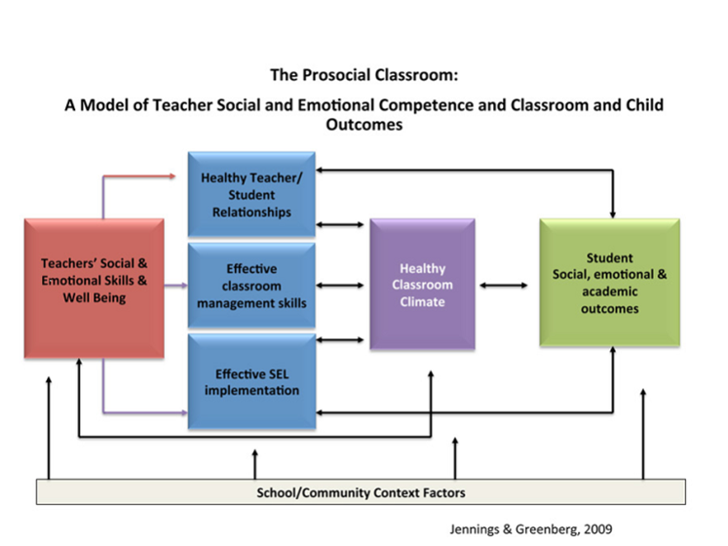
Notes:
LM

Slide 52
SELF-CARE FOR STAFF
Self-Awareness is essential for cultivating knowledge of one’s character, feelings, behaviors & motives
Examine Thoughts & Feelings
Stay Calm & Focused
Be Aware of Self-Storytelling
Recognize Contagious Emotions
Be aware of/accept our own thoughts & feelings and adjust our actions accordingly
Mindfulness practices can reduce emotional reactivity & support decision-making
Look for the stories you’re telling yourself about the circumstances & question whether your thoughts are realistic or fear-based
Do your best to keep fear & panic contained by modeling calmness & expressing optimism
We can provide space for others to talk & process their feelings before diving into new tasks
Model mindfulness during your conversations with others
When feeling stressed, consider ways to reschedule or reconnect when your mind is feeling steadier
Before reacting, pause, take a breath & notice the thoughts in your mind & the sensations in your body
Center to Improve Social and Emotional Learning and School Safety
Notes:
LM

Slide 53
SELF-CARE FOR STAFF
General Recommendations
•Maintain healthy eating habits; Limit the use of alcohol/other substances
•Get adequate sleep and exercise
•Take your "emotional temperature"
Feeling frustrated or overwhelmed is normal, so take breaks; Know/respect your limitations
•Maintain normal daily routines as much as possible
•Connect with trusted friends or family
•Acknowledge that you and/or your family may need additional help
Notes:
LM
-Taking care of yourself is vital to being able to care for your children and others in your care.
-From Care for the Caregiver; NASP PREPaRE

Slide 54
SELF-CARE FOR STAFF
Being optimistic & solution-focused will assist with focusing on the positive & minimize judgement
Take a Solution-Focused Approach
Shift From Pessimism to Optimism
Find Opportunities & Meaning
Practice Gratitude
Demonstrate Compassion
Avoid analysis paralysis & start searching for solutions
Challenge thoughts of "can’t" by redirecting your focus to what you do like & want to do
Look for opportunities in the challenges & search for the meaning in the lessons emerging from the challenges & uncertainties
Take time daily to express appreciation &/or gratitude
Connect with others through active listening, seek to understand rather than be understood & strengthen feelings of concern for others
Explore what is causing the problem, separate it from people & formulate a plan to try to resolve it
Practice reframing by focusing on the positive instead of the negative
Encourage staff to look ahead & apply what they are learning now to future scenarios
Try writing a gratitude list, speaking your appreciation, &/or posting positive messages on social media
Take time to get to know colleagues, show kindness by offering help or words of encouragement & build trust in your relationships
Center to Improve Social and Emotional Learning and School Safety
Notes:
LM

Slide 55
ASSISTING STAFF WITH COPING WITH STRESS
Morning Circle for Staff
Teams sharing workloads/used as a source of support
Team & Staff huddles
Designated quiet space to reset & use a calming strategy
Universal signal for staff to use with each other to show the need for a break
Notes:
LM

Slide 56
STAFF & SELF CONCERNS
When to Seek Help for Yourself & Colleagues
Friends, families & colleagues can be a great source of support when stress or low feelings arise
Occasionally experiencing a low mood or some anxiety is considered normal
Feeling intense, persistent, or prolonged feelings of hopelessness, despair, or anxiety are important indicators that additional support may be required
Seek professional assistance if the feelings of fear or hopelessness is significantly disrupting daily functioning
Institute of Education Sciences
Notes:
LM
Add talking points (be empathetic and supportive)
From the CASEL guide:
Some adults in the building may be struggling with mental health issues, trauma, secondary traumatic stress, or “compassion fatigue.” Look
for signs that adults might need more support and identify available resources. You can use the SAMHSA
mental health services locator to search for resources in your community.
Consider tracking your mood daily

Slide 58
HOPE IS NOT CANCELLED

Slide 59
ADDITIONAL RESOURCES
Notes:
LM

Slide 60
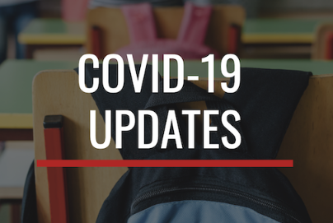
RCCSD RESOURCES
https://covid19.redclayschools.com/home

Slide 61
CASEL RESOURCES
CASEL CARES: SEL Resources During COVID-19
CASEL: An Initial Guide to Leveraging The Power of Social and Emotional Learning
CASEL CARES: Strategies for Being Your Best ‘SEL’f featuring Dr. Marc Brackett Presentation Slides
CASEL CARES: Leading for Equity in Challenging Times: Our Role as Leaders to Catalyze Change for Our Collective Well-being featuring Kathleen Osta, Victor Cary, and Hugh Vasquez
CASEL CARES: Weekly SEL Webinars

Slide 62
CDC RESOURCES
CDC: Making Reopening Decisions
CDC: Child Care, Schools, and Youth Programs-Plan, Prepare & Respond
CDC: Considerations For Schools
CDC: Interim Guidance for Administrators of US K-12 Schools and Child Care Programs

Slide 63
DATA WISE RESOURCES
Harvard University Data Wise Project
Data Wise: Data Wise Arrow Handout
Notice & Wonder Catcher (District Tier 1 & Tier 2/3 Schoology Page)
Data Wise: Assessment Report Scavenger Hunt
Data Wise: Data Display Checklist
Data Wise: Data Wise Journey Presentation Template

Slide 64
DE-PBS PROJECT RESOURCES
Delaware Positive Behavior Support Project
Tier 1: Universal, School-wide Framework
Tier 2: Targeted Framework
Tier 3: Intensive Framework
Multi-tiered System of Support for Behavior: Overview Presentation Part 1
Multi-tiered System of Support for Behavior: Overview Presentation Part 2
Tier 2: Targeted Framework

Slide 65
EXPLORING THE EVIDENCE BASE FOR PBIS
At its foundation, PBIS is a framework supported by research spanning decades.
Study after study confirms the positive impact these tiered systems and practices have on improving student outcomes.
The evaluation brief, "Is School-wide Positive Behavior Support an Evidence-based Practice?" and the article "Examining the Evidence Base for School-wide Positive Behavior Support" each lay out some of the research and provide additional resources to explore the topic further.
https://www.pbis.org/pbis/tiered-framework

Slide 66
MTSS RESOURCES
Center on PBIS: Multi-Tiered Framework
Mid-Atlantic APBS: Community Conversations-Proactively Shaping for the “New Normal”
Presenter: Mid-Atlantic APBS Network Featuring Dr. George Sugai Presentation Slides
Mid-Atlantic APBS: Community Conversations-Building Resilient School Communities
Presenter: Mid-Atlantic APBS Network Featuring Susan Barrett Presentation
National Child Traumatic Stress Network (NCTSN)
PBIS Rewards: What is MTSS?

Slide 67
NASP RESOURCES
NASP: COVID-19 Resource Center
NASP: Academic Screening Post COVID-19 (VIDEO)
Supporting and Educating Traumatized Students: A Guide for School-Based Professionals (2012), By: Eric Rossen and Robert Hull

Slide 68
SELF-CARE RESOURCES
Center to Improve Social and Emotional Learning and School Safety: Strategies for Districts to Support Self-Care for Educators During the COVID-19 Pandemic
Institute of Education Sciences: Strategies for Districts to Support Self-Care For Educators During the COVID-19 Pandemic
ASCD: 5 Strategies For Teacher Self-Care
SAMHSA: Finding Treatment Options

Slide 69
SELF-CARE RESOURCES
Strategies for Districts to Support Self-Care for Educators During the COVID-19 Pandemic
Presenter: REL West featuring
Dr. Christina Pate and Dr. Kaylene Case
Presentation Slides Handout
NAMI: COVID-19 Resource & Information Guide
https://trailstowellness.org/
Skovholt Practitioner Professional Resiliency and Self-Care Inventory

Slide 70
CONTACTS & REMINDERS
Adriane Simpson
adriane.simpson@redclay.k12.de.us
Ashlynn Guptill
ashlynn.guptill@redclay.k12.de.us
Gabrielle Koury
gabrielle.koury@redclay.k12.de.us
Lauren Messick
lauren.messick@redclay.k12.de.us
Please remember to complete the workshop survey on DSC to provide constructive feedback for future planning. Thanks for your participation!

