Slide 1
Delaware School Survey Data
Understand, Interpret, Use & Share
Delaware Positive Behavior Support Project
May 13, 2019
www.delawarepbs.org

Slide 2
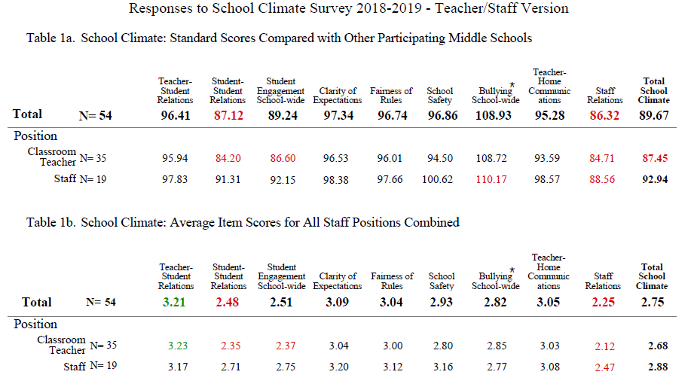
Data Report Overview

Slide 3
Data Report
Structure & Coding
Table Number Codes
1 = School Climate Subscales
2 = Techniques Subscales
3 = Bullying Subscales Data
4 = Engagement Subscales
5 = Social Emotional Competencies Scale
Response Codes
Table 1, 2, 4:
1 = Disagree A Lot, 2 = Disagree,
3 = Agree, 4 = Agree A Lot
Table 3:
1 = Never, 2 = Less than once a month ,
3 = Once or Twice/Month, 4 = Once/Week,
5 = Several Times/Week, 6 = Everyday
Table 5:
1 = Not like me at all, 2 = Not much like me,
3 = Somewhat like me, 4 = Very much like me

Slide 4
Data Report
Structure & Coding
Table Letter Codes
a = Standard Scores (SS)
b = Average Item Scores (AIS)
c = Individual Items % Response
STUDENT only:
(1) = Race & Gender Breakdown
(2) = Grade Level Breakdown
Symbol Code
* A higher score represents an unfavorable response to items on the Bullying School-Wide subscale and the Use of Punitive Techniques subscale.

Slide 5
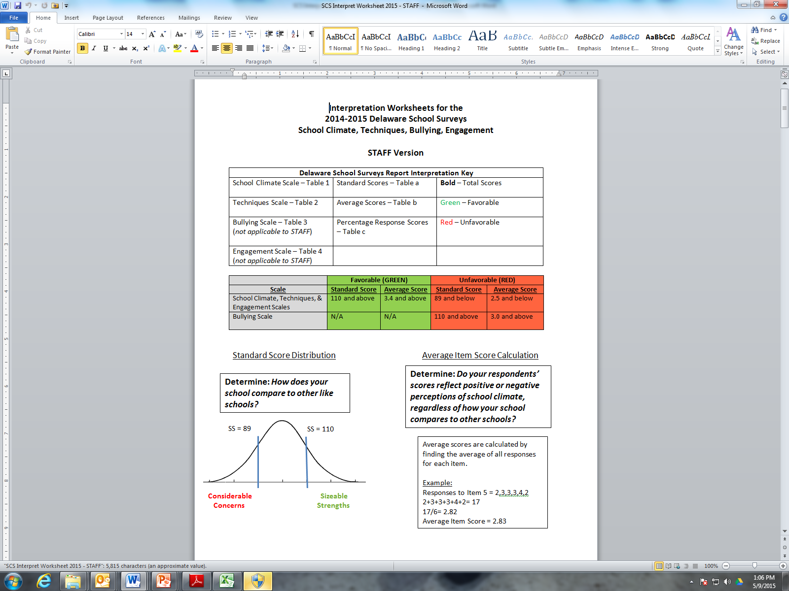
Standard Scores
Data Report – Types of Scores
Based on grade-level norms (typically elementary, middle school, high school) or on specific grades for student survey (3-12).

Slide 6
Average Item Scores
  Particularly meaningful when scores tend be very high across all schools
  Most appropriate score for comparing scores from year to year.

Slide 7
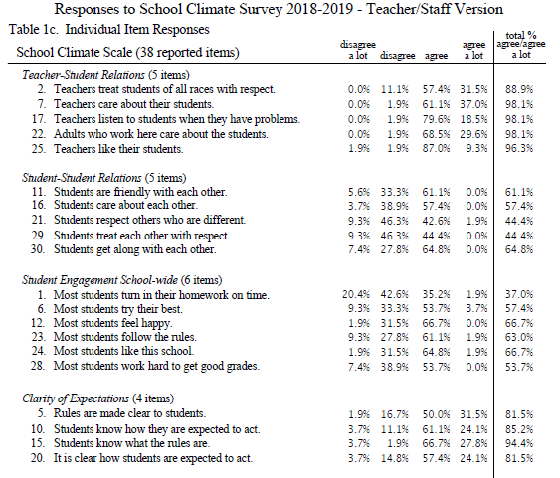
Frequency Scores
Given a subscale score, what specific items caused the score to be low or high?

Slide 8
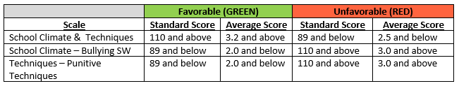
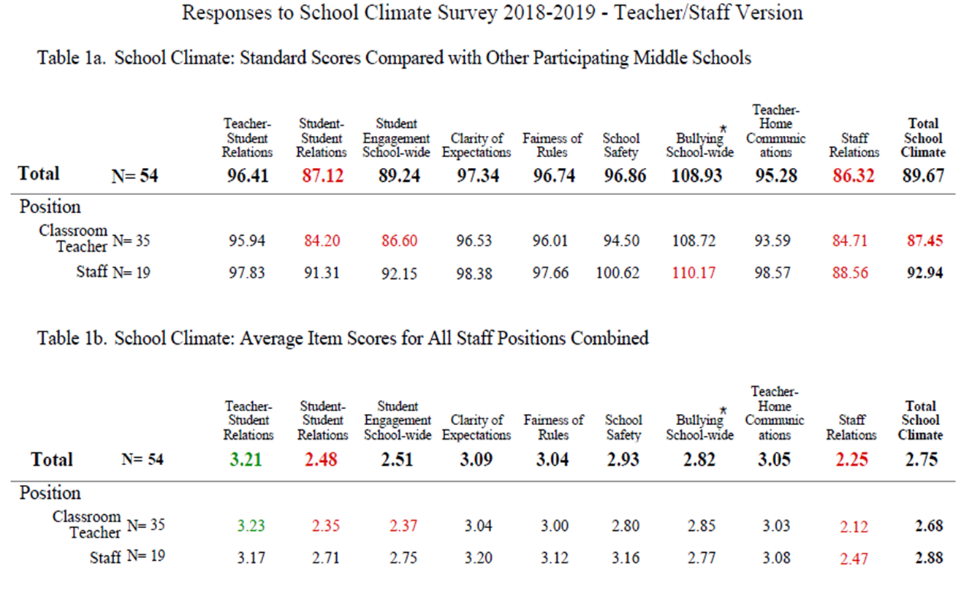
Color Coding
Data Report Features

Slide 9
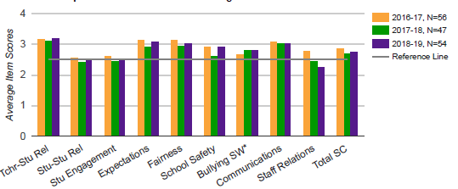
Multi-year Graph
(average item)
Staff Graph 1b School Climate

Slide 10
A Note on “Significant Differences”
Is the difference in scores (within subscales or from year to year) “significant”?
  Practical significance: is the difference meaningful for our school?
  Statistical significance: 95% chance that the difference in scores is not due to chance
  *Statistical significance does not imply practical importance
Schools should have little concern about significant differences when all of their scores are fairly high (e.g., above 3.3)
Schools should be less concerned about a difference from year to year than about general pattern in scores over multiple years

Slide 11
How to determine significant differences
Approximate Difference in Average Item Scores (1.0-4.0) Needed to be Statistically Significant
Size of Sample (N) | Approximate Difference Needed
15 | .38 or larger
20 | .33 or larger
30 | .29 or larger
40 | .26 or larger
50 | .20 or larger
60 | .19 or larger
70 | .17 or larger
80 | .16 or larger
90 | .15 or larger
100 | .14 or larger
120 | .13 or larger
140 | .12 or larger
160 | .11 or larger
200 | .10 or larger
240 | .09 or larger
310 | .08 or larger
400 | .07 or larger
540 | .06 or larger
780 | .05 or larger
Table & guidance included on the last page of all Interpretation Worksheets (Student, Staff, Home)
Helps determine if differences in average item scores NOT standard scores are likely to be statistically significant
Table notes approximate size differences needed for statistical significance

Slide 12
How to use the table
1. Look at the number of respondents for the two given scores (i.e., the sample size, or N). If the number is different, use the lower N or an average of the two (e.g., 120 students completed the Teacher-Student subscale and 80 completed the Student-Student subscale, use 80 or 100, with 80 being more conservative).
2. Find the number in Column 1 that is closest to your N.
3. Find the number in Column 2 (Approximate Difference Needed) that aligns with your N. This difference is the minimal difference needed for statistical significance. For example, if you have 50 students, you need a difference of .20 or larger to conclude that there is a 95% chance that the difference is not an error and is statistically significant.

Slide 13
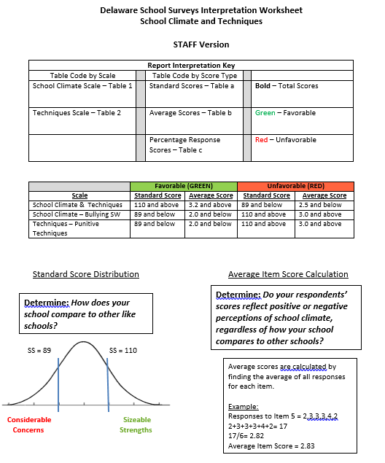
Interpretation Worksheets & Action Plan Overview

Slide 14
Interpretation Worksheet Structure
Worksheet per survey population
  (Student, Staff, Home)
Guides you through each survey scale
  (School Climate, Techniques, Bullying, Engagement, Social Emotional Competencies)
Guides you through 3 types of scores plus graphs
Information gathered then used to complete action planning template

Slide 15
Interpretation Worksheet Structure
When interpreting standard and average item scores for your school:
  First, focus on Total Scores
  Next, check for differences within and between groups
    Student Survey: Grade, Race, Gender
    Teacher Survey: Teacher vs. Staff
    Home Survey: Race
  Consider strengths, concerns, general notes such as significant differences
School Climate Workshop, 5/7/13

Slide 16

Order of Review Prompts per Scale
Multi-Year Graphs
Average Item Scores
Individual Item Percent Responses
Standard Scores

Slide 17
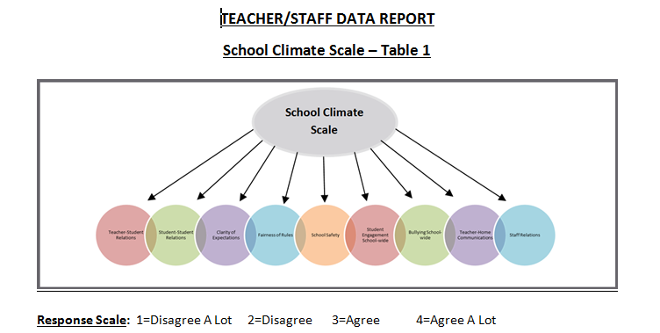
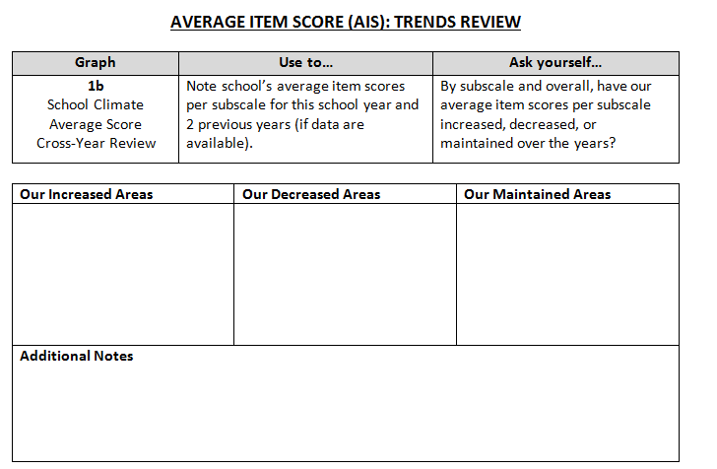

Slide 18
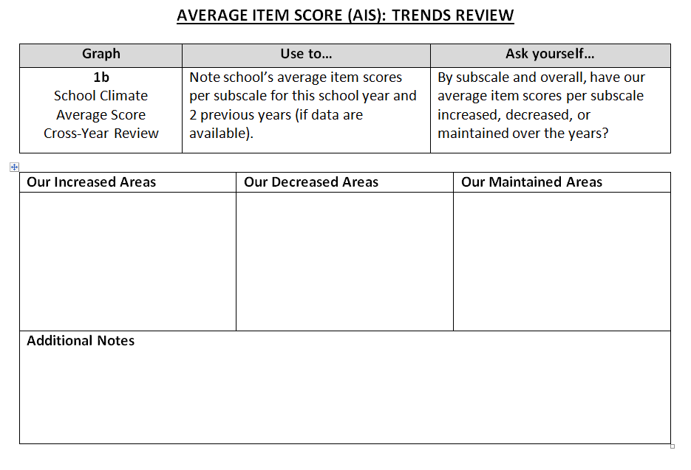
You are looking at Average Item Scores(AIS)
Look for Table # referenced in section directions
“Table 1b”
Check out utility of data and prompting questions.
Prompts to examine total scores and scores by subgroups.
Prompts to examine total scores and scores by subgroups.

Slide 19
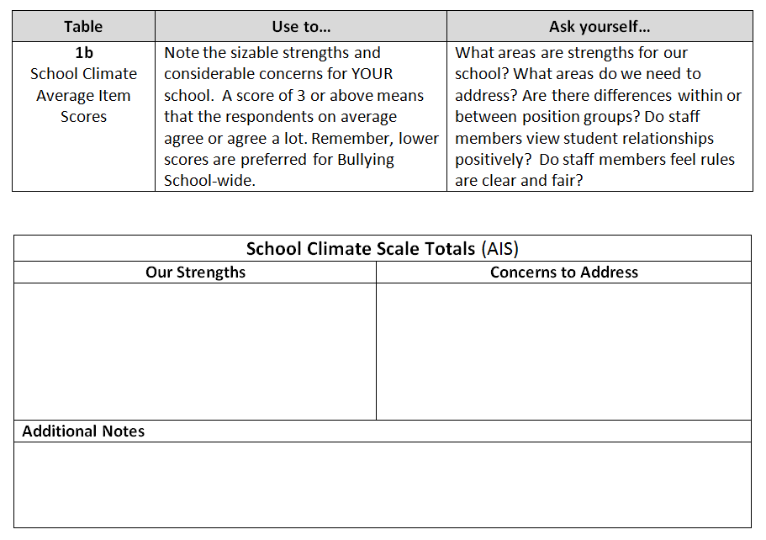
To note your “sizeable” strengths and your relative strengths.
To note your “considerable concerns” and your relative concerns.

Slide 20
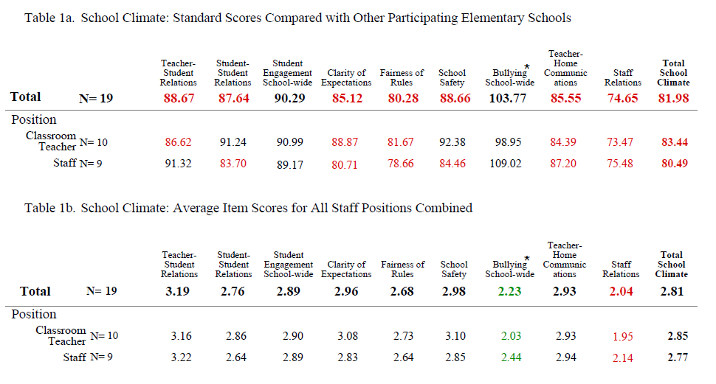
Where and what are the “sizeable” strengths
for YOUR school?
Pg.1 of Staff Report

Slide 21
Pg.1 of Staff Report
Here are your sizeable strengths!

Slide 22
Pg.1 of Staff Report
Now, where and what are your “considerable” concerns?

Slide 23
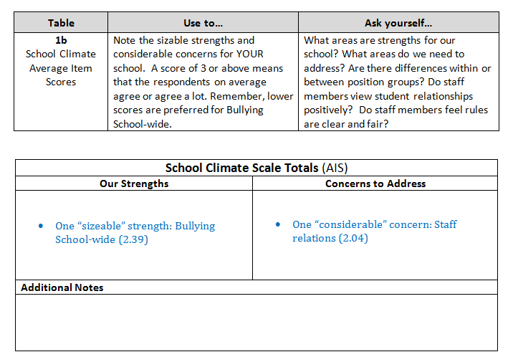

Slide 24
Pg.1 of Staff Report

Slide 25
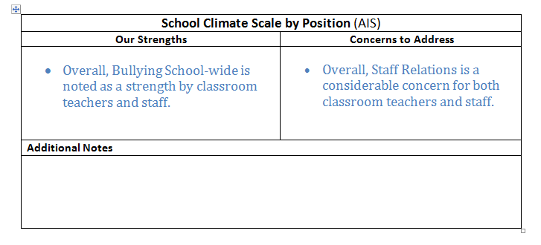

Slide 26
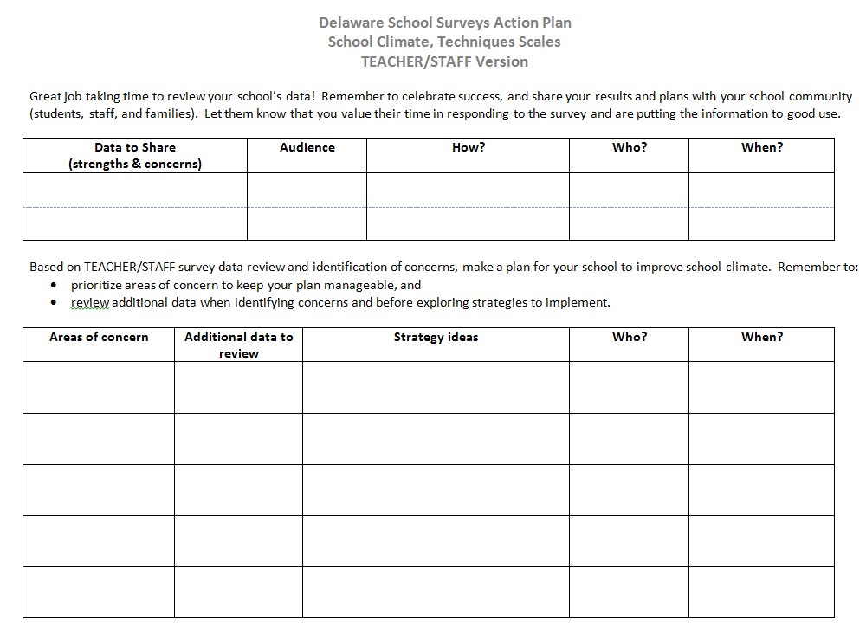

Slide 27
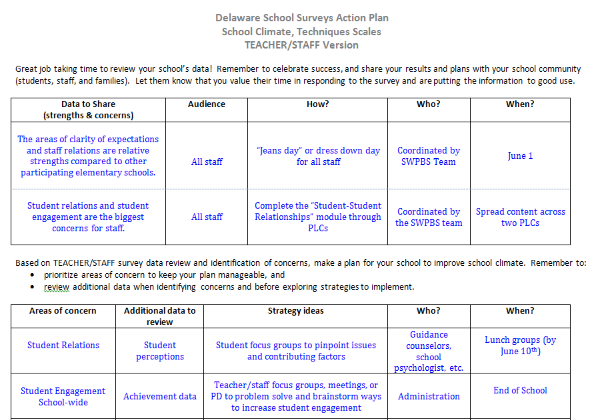

Slide 28

Remember to Share!
Don’t keep data a secret.

Slide 29
Data Sharing Templates for Staff & Families
PowerPoints Include:
Overview of school climate
Summary of survey structure & report information
School results templates & samples
Discussion & planning prompts
Resources

Slide 30
PowerPoint Data Sharing Templates
Feel free to edit the templates to meet your presentation needs. It’s okay to cut and add slides.
Read the “notes” section for each slide to help you finalize what goes where in your presentation
Using screen shots from your DSCS report or interpretation guide notes to save time.
Consider giving staff time immediately after your presentation to:
  brainstorm ways to improve any areas of concern (Action Planning)
  share strategies that they feel help to address any identified areas of strength or concerns

Slide 31
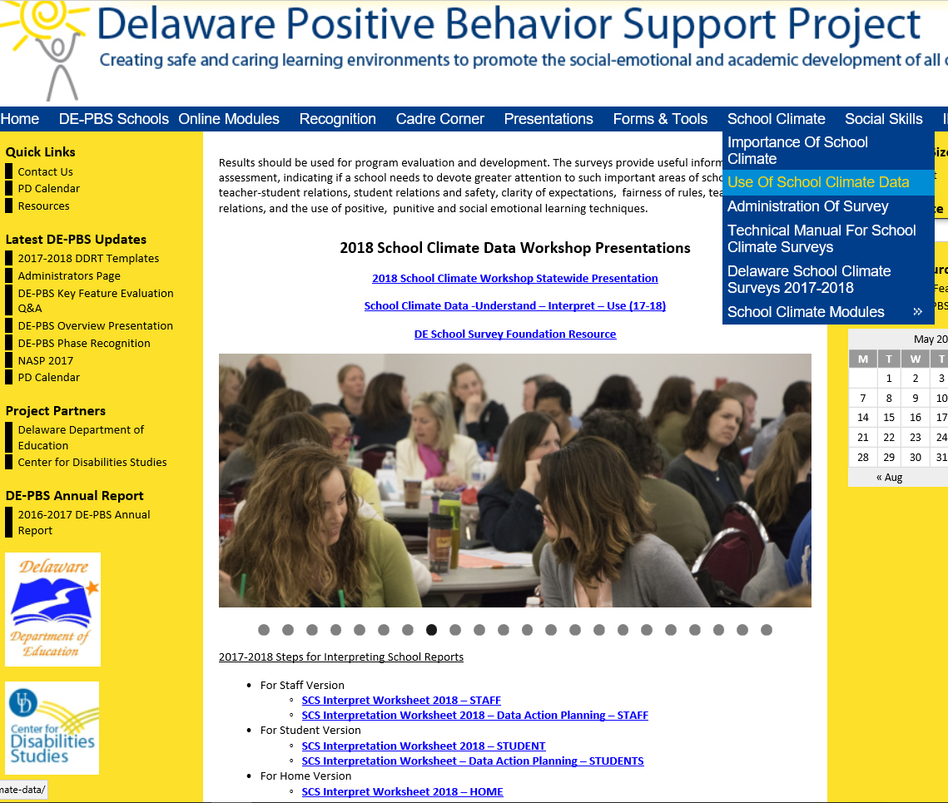

Slide 32


Don’t forget to CELEBRATE your good news!
Even when you get data that isn’t what you were looking for,
your data gives you important information to guide next steps in promoting positive climate
in your school.

Slide 33

Recommended next steps for today:
Review student report (if applicable)
Your next steps in the coming weeks:
Determine how and when to share!
Start action planning

Slide 34
Data Review

