Slide 1
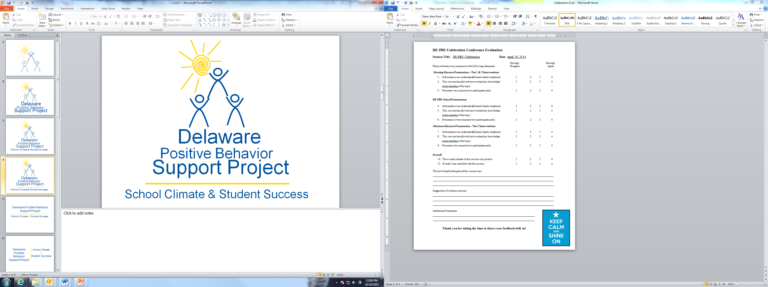
WiFi:
DTCC Special Events
20181015nXyc
October 17, 2018

Slide 2
Multi-Tiered System of Support
Tier 1: DE-PBS School-wide
Positive Behavior Support
October 17, 2018

Slide 3
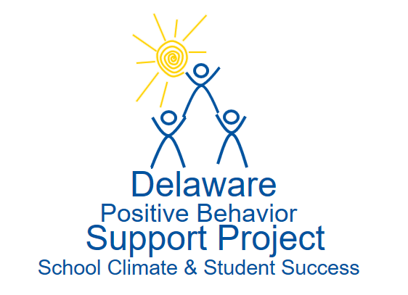


The DE-PBS Project serves as a technical assistance center for the Delaware DOE to actualize the vision to create safe and caring learning environments that promote the social-emotional and academic development of all children.
The statewide initiative is designed to build the knowledge and skills of Delaware educators in the concepts and evidence-based practices of Positive Behavior Support (PBS) as a Multi-tiered System of Support (MTSS).

Slide 4
Materials adapted from:
Maryland PBIS: http://www.pbismaryland.org/
Midwest PBIS Network: http://www.midwestpbis.org
OSEP Technical Assistance Center on PBIS: http://www.pbis.org/
Sustained Implementation of School-wide PBIS for All Students (G. Sugai, 2011)
Strategies for Developing Self-Discipline and Improving School Climate (G. Bear, 2012)
SEL module: http://wh1.oet.udel.edu/pbs/scss-modules/sel-swpbis-integration/
Supporting and Responding to Behavior: evidence-based classroom strategies for teachers: http://www.pbis.org/common/cms/files/pbisresources/Supporting%20and%20Responding%20to%20Behavior.pdf

Slide 5
Today’s Agenda
Time | Topic
9:00 – 10:00 | Welcome & Overview of DE-PBS
10:00–10:30 | Program Development & Evaluation
10:30-10:45 | Break
10:45 – 11:15 | Program Development & Evaluation
11:15 – 11:45 | Prevention: Implementing School-wide and Classroom Systems
11:45 – 1:00 | Lunch
1:00 – 1:45 | Prevention: Implementing School-wide and Classroom Systems
1:45 – 2:30 | Correcting Problem Behaviors
2:30 – 3:15 | Developing Self-Discipline
3:15 | Closing

Slide 6
Our Audience & Our Goals
Audience –
New team members joining Tier 1 existing teams
Teams regrouping around SWPBS
Goals-
Provide an in-depth overview of SWPBS Framework
Leave with understanding of tools & products you can use to develop and enhance Tier 1 framework
Call on audience experience to enhance discussion

Slide 7
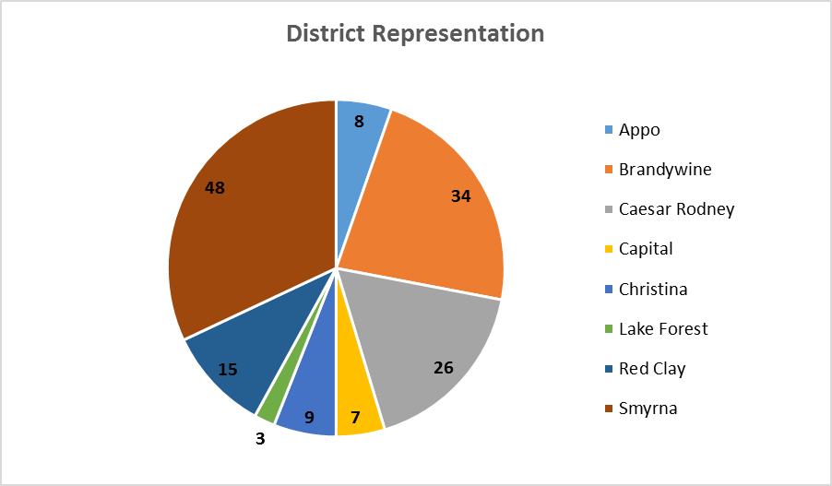
Who’s here?

Slide 8
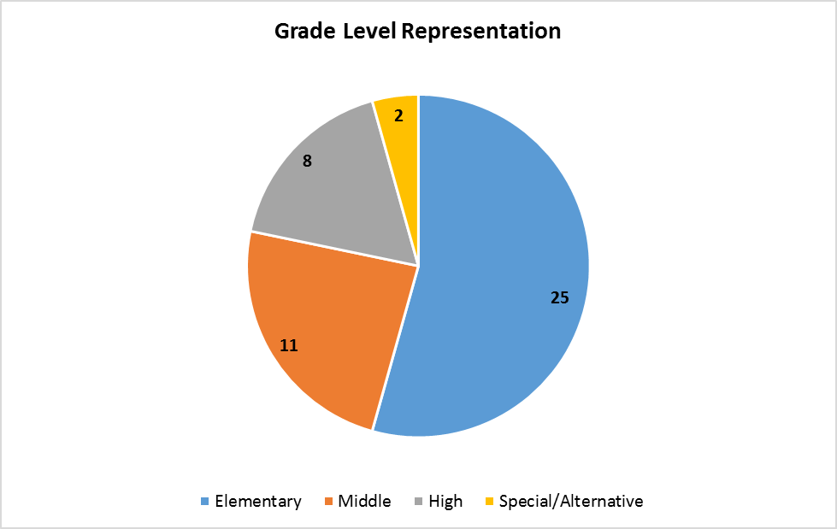
Who’s here?

Slide 9
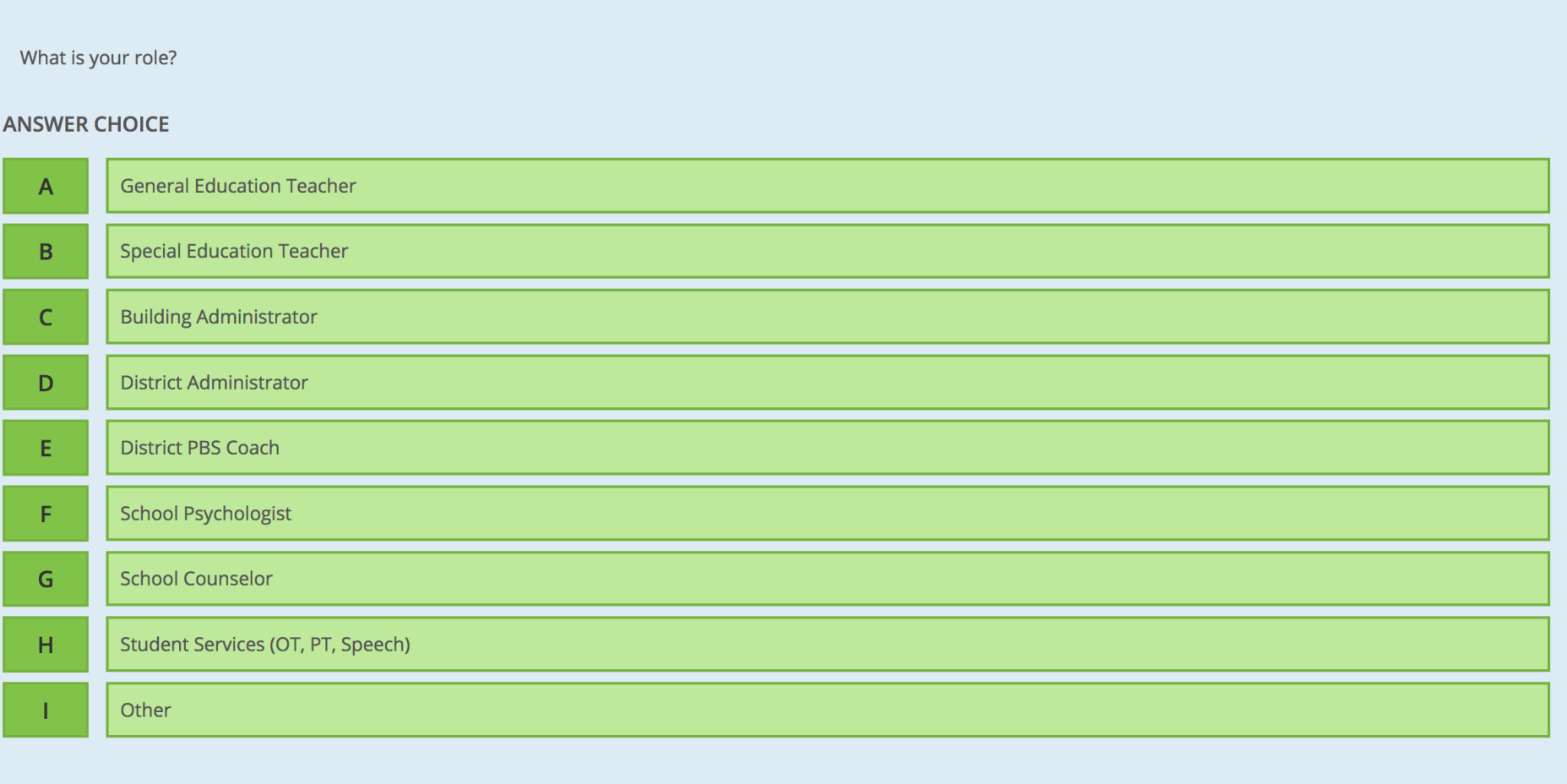
Poll Directions
Go to socrative.com
Select “Student Login”
In the “Room Name” box type: SXBVFR8
Answer first question, what is your role?

Slide 10
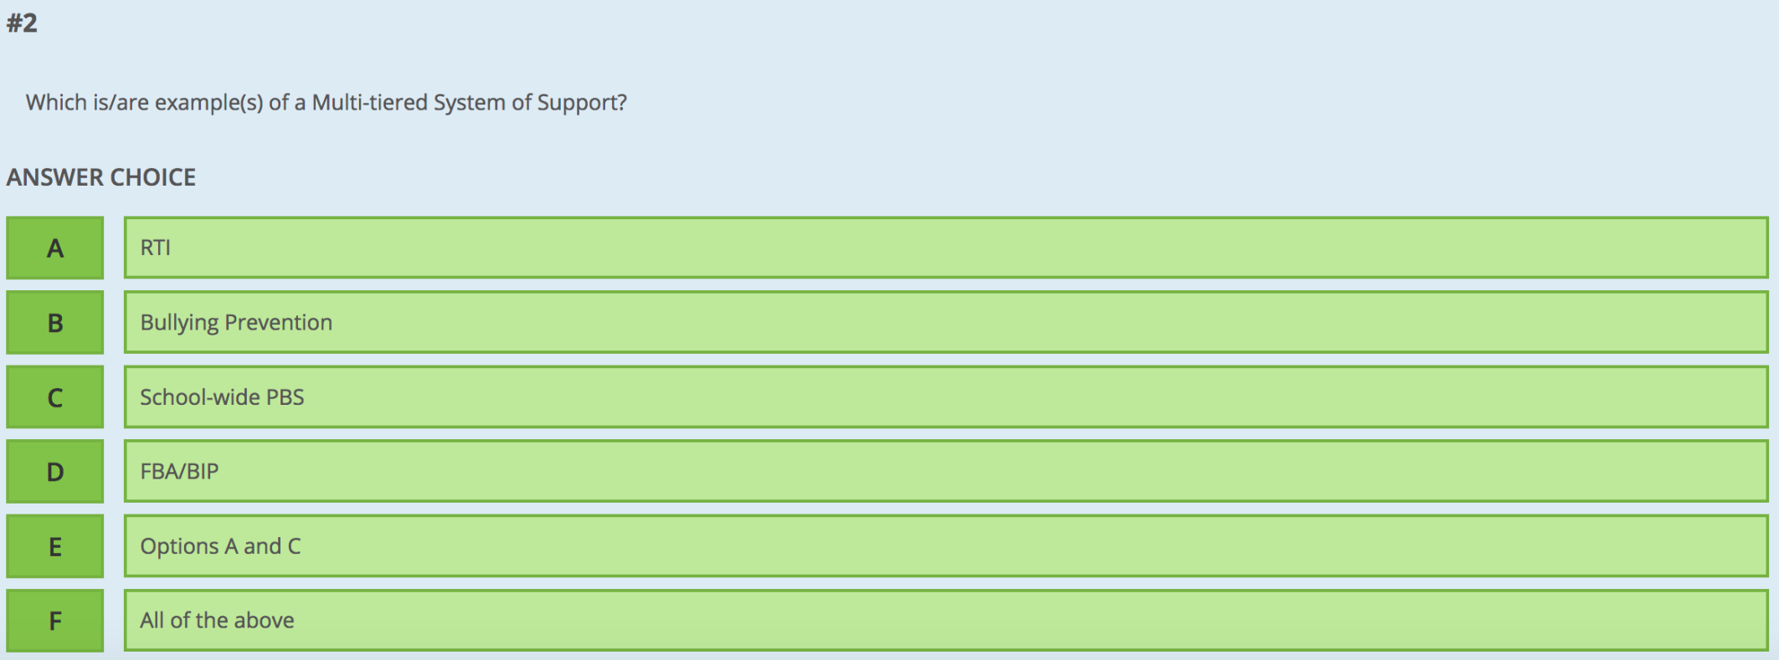
2. Which is/are example(s) of MTSS?

Slide 11
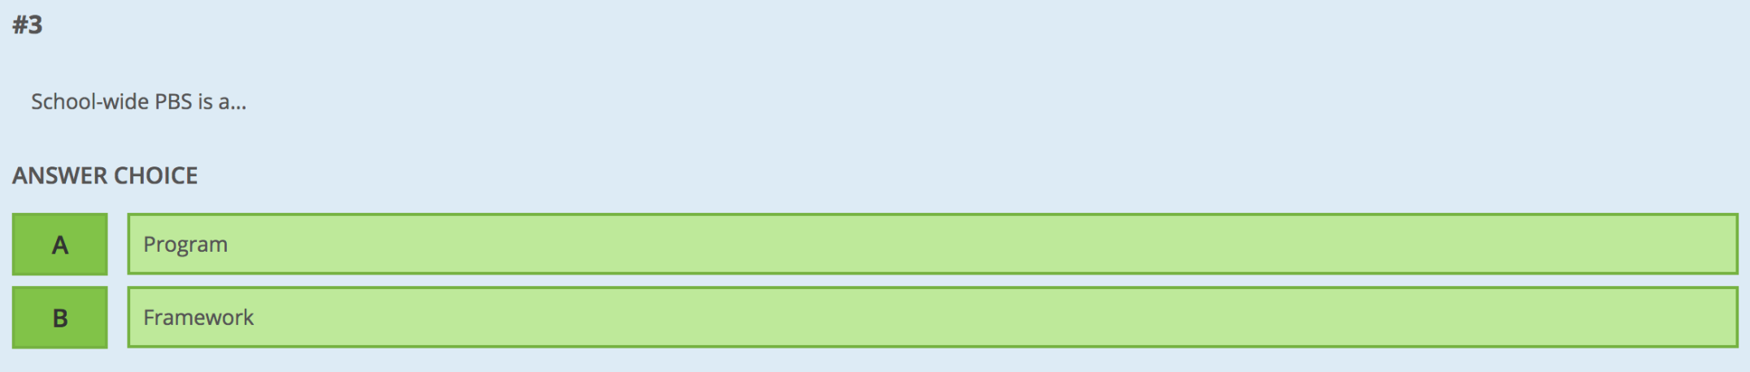
3. SW PBS is a …

Slide 12
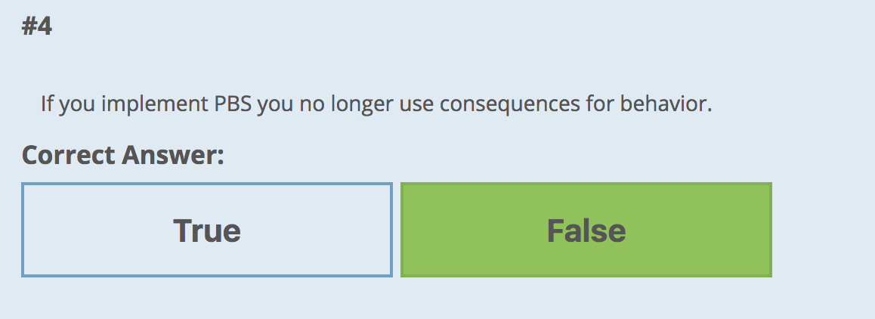

Slide 13
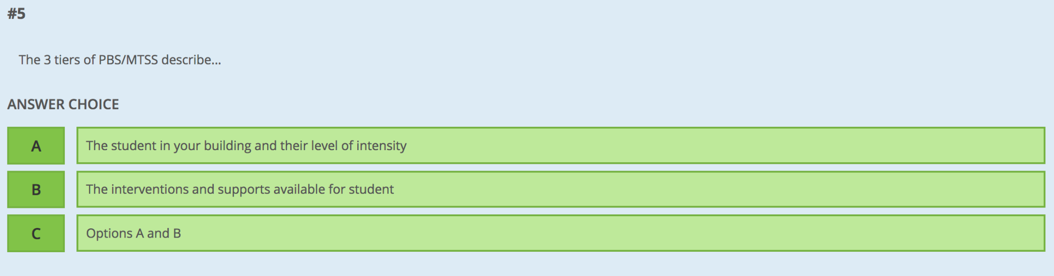
5. The 3 tiers of PBS/MTSS describe:

Slide 14
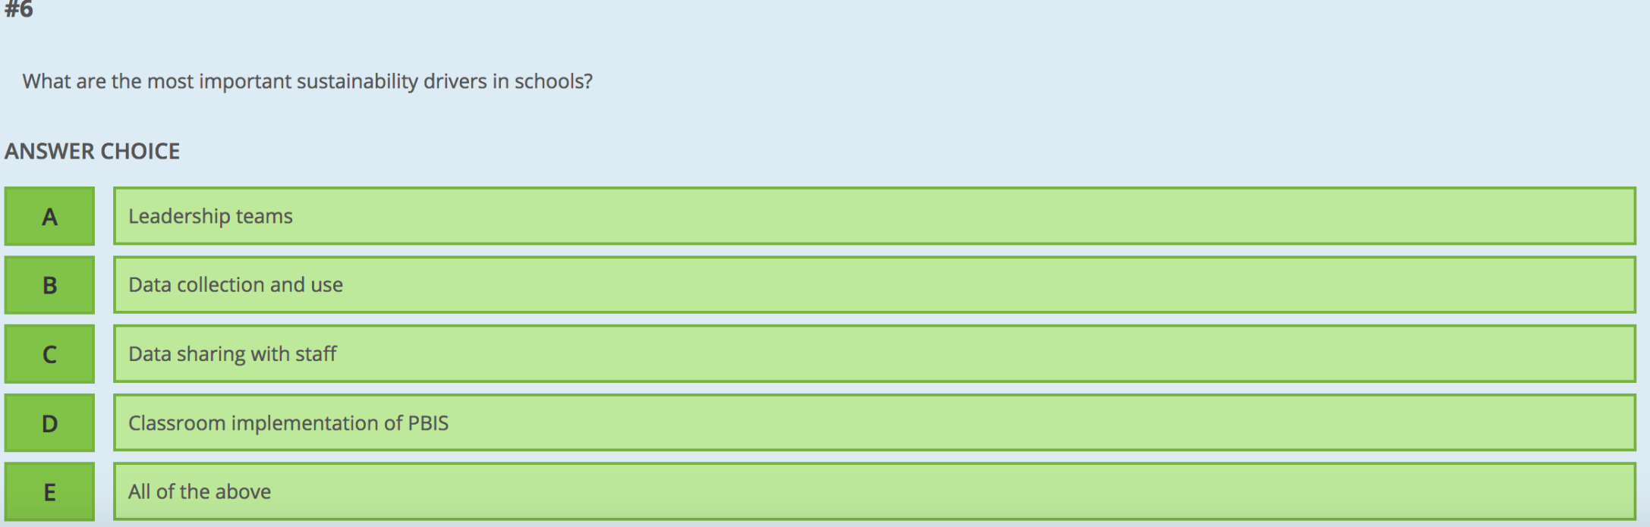
6. What are the most important sustainability drivers in schools?

Slide 15
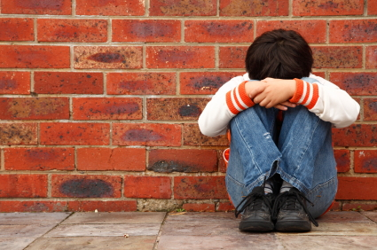
Why are we here?
High rates of discipline referrals and suspensions
Disproportionality
Student failing to meet proficiency on state test
Attendance and drop out rate concerns
Negative school climate
Need to improve student social and emotional skills
Need to support students exposed to trauma and chronic stress

Slide 16
Perception Shift:
High Suspension and Expulsion Rates Driven By Ineffective School Policies and Practices, not “Bad Kids”
“Far from making our schools safer or improving student behavior, the steadily increasing use of suspension and expulsion puts students
– especially students of color and other targeted groups –
at an increased risk of academic disengagement,
dropout and contact with juvenile justice”
Russell J. Skiba, director of Discipline Disparities Research-to-Practice Collaborative

Slide 17
Why use the MTSS/PBS framework for schools?
“The fundamental purpose of PBIS is to make schools more effective & equitable learning environments.”
Rob Horner, Co-Director of the OSEP Technical Assistance Center for PBIS
Predictable
Positive
Consistent
Safe

Slide 18
PURPOSE
Provide suggestions for maximizing accurate AND sustained implementation of PBS continuum for all students

Slide 19
Examples of PBS Implementation “Infidelity”
“SWPBS is an intervention”
“Let’s schedule in-service day”
“Bring George Sugai to our staff meeting”
“We have Responsive Classroom now”
“PBS is about giving kids tangible rewards”
“Students with tier 3 supports aren’t part of SWPBS”
“Let’s do PBS during morning advisory”

Slide 20
YES NO ?
Do all staff understand what PBS and MTSS means?

Slide 21
MTSS = “school-wide structure used to improve integration & implementation of behavioral practices, data-driven decision making systems, professional development opportunities, school leadership, supportive SEA & LEA policies, & evidence-based instructional practices”
(Fed. Reg., Vol. 79, No. 88, p. 26235)
Leadership Team
Data-driven Decision Making
Universal Screening
Tiered Continuum of Evidence Based Practices
Implementation Fidelity
Continuous Progress Monitoring

Slide 22
MTSS Defined
for enhancing adoption & implementation of
of evidence-based interventions to achieve
& behaviorally important outcomes for
students
Framework
Continuum
Academically
All

Slide 23
Multi-Tiered Systems of Support
(MTSS) for Student Success
Academic Systems
Behavioral Systems
Tier 3/Tertiary Interventions 1-5%
Individual students
Assessment-based
High intensity
1-5% Tier 3/Tertiary Interventions
        FBS/BSP
Tier 2/Secondary Interventions 5-15%
Some students (at-risk)
High efficiency
Rapid response
Small group interventions
Some individualizing
5-15% Tier 2/Secondary Interventions
        Some students (at-risk)
        High efficiency
        Rapid response
        Small group interventions
        Some individualizing
Tier 1/Universal Interventions 80-90%
All students
Preventive, proactive
80-90% Tier 1/Universal Interventions
        All settings, all students
        Preventive, proactive
www.delawarepbs.org
Adapted from “What is school-wide PBS?” OSEP Technical Assistance Center on Positive Behavioral Interventions and Supports. Accessed at http://pbis.org/schoolwide.htm, Illinois PBIS Network, Revised May 15, 2008.

Slide 24

















Neighborhood Strife
Academic Struggles
Family
Set-backs
Disability
Social Isolation
MTSS
Long-term Traumatic Events
Staff
Students
Families

Slide 25
Call it what you want!
PBS
    EBS
School climate
    Discipline
SEL

Slide 26




MTSS for Social Competence &
Academic Achievement
Outcome data (social behavior, academic achievement), Progress Monitoring, Fidelity
OUTCOMES
SYSTEMS
DATA
What we do to support adults to implement the practices
PRACTICES
What we do to
support students

Slide 27
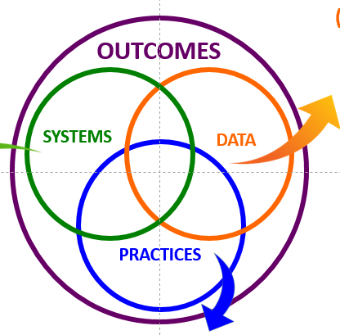
Practices
Systems
Data
3-5 defined school-wide expectations, procedures for teaching and acknowledging expectations, procedures for discouraging problem behaviors, procedures for using data to target needed practices.
Team-based leadership, coaching support, data-based decision-making protocols, developed procedures and materials for implementing assessment and practices, active supervision protocols
Climate surveys, office disciplinary referrals, academic and behavioral screening information, attendance and tardy data, frequency of nurse/counselor/well-ness center contacts, fidelity checklists and observations
Outcomes
School climate, discipline, academic performance, attendance, nurse visits, counselor contacts

Slide 28
POSITIVE SCHOOL & CLASSROOM CLIMATE
Definition: Shared norms, beliefs, attitudes, experiences, & behaviors that shape nature of interactions between & among students, teachers, & administrators
Outcomes | Data | Practices | Systems
Academic Self-management Interpersonal Career & postsecondary Mental health | Screening Progress monitoring Implementation fidelity | ALL | Leadership MTSS Teaming Professional development Evaluation Policy Exemplars demonstrations
 |  | SOME
 |  | FEW
Sugai, G. 2016 School Climate Transformation Grant meeting

Slide 29
Reflecting on your school PRACTICES
Intervention Names Coordinators Intent/Outcome Goal
Tier 3
Tier 2
Tier 1

Slide 30
At the individual level: Tier 3
Problem-solving team with behavioral expertise established to monitor system & student progress
Team formed with those who know the student to develop individual plan
Target behaviors identified and defined
Antecedents (predictors) and consequences (responses) of problem behavior identified
Hypothesis generated by data
Multi-component intervention plan built and linked with hypothesis
Progress monitoring plan established
Fidelity measurement of intervention implementation developed and scheduled

Slide 31
At the small group level: Tier 2
  Problem-solving team with behavioral expertise established to monitor system & student progress
  Data used to identify students in need of supports and to monitor progress & intervention fidelity
  Intervention selected to match function of student behavior
  Interventions are:
    efficient
    continuously available
    aligned with school-wide expectations
  Intervention designed to support multiple students simultaneously (e.g. Check-In/Check-Out, Social Skills Groups, etc.)

Slide 32
At the school-wide level: Tier 1
  Problem-solving leadership team with administration established
  Ongoing data-collection, analysis and action planning
  Prevention through established SW & Classroom systems
  Positive social expectations defined, actively taught, and recognized
  Focus on relationship building (students, staff, home)
  Arrange consistent consequences for problem behavior
  Focus on developing self-discipline

Slide 33
Working Smarter, Not Harder
PBIS Enables Schools To…
  Establish a small number of priorities
    “do less, better”
  Consolidate/integrate whenever possible
    “only do it once”
  Specify what is wanted & how you’ll know when you get there
    “invest in a clear outcome and assess progress”
  Give priority to what works
    “research-based, evidence-based”

Slide 34
Circle:
1 thing that resonated with you
1 thing that surprises you or would surprise others
Delaware PBS Key Features
Data-based decision making
ALL students
Participation and implementation with fidelity
Developing Self-discipline
Positive and safe
On-going professional development and support
Preventing behavior problems
Problem-solving team process
Sustained Commitment
Correcting misbehavior
Comprehensive and intensive evidence-based interventions and supports
Dynamic and evolving

Slide 35
YES NO ?
Have you aligned MTSS with other related initiatives?

Slide 36
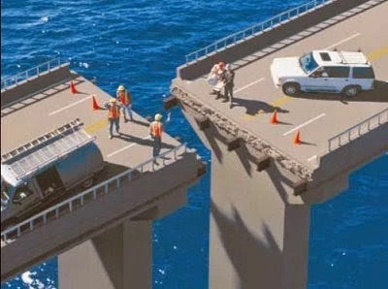
Why Alignment is Important
“One of the major variables affecting sustained implementation of effective practices is the introduction of new initiatives that either (a) compete with resources needed for sustained implementation or (b) contradict existing initiatives.”
  McIntosh (2015)

Slide 37

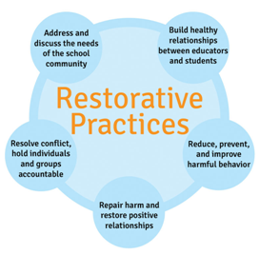



Keep in Mind…
MTSS/PBS provides the structure that increases likelihood that specific practices/interventions (e.g., Restorative Practices, Leader in Me, Trauma Informed Pracitices) will be implemented with fidelity.

Slide 38
How Do We Integrate/Align with other Key Initiatives?
Identify key components of each intervention or approach
Identify areas that share common aims, goals, and practices
Identify differences in key components and decide if these can enhance one another or should be modified or negotiated

Slide 39
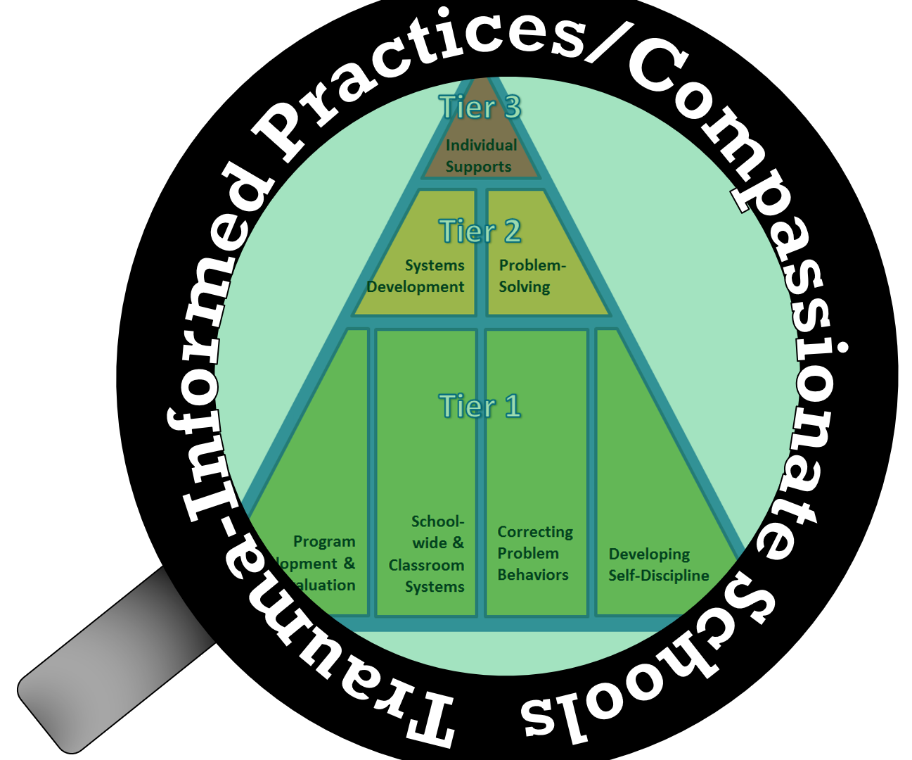
PBS and Trauma-Informed Practices
Compliment Each Other
Trauma-informed practices bring these additional attributes to PBS schools:
the incorporation of mindfulness in schools
the promotion of resilience among all community members
mindfulness in avoiding re-traumatization of students.
But both help to schools
to develop MTSS that are:
  Consistent
  Inclusive
  Culturally Relevant & Responsive
  Building Positive Relationships

Slide 40
Behavior is the language of trauma
  Most children lack the language skills to describe how they are feeling, so behavior is their expression
  Most expressive behaviors used by these children are considered “negative”
    Reactive, impulsive, aggressive, withdrawn, defiant
    Other behaviors – perfectionistic, lack of trust in adult & peer relationships
  Many of the most challenging behaviors are strategies that have helped the child to survive & have been generalized to other environments (e.g., school)
We need to teach new skills!
Adapted from Chris Dunning, “The Heart of Learning & Teaching Compassion, Resiliency & Academic Success” (Wolpow et al, 2009)

Slide 41
Classroom Matrix to teach coping skills
The Wilson Way | Classroom Rules | Classroom (Attention Signal: 1-2-3 Eyes on Me)
 |  | When you feel upset … | Morning Routine | How to Transition/ Line Up | Small Group Work
Be Responsible | Stay on task Clean up area Apologize for mistakes | Recognize what you’re feeling “I feel…” Stop and take a few deep breaths | Turn in homework Put instructional materials in desk | Put materials away Get materials ready for next activity | Do your fair share Manage time carefully
Be Respectful | Raise hand Listen to speaker Follow directions Use appropriate voice level | Ask for a break if you need a moment Express your feelings appropriately | Say “good morning” to teacher and classmates Talk in soft voices | Listen for direction to next activity Be silent | Listen to understand your peers Take turns speaking Use kind words with feedback Speak only to group members
Be Safe | Walk quietly Keep hands and feet to self | Talk to someone if you need help Talk to someone if it will make you feel better | Put personal belongings in designated areas Take your seat | Stand up Push in chair Wait for group to be called to line up | Clean up area when time is up

Slide 42















Neighborhood Strife
Academic Struggles
Family
Set-backs
Disability
Social Isolation
SW-PBS
Long-term Traumatic Events
Leader in Me
Trauma-Informed
Practices
Restorative Practices
Compassionate Schools
Love
& Logic
Responsive Classrooms
Solution Teams
Staff
Students
Families

Slide 43

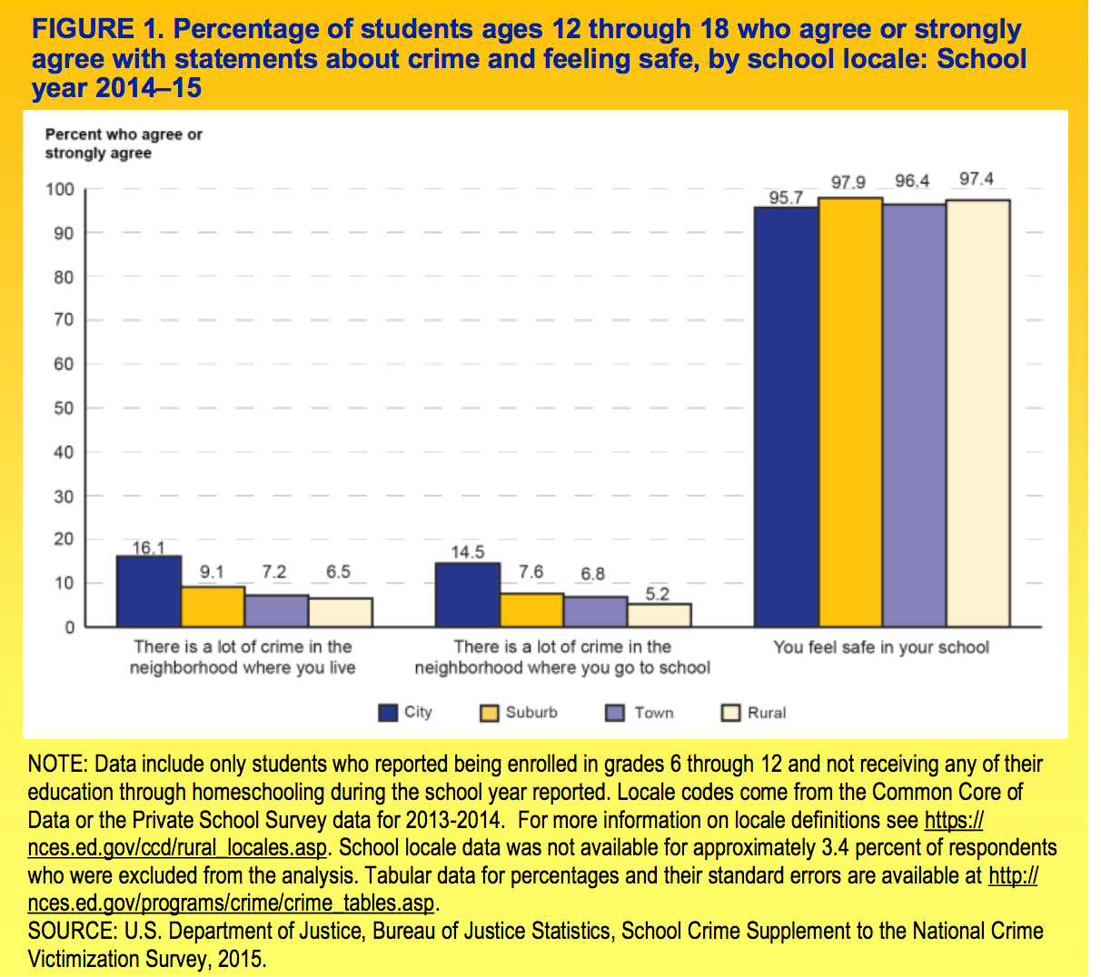
Regardless of perception of crime, 95% of students report feeling safe at school

Slide 44
Sample subscale responses associated with student scores (School Climate) | Percent who Agreed or Agreed a lot
 | Elem School | Middle School | High School
Teacher-Student Relations 7. Teachers care about their students. | 95.8 | 86.5 | 78.9
Student–Student Relations 11. Students are friendly with each other. | 75.8 | 61.2 | 64.7
Student Engagement School-wide 28. Most students work hard to get good grades. | 92.0 | 75.8 | 68.9
Clarity of Expectations 10. Students know how they are expected to act. | 88.1 | 82.3 | 83.8
Bullying School-wide* 9. Students threaten and bully others. | 35.3 | 53.9 | 44.3
Fairness of Rules 18. The school’s Code of Conduct is fair. | 90.1 | 76.6 | 69.6
School Safety 13. Students feel safe. | 90.3 | 80.1 | 75.1
* = A high score on this subscale is negative because items are negatively worded.

Slide 45
Did we address these and other misperceptions?
“SWPBS is intervention”
“Let’s schedule an in-service day”
“Bring George Sugai to our staff meeting”
“We have Responsive Classroom now”
“SWPBS is about giving kids tangible rewards”
“Students with tier 3 supports aren’t part of SWPBS”
“Let’s do SWPBS during morning advisory”

Slide 46
DE-PBS MTSS Framework Components
Program Development & Evaluation
  Problem-Solving/Leadership Team
  Data
  Professional Development & Resources
Developing SW and Classroom Systems to Prevent Problem Behavior
  Expectations and Teaching
  Positive Relationships
Correcting Problem Behaviors
  Consistent and clear procedures
  Disciplinary encounters used as learning opportunities to teach problem solving strategies
Developing Self-Discipline

Slide 47
Program Development & Evaluation
Tab 1 - Workbook

Slide 48
Program Development & Evaluation
  Problem-Solving/Leadership Team
    Representation – administration & member participation
    Effective meeting Strategies
      Roles
  Data
    Data sources
    Data use
  Professional Development & Resources
    School Buy-in & commitment
    Overview provided to all staff
    Parent information
    Monitoring
    Resources – time, funding

Slide 49
Building a Strong & Effective
MTSS/PBS Leadership Team
Adopt a problem-solving team process for
  planning,
  development, and
  evaluation
of evidence-based practices across all three systems of prevention and intervention
  Tier 1 - all,
  Tier 2 - some, and
  Tier 3 - few.

Slide 50
Are we as a team representative of our staff?
If integrating with other initiatives, streamline teams with similar goals.
Work Smarter Not Harder!
  Administration a must have!
Consider:
  Grade levels
  Content areas: academic and related arts
  Regular and Special Education
  Related arts
  Specialists: Counseling/School Psychology
  Students
  Parents

Slide 51

Points to Ponder
How do we remain representative?
How do you keep your team fresh?
  Team atrophy/Team Leader rotation
How do you engage others in the SW Team/SW Activities?
  Student involvement in SW PBS Team
  2-way communication with parents/families

Slide 52


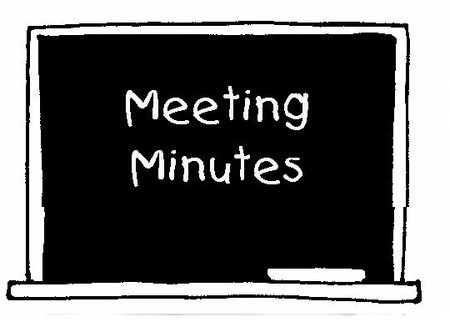
Effective Meeting Strategies
Monthly Meetings
Clear Agenda
Meeting Notes
Action Plan
Reasonable
Goal oriented
Data included
Pre-set
Consistent
Decisions made
Tasks & timelines
Data monitoring
Attendance/Roles
Use roles

Slide 53
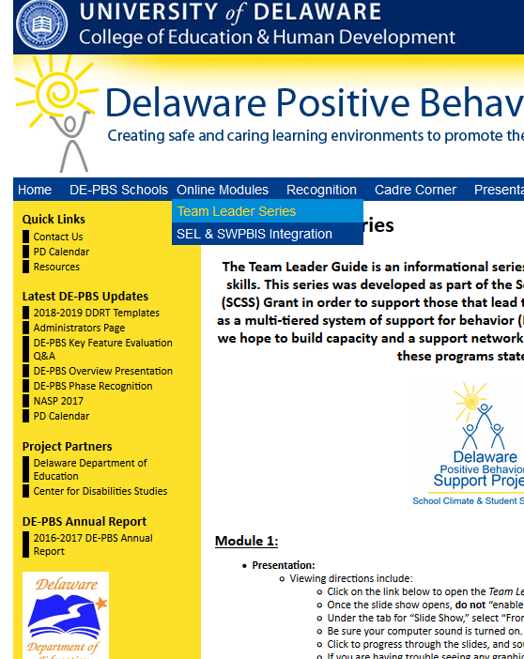
Team Leader PD Resource
The presentation includes strategies to:
  enhance communication with all stakeholders,
  organize effective team meetings, and
  use data to make decisions.
Available online & through Schoology
Course: DE-PBS Project Team Leader Guide Module
Section Number: 48717

Slide 54
Program Development & Evaluation
  Problem-Solving/Leadership Team
    Representation – admin & member participation
    Meeting schedule
    Effective meetings
  Data
    Data sources
    Data use in decision making
  Professional Development & Resources
    School Buy-in & commitment & planning
    Overview provided to all staff
    Parent information
    Monitoring
    Resources – time, funding

Slide 55
DE-PBS Key Feature
Schools value the importance of data-based decision making, as reflected in the on-going evaluation of program effectiveness and modification of program components, interventions and supports based on multiple sources of data.

Slide 56
Understanding & Using Data
DATA
Sources
Analysis
Action Planning

Slide 57
Why use data?
It takes the emotion out of our experiences
Graphs help people see the big picture
Sets baseline to measure improvement
Identifies need
Guides intervention planning
Measures effectiveness of our systems and practices
It reminds us to celebrate our accomplishments

Slide 58
Office Discipline Referral Data (ODR)
The Big 5 – Organizing ODR Data Source
  Average Referral/Day/Month (DDRT)
  # of Referrals by Location
  # of Referrals by Behavior
  # of Referrals by Time of Day
  # of Referrals by Student (DDRT)

Slide 59
What do we do with all this data?
Data Summaries reviewed monthly with team & used to make decisions
  Designate a data person
  Utilize a subgroup to review & present summary
Utilize Guiding Questions
  Is there a problem?
  What areas/systems are involved?
  Are there many students or a few involved?
  When is misbehavior most likely to occur?
  What is the most effective use of our resources to address this problem?

Slide 60
Improving Decision-Making
Solution
From
Problem
Information
Problem
Solving
To
Problem
Solution
Information

Slide 61
Going from primary to precise
Primary statements are vague and leave us with more questions than answers
Precise statements include information about 5 “Wh” questions:
  What is the problem?
  Where is it happening?
  When is the problem most likely to occur?
  Who is engaging in the behavior?

Slide 62
What are the data you need to move from a Primary to a Precise statement?
What problem behaviors are most common?
  ODR per Problem Behavior
Where are problem behaviors most likely?
  ODR per Location
When are problem behaviors most likely?
  ODR per time of day
Who is engaged in problem behavior?
  ODR per student

Slide 63
From primary to precise:
An example
Precise statement:
Major defiance and fighting are increasing and referrals mostly occur between 10-1 when students are in the cafeteria. This pattern is most common in 6th grade, involving many students.
Primary statement:
  “ODRs during October were higher than September and worse than last year.”

Slide 64
From primary to precise:
Plan of action example
Precise statement:
Major defiance and fighting are increasing and referrals mostly occur between 10-1 when students are in the cafeteria. This pattern is most common in 6th grade, involving many students.
Plan of Action
During 6th grade advisory periods during the week of November 7-11, staff will review “Be Respectful” lessons for the cafeteria. Examples discussed will reflect current scenario.
At 11/4 PLC mtg, team member representatives will discuss & brainstorm with their teams strategies for active supervision in the cafeteria and use of positive praise for being respectful to adults and peers.

Slide 65
From primary to precise: Developing a measurable goal
In goals statement include the following:
By WHEN – timeline goal
WHAT will happen – Include MEASUREMENT
HOW will you measure
Teams will want to build fluency in developing precision statements and action plans with measurable goals.

Slide 66
From primary to precise: Developing a measurable goal example
By December 5 (Tier 1 - school-wide PBS team meeting), there will be a 5% decrease in fighting and defiance referrals in the cafeteria for students in 6th grade as measured by ODR data.

Slide 67
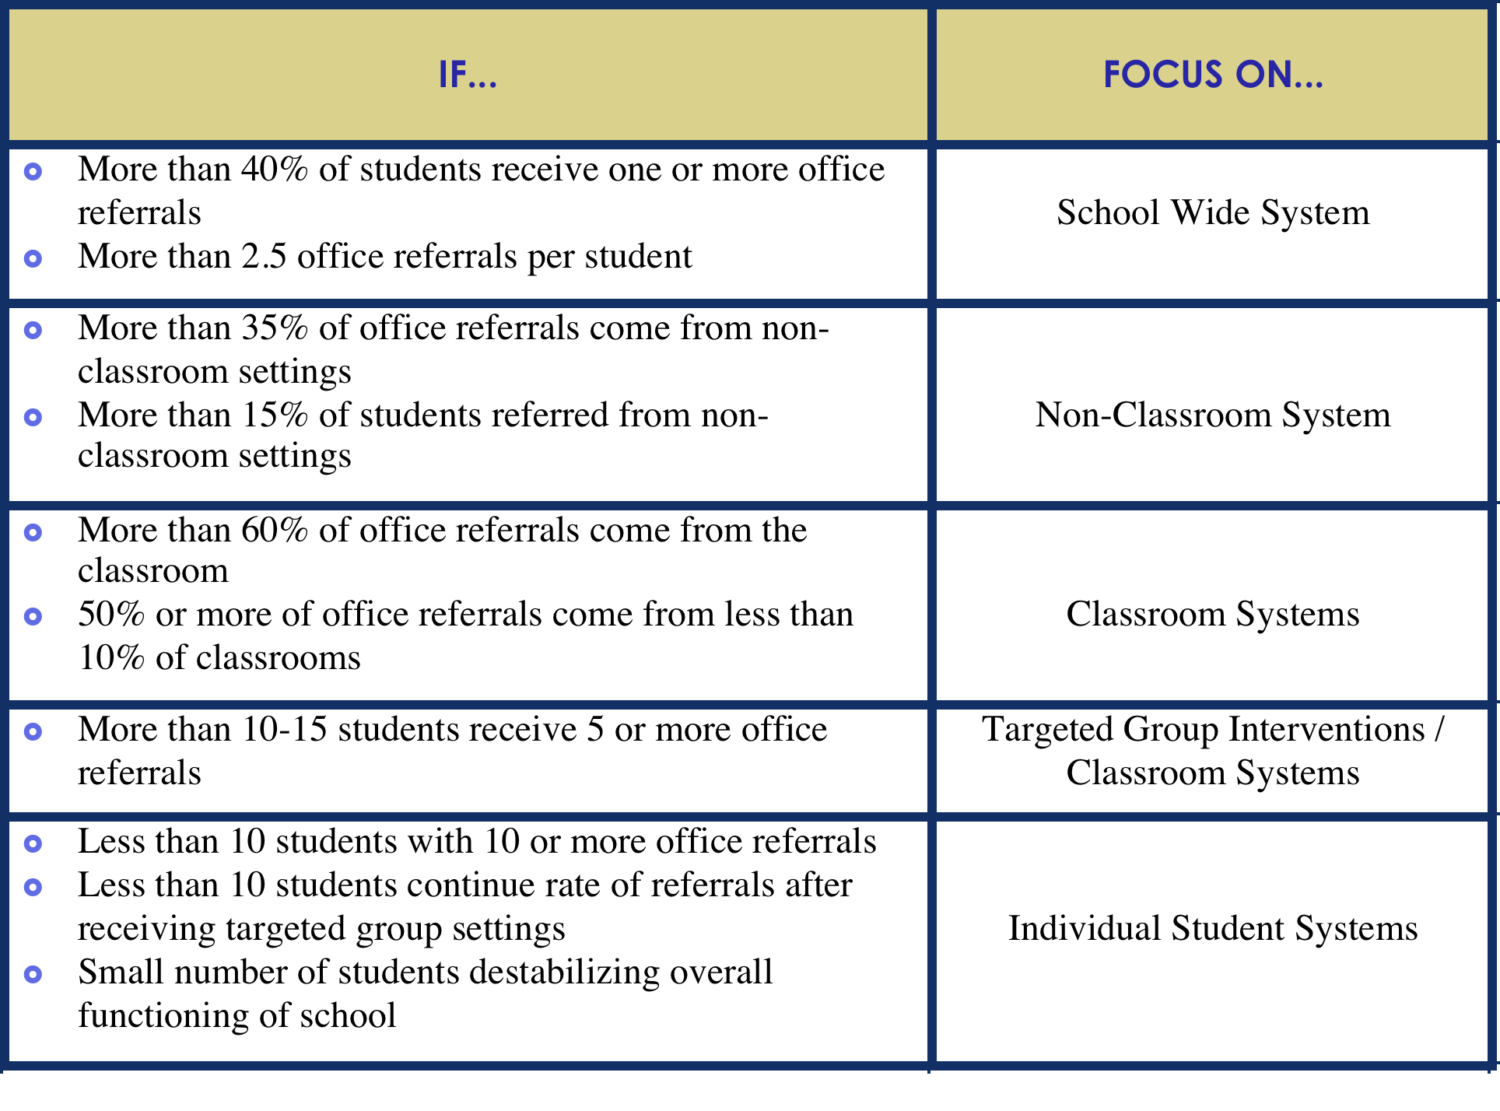

Slide 68
+ If many students are making same mistake, consider
changing systems ... not students
+ START by teaching, monitoring & recognizing success
…before increasing PUNISHMENT

Slide 69
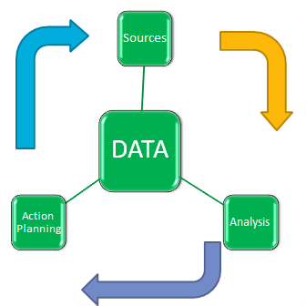
Multiple Data Sources
Examining multiple data sources will provide you with most comprehensive picture
Examples:
  Staff & Student Attendance
  Retention, Dropout, Graduation Data
  Supported through DE-PBS Project
    School Climate Surveys (staff, student, families)
    DE-PBS Key Feature Evaluation
    Delaware Assessment of Strengths and Needs for PBS (DASNPBS)

Slide 70
What do we do with all this data?
Share data with staff at least 3-4 times/year
  Staff Meetings
  Content/grade level team meetings
  PLC meetings
Share highlights with parents & community
  School & district newsletters
  Community news

Slide 71
Points to Ponder
Does your team have a designated person to access & pull data for use at team meetings?
  Reach out if this is an area of concern
Is the team reviewing the Big 5 data summaries on a monthly basis to make decisions?
Is the team sharing with staff?
What additional data sources is your team using? How often are they used?
  DE School Climate Survey
  DE-PBS Assessment of Strengths & Needs (staff self-assessment)
  Fidelity Measures
  Others

Slide 72
Program Development & Evaluation
  Problem-Solving/Leadership Team
    Representation – admin & member participation
    Meeting schedule
    Effective meetings
  Data
    Data sources
    Data use
  Professional Development & Resources
    School Buy-in & commitment
    Overview provided to all staff
    Parent information
    Ongoing PD
    Monitoring
    Resources – time, funding

Slide 73
Importance of Buy In
Anecdotal information indicates that 80% buy-in from staff is critical to successful implementation
You need buy-in to impact School-wide climate
  Not just hallway climate
Lack of staff buy in due to negative beliefs is a frequently reported barrier to implementation

Slide 74


What is “buy in”
What would it look like if staff bought in to PBS?

Slide 75
Defining “buy in”
Staff are familiar with PBS philosophy and concepts:
  Majority of staff members can summarize the basic concepts of SW-PBS
  Majority staff of know the SW expectations
  Overall commitment to supporting all students
Staff participate in:
  Teaching and acknowledging SW expectations
  Ongoing training opportunities
  Implementation of secondary and tertiary supports

Slide 76

Start with Staff Input about the need
Is there a problem with current school climate and/or student behavior?
  AKA: How is business as usual working for you?
What is the solution? Do staff see PBS as part of the solution? Are staff part of developing the plan?

Slide 77
Systems First
Build systems to support teacher behaviors FIRST!
  Communication system
    Feedback loop
  Create team & prioritize meetings
    Strong administrative presence, involvement
  Policy review & trainings
    Do your policies make teacher work harder? Easier?
  Data sharing

Slide 78

Management / Policy
District Policy
Administrative leadership
  Active
  Prioritize PBS on meeting minutes, school-wide communication, in daily practices
School policies reflect PBS
  Student and faculty handbook
  Disciplinary consequences

Slide 79
Policy & Implementation Commitment
School Improvement Plan includes school-wide efforts to improve school climate and increase positive behaviors among all students.
  Include measurable goals and objectives
  Uses Data such as School Climate Data & ODR Data
The components of School-wide DE-PBS are implemented with all students (all grades, classrooms, with and without disabilities, etc.)

Slide 80
Training for Staff
Explicit training:
  What is PBS and, What do I have to do?
Frequent training:
  Introductory, Boosters, Specific topics of focus,
Small group training
  Small Learning Communities, Content area meetings, Workshops for new teachers, substitute teachers
Embedded training: showing PBS alignment with other school initiatives

Slide 81
Example of a specific topic:
Positive Greetings at the Door
Teachers in Middle School Trained in this 3 step process for Positive Greetings at the Door
Teachers greet students positively as they enter the classroom
Teachers deliver preplanned, precorrective statements to increase the likelihood of students transitioning successfully into the classroom and engaging as quickly as possible in the planned learning activity.
Teachers strategically provide behavior-specific praise statements to reinforce desired behavior and capitalize on social learning.

Slide 82
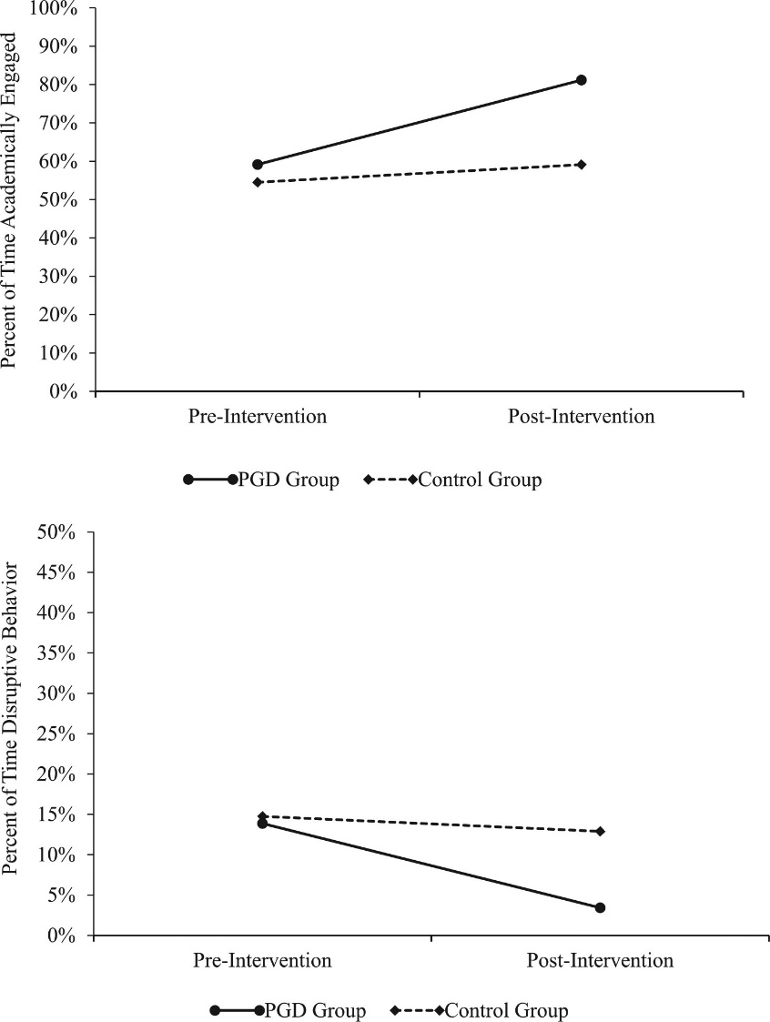
Students in the PGD classes had 20% gain in Academic Engaged Time
= extra 12 min of on-task behavior per instructional hour
or 1 hour during course of a 5-hr instructional day.
Note. PGD = Positive Greetings at the Door.
Published in: Clayton R. Cook; Aria Fiat; Madeline Larson; Christopher Daikos; Tal Slemrod; Elizabeth A. Holland; Andrew J. Thayer; Tyler Renshaw; Journal of Positive Behavior Interventions 20, 149-159.
DOI: 10.1177/1098300717753831
Copyright © 2018 Hammill Institute on Disabilities

Slide 83
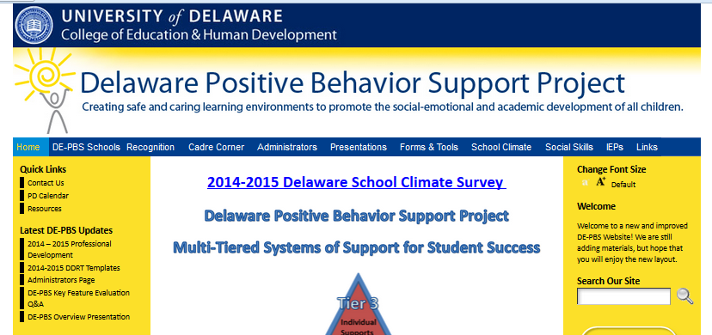
Providing Staff Overview: Resources
  Delaware PBS Project
    Delawarepbs.org
Overview presentation template available here
Technical Assistance Center on Positive Behavioral Interventions and Support
  http://www.pbis.org/

Slide 84


Sharing with your staff
Based on what we’ve heard so far today, what key points do you want to share with your staff?
Think about multiple initiatives in your school and the goals of those initiatives
  How do they relate to PBS?
  How are you coordinating and sharing information to your staff?
PBS

Slide 85
It is more than training, provide ongoing communication
Twice-monthly / monthly emails
Include in newsletters
  Teachers
  Community
“PBS minute” on morning announcements
“PBS minute” at weekly department / academic meetings
PBS updates at each staff meeting
Communication coordinator / work group

Slide 86
Communication Loop for Staff
Communication is two way
System for staff feedback:
  Surveys (on-line, paper pencil, secret ballots)
  Q & A section at staff meetings
  Grade level or PLC meetings and voting

Slide 87
DATA…so many uses ☺
Use data to:
  Present the extent of “problems”
    EX: 55% of our referrals are for latenesses
  Pinpoint areas of focus
    EX: Most latenesses happen on Mondays and Fridays
  Show improvements
    EX: Since focusing on “Responsible” on-time behaviors we’ve seen a 13% decrease in latenesses.
  Validate teacher concerns
  Shape expectations, acknowledgments, roll-out and booster activities

Slide 88
DATA, Validation station…
Validate teacher concerns by identifying specific problem behaviors through data review:
  ODRs, attendance, grades, state testing, graduation rates, student and staff surveys
Data to create action plan.
  PBS may roll-out may work differently at your school depending on your school needs

Slide 89
Data, Specific surveys
Get staff feedback on:
  School-wide expectations
  Acknowledgements
  Policies
  Data
  Concerns
  Celebrations

Slide 90
PBS the PBS-ers
Build on what is already in place:
  Find components of PBS already at work in classrooms and reinforce teacher behaviors.
Team members, talk the talk and walk the walk:
Explicit expectations for teacher behaviors
  Teach
    Model, lead, test
  Check for understanding
  Repeated opportunities to practice correctly
Reinforce
    Recognition for staff behaviors
    Rewards for staff behaviors

Slide 91

Example of
PBS for staff:
“Faculty members are eligible for regular raffle drawings for a variety of prizes. Administration also gives “Shout-outs” and “Thank-you Cards” to acknowledge positive staff behavior.”
“Our PRIDE cards are perforated, student names on one half teachers on the other. If a student gets pulled for a reward the teacher who wrote the positive referral also gets a reward. Teachers love it!”
“At staff meetings, teachers are invited to share examples of how our STAR rewards work in the classroom- we share ideas and feel good about our efforts!”

Slide 92
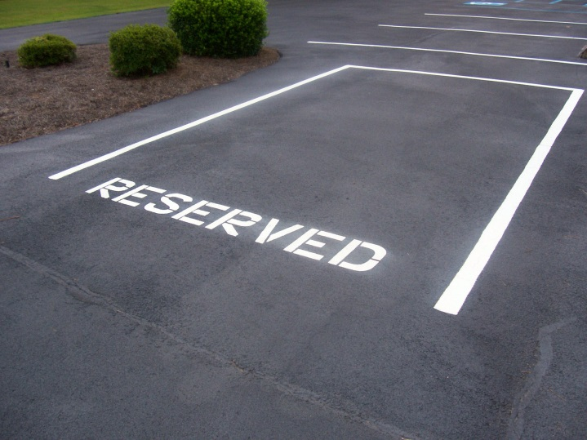
More PBS for staff
STAFF REWARDS:
  PBS parking spot
  Administrator teaches class / takes duty
  Subs for a sub
  Leave school early on a Friday
  Student assistant for a period
  Coffee card
  PBS fridge in the teachers’ lounge

Slide 93

Student Buy-In through
Student Involvement
As early as elementary level, include older students in program implementation
Secondary schools: utilize students on the team, or form a PBS Student Team
Include students that represent all students (consider athletes, academics, student government, uninvolved, kids with referrals)
Use students in teaching lessons, peer-mentoring around PBS, reinforcer ideas, etc.

Slide 94
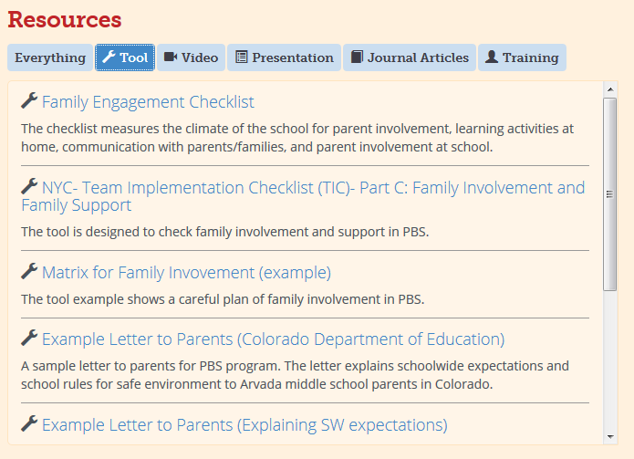
Make sure to engage families too: Suggestions & Tools
Avenues for sharing SWPBS and/or your MTSS of support
  Back-to-School Night PowerPoint
  Brochure
  School newsletter
  Post these materials on your school website
Technical Assistance Center on
Positive Behavioral Interventions
and Support
  http://www.pbis.org/

Slide 95

How will you promote buy-in?
Review the Buy-In Checklist on p. 47 in Tab 1
Select one area your team needs to address
Determine how you will implement

Slide 96
Prevention: Developing Schoolwide & Classroom Systems
Tab 2 – Workbook & Examples

Slide 97
DE-PBS MTSS Framework Components
Program Development & Evaluation
  Problem-Solving/Leadership Team
  Data
  Professional Development & Resources
Developing SW and Classroom Systems to Prevent Problem Behavior
  Expectations and Teaching
  Positive Relationships
Correcting Problem Behaviors
  Consistent and clear procedures
  Disciplinary encounters used as learning opportunities to teach problem solving strategies
Developing Self-Discipline

Slide 98
Key Features
Recognize the critical importance of preventing behavior problems. This is evident throughout school policies and evidence-based practices, especially in preventive classroom management, clear school-wide expectations, and school-wide teaching and recognition of positive behaviors. It also is seen in positive teacher-student, student-student, and school-family relations.
Recognize that ALL students benefit from positive behavioral supports. This includes students with and without behavior problems or disabilities, and requires sensitivity to individual and cultural differences.

Slide 99
Positive, Predictable Environment
Schoolwide Expectations
Teacher Agreements
Positive, Predictable Environment
www.pbis.org

Slide 100
Developing SW and Classroom Systems to Prevent Problem Behavior
  Expectations
    Expectation development
    Posting
  Active Teaching
    Kick off
    Lesson plans
  Positive Relationships
    Teacher-student
      Acknowledgement
    Student-student
    School/teacher - home

Slide 101

“It is important to note a proactive approach to schoolwide discipline by definition focuses on behavior that is desirable."
- Geoff Colvin, 2007

Slide 102
School-wide Expectations & Rules
Expectations
Rules
A list of specific, positively stated behaviors that are desired of all faculty and students
These expectations should be in line with the school’s mission statement and should be taught to all faculty, students, and families
Specific skills you want students to exhibit and the procedures you want students to follow in specific settings
www.pbis.org

Slide 103
How Are Expectations and Rules Similar?
Both should be limited in number (3-5)
Both should be positively stated
Both should be aligned with the school’s mission statement & policies
Both should clarify criteria for successful performance
www.pbis.org

Slide 104
How Are Expectations and Rules Different?
Expectations
Rules
Expectations are broadly stated
Expectations apply to all people in all settings
Expectations describe the general ways that people will behave
Rules describe specific behaviors
Observable
Measurable
Rules may apply to a limited number of settings
Rules clarify behaviors for specific settings
www.pbis.org

Slide 105
What Is Gained by Identifying Expectations & Rules?
Establishes common, unifying language for staff, students and families
Supports social behavioral curriculum design
Promotes uniform instruction across multiple programs and settings within the school
Adapted from: www.pbis.org

Slide 106

Our Goal!
Select three to five schoolwide expectations that define success for all students and are applicable in all settings.
    Examples:
    Respectful
    Cooperative
    Safe
    Kind

Slide 107

School-wide Expectations Guidelines
Expectations are the umbrella for more specific rules:
Identify 3 – 5 positively stated expectations
Use data to determine expectations
Choose positive actions and terms
Keep them simple and easy to remember
Remember to be age appropriate
Overall goal to promote self-discipline, positive social and academic outcomes

Slide 108
Expectation Example
Dover High and Central Middle
RAP Expectations
Respect
Accountable
Productive
Other Thoughts…
Where "Koalaty" Counts
Distinct Expectations
Acronym that works well
Continuity within district
Connect to school mottos
Connect with other behavior initiatives

Slide 109

Already have expectations?
If integrating with Leader In Me, consider how SW expectations align with The 7 Habits.
Incorporate them!
  Find common themes
Goal is to have only have one set of school-wide expectations.

Slide 110

Our Goal!
Create a teaching matrix of specific behaviors/rules to further clarify each schoolwide expectation for every setting.

Slide 111
School-wide Teaching Matrix Reminder
PURPOSES:
Defines the Expected Behaviors for Specific Settings:
  hallways, classrooms, gym, cafeteria, commons,
  bus loading, bathrooms, assemblies
    State definitions positively
    Use a few common words
    Show what the behavior “looks like”
Creates the “Curriculum” that will guide the teaching of expected behaviors.
Enhances communication among staff and between students and staff.

Slide 112
Teaching Matrix Guidelines
Remember our behaviors/rules are specific tasks students are to do to achieve the schoolwide expectations
When defining specific behaviors/rules they should be:
Observable – behaviors that we can see,
Measureable – we could actually count the occurrence of the behavior,
Positively Stated – things to do to be successful,
Understandable – student-friendly language, and
Always Applicable.
http://pbismissouri.org

Slide 113
Example of Rules Following Guidelines
Guidelines | This Means | Example | Non-Example
Observable | I can see it. | Raise hand and wait to be called on. | Be your best.
Measurable | I can count it. | Bring materials. | Be ready to learn.
Positively Stated | I tell students what TO do. | Hands and feet to self. | No fighting.
Understandable | The vocabulary is age and grade appropriate. | Hands and feet to self. | Maintain personal space (K-1 rule)
Always Applicable | I am to consistently enforce. | Stay in assigned area. | Remain seated until given permission to leave.
http://www.midatlanticpbis.org

Slide 114
Specific Behaviors + Social-Emotional Skills
Expectation | Specific Behavior or Social Emotional Skill
Be Safe | Keep hands and feet to self
 | I tell an adult when I am worried about a friend.
Be Respectful | Use the signal to ask a public or private question.
 | Make sure everyone gets a turn.
Be Responsible | Turn in all work on time
 | Check in with my feelings during the day
http://www.midatlanticpbis.org

Slide 115
Specific Behaviors + Pro-Social Skills
Specific Behaviors
Pro-Social Skills
Throw paper in the waste can
Use the right side of the stairway
Bring all materials to class
Keep hands, feet, and other objects to yourself
Choose kindness over being right; pick up trash even if it isn’t yours
Encourage others; tell peers they did a good job
http://www.midatlanticpbis.org

Slide 116
Teaching Matrix: Template
 |  | ROUTINE/SETTING
RULE/EXPECTATION
http://pbismissouri.org

Slide 117
Classroom Teaching Matrix: Rules/Norms/Specific Behaviors
 |  | Routines and Signal
School-Wide Expectations | Class-wide Rules/Norms
http://www.midatlanticpbis.org

Slide 118
Classroom Matrix
Extend School-wide expectation to the classroom
Take 3-5 positively stated expectations and classroom teachers & students define those expectations across their routines
Definitions can look different across classrooms & routines
  Science lab group work vs. History whole group instruction
  Morning meeting vs. leaving the classroom

Slide 119
Classroom Rules/Norms/Specific Behaviors
Examples
Non-Examples
Turn in completed assignments on time
Walk at all times in the classroom
Keep hands, feet, and objects to yourself
Raise your hand and wait for permission to speak
Do what your teacher asks immediately
Be in your seat when the bell rings
Keep your hands, feet and objects to yourself
Be on task during work times
Be responsible
Be a good citizen
Respect authority
Pay attention
Be ready to learn
Do your best
Be kind to others
Be polite
Be safe
http://www.midatlanticpbis.org

Slide 120
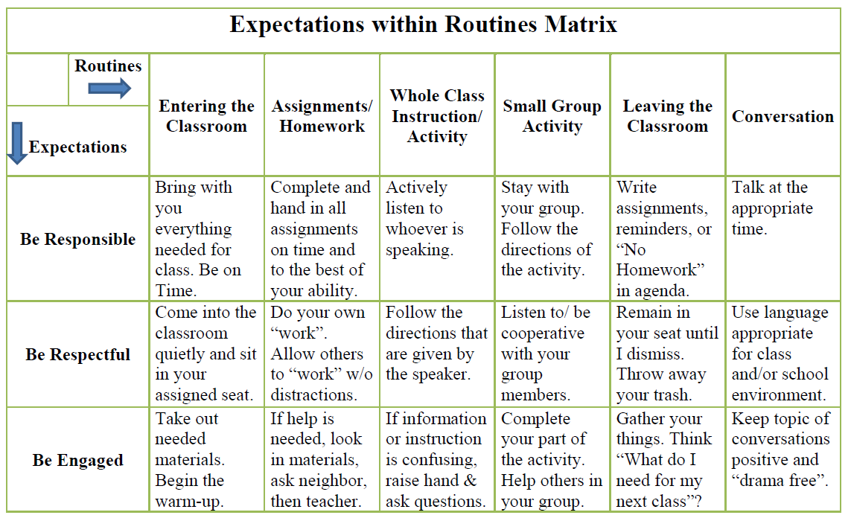

Slide 121
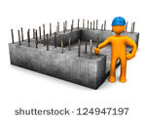
Invest in Building a Strong Foundation
The teaching matrix is foundation for
  TEACHING behavior & social skills
  ACKNOWLEDGING/REINFORCING skills
  PRE-CORRECTING for desired behaviors, and
  CORRECTING behavioral missteps through re-teaching.

Slide 122

They’re Alive!
Think of your School-wide and Classroom Matrices as living, fluid documents. If being responsive to your data and needs of your school and community, then teams and schools need to be flexible and willing to revisit expectations and rules.

Slide 123
Once you have developed school-wide expectations, it is not enough to just post the words on the walls of the classroom, or simply tell students what they are…
YOU MUST ACTIVELY TEACH THEM!

Slide 124
Why Develop a System for Teaching Behavior?
Behaviors are prerequisites for academics
Procedures and routines create structure
Repetition is key to learning new skills
For a youth to learn something new, it needs to be repeated on average of times (Joyce and Showers, 2006)
Adults average (Joyce and Showers, 2006)
For youth to unlearn an old behavior and replace with a new behavior, the new behavior must be repeated on average times (Harry Wong)
8
25
28
www.pbis.org

Slide 125
Teaching Expectations Using an Instructional Approach
Define | Observable, measurable
Teach | Identify, prior knowledge, model, structured practice, acknowledge
Remind | Pre-correct, prompt behaviors/rules prior to entering natural context
Monitor | Supervise, feedback/acknowledgement, data
Evaluate | Data, modifications needed, non-responders needing more support

Slide 126
Teaching Structures
Provide initial lesson plans to begin teaching behavior
  Assembly
  School teaching tour
Build on what you have (i.e. character ed.)
Develop a system for expanding behavior lesson plan ideas throughout the year
  Skill of the month
  Booster Sessions
  Advisory
Determine the minimum requirements for teaching behavior (i.e. how often)

Slide 127
Strategies to Support Student Expectation Knowledge
Keeping expectations visible (posters, letter head, magnets)
Simplify expectations as needed
Keep teaching fresh
Curriculum integration/connections – ongoing teaching
Classroom based matrix –
  Responsive Classroom –Morning Meeting Discussion

Slide 128
Using Videos to Engage and Teach
Simple teaching video:
  http://www.hasd.org/schools/ges/pbis.cfm
Secondary level video:
  http://www.youtube.com/watch?v=KXkZgS0toWk
Cyberbullying video:
  http://vimeo.com/groups/pbisvideos/videos/78173708

Slide 129

Remember…
“You are a primary model for appropriate behavior.”
The IRIS Center
http://iris.peabody.vanderbilt.edu

Slide 130
Points to Ponder
Do our students know the school-wide expectations? Could they share what they are and what it looks like to follow expectations across school locations?
What creative ideas have we used or want to use to actively teach expectations?

Slide 131

Choose Your Own Adventure…
Establish or Revise Expectations
Create or review teaching matrix for a given area or routine
Explore supporting staff to establish/revise classroom expectation & routines
Brainstorm new expectation teaching ideas (initial or booster)

Slide 132
Developing SW and Classroom Systems to Prevent Problem Behavior
  Expectations
    Expectation development
    Posting
  Active Teaching
    Kick off
    Lesson plans
  Positive Relationships
    Teacher-student
      Acknowledgement
    Student-student
    School/teacher - home

Slide 133
Preventing Problem Behavior through Developing Positive Relationships
Teacher-Student
School/ Teacher - Home
Student-Student

Slide 134

Teacher-Student Relationships
School-wide focus on caring and supportive adult-student relationships.
Goals:
  Adults demonstrate warmth, respect, support, and caring toward all students
    (irrespective of gender, race, ethnicity, socioeconomic background, disabilities, previous history of behavior)
  Every student has a supportive relationship with at least one adult at school.

Slide 135
Why are teacher-student relationships important?
Not only do students like teachers who are caring, respectful, and provide emotional support, but when those qualities are found students also show:
GREATER school completion, academic engagement, and academic achievement
GREATER peer acceptance
INCREASED motivation to act responsibly and prosocially
LESS oppositional and antisocial behaviors, including bullying
BETTER subjective well-being

Slide 136
How can staff and student relationships be supported?
Supporting everyday relationship building:
  Finding/asking about student interests/extracurricular activities
  Students providing 1-minute reports on areas of their interest (i.e. sports, drama)
  Attending extracurricular events
  Highlighting student talents (i.e. bulletin board with newspaper articles)
  Staff acknowledge student success and EFFORT

Slide 137
Purpose of Reinforcers/Acknowledgements
Recognizing desired behavior is a strategy to prevent behavior problems.
Teach new behavior
Strengthen replacement behaviors that compete with habitual undesirable behavior
Create frequent positive interactions between staff and students

Slide 138
Strategic Use of Praise and Rewards – Part 1
Use strategically to support teaching of a school-wide expectations
Focus on the message, not the reward
Highlight the student’s specific achievement and efforts demonstrated

Slide 139
Strategic Use of Praise and Rewards – Part 1
Students are routinely recognized for demonstrating the SW expectations through the associated actions defined through the teaching matrix
  “You really showed how to be cooperative in science lab today by working together to create the model.”
  “Thanks to everyone for being so responsible and caring by bringing in canned goods for the PBS food drive.”

Slide 140
Strategic Use of Praise and Rewards – Part 2
Use strategically to reinforce social and emotional learning competencies and effort that underlie prosocial behavior.
Routinely recognize students with praise and rewards for demonstrating empathy, caring, responsibility, respect, and effort/hard work

Slide 141

Strategic Use of Praise and Rewards – Part 2
  Highlight the future value or usefulness of the behavior
  “That’s terrific that you were able to control your anger when teased by Jerome. That’s an important skill that will help you keep friends (and avoid being sent to the office ☺”).
  “Great! You must have stopped and thought about how your behavior might affect others.”

Slide 142
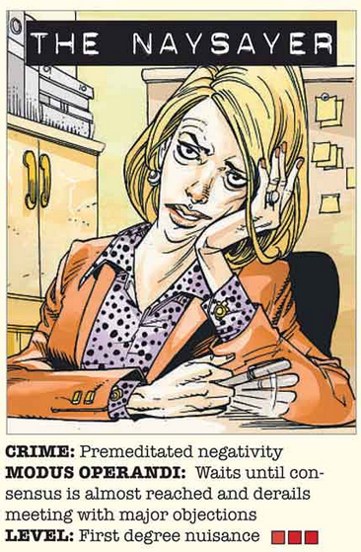
Reality check please…
You Got It!
Positive Approaches to Behaviors provide real, meaningful results for
Schools, teachers and students:
Increased academic engagement
Decreased disruptive behavior
Increased intrinsic motivation
Increase peer social acceptance
(Rodgriguez & Sprick handout)

Slide 143
School-wide Acknowledgement Plans
Avenues to support recognition practices -
High Frequency Acknowledgements
Activities for Staff and Student Relationship Building
Positive Contacts Home
Unexpected/Intermittent Acknowledgements
Long Term Celebrations
Staff Reinforcement

Slide 144
Operationalize School-wide Acknowledgement Plans
TYPE | WHAT | WHEN | WHERE | WHO
Immediate/High Frequency In the moment, predictable (e.g., Gotchas, Paws, High Fives) | KIDS: ADULTS: | High frequency for a short time when first teaching desired behavior or re-teaching identified problem behavior from data |  | ALL KIDS, ALL STAFF
Redemption of high frequency (e.g., school store, drawings) | KIDS: ADULTS: | At least monthly |  | ALL KIDS. ALL STAFF
Intermittent/Unpredictable (e.g., surprise homework completion treat, random use of gotchas in hallway) | KIDS: ADULTS: | Maintaining a taught behavior (fading) |  | ALL KIDS, ALL STAFF
Long-term School-wide Celebrations (school-wide not individually based) FOR: Ex: ODR reduction, school-wide target met for certain setting/behavior area ACTIVITY: (e.g., ice cream social, dance, game day) | BOTH TOGETHER: | At least quarterly |  | ALL KIDS, ALL STAFF

Slide 145
Points to Ponder – Recognition
New Team
1. Make a list of all current ways your school acknowledges positive student behavior/choices.
2. How effective are these methods? How do you know?
Existing Team
3. How do you monitor the equity of your current recognition systems (for students and staff)?
4. What are the patterns you see in the participation and non-participation of students? And how to address problematic ones?
5. Where do the voice of students and families come into your discussions regarding students and staff recognition systems?
Check out resources at pbis.org

Slide 146
Preventing Problem Behavior through Developing Positive Relationships
Teacher-Student
School/ Teacher - Home
Student-Student
DE-PBS

Slide 147
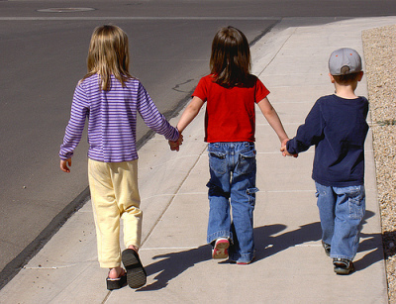

Why are student-student relationships important?
Students with positive peer relationships experience greater:
  academic initiative and achievement
  liking of school
  school completion
  self-esteem
They experience less:
  school avoidance
  depression
  delinquent and aggressive behaviors
  bullying

Slide 148
How can student relationships be supported?
Curriculum lessons that directly teach social, emotional, and behavioral competencies, especially those related to student-student relations.
Opportunities to help students learn and practice skills
  e.g. Morning Meetings, Peer-assisted and cooperative learning, Extracurricular activities
Increased awareness and recognition of acts reflecting positive student-student relations
  e.g., posters, school or class newsletters, morning announcements, etc.
  Give recognitions for acts of caring, kindness, friendship, and respect at the individual, class, and school levels.

Slide 149
Relationships and Bullying Prevention
A positive school climate that includes supportive teacher-student and student-student relationships (and family relationships) also helps buffer bullying victims from negative outcomes related to their being bullied (Swearer, Collings, Fluke, & Stawhun, 2012)
Relationships are very important not only in
preventing bullying,
but also in responding to bullying.

Slide 150
Preventing Problem Behavior through Developing Positive Relationships
Teacher-Student
School/ Teacher - Home
Student-Student

Slide 151

School/Teacher - Home Relationship Building
School-wide focus on developing
strong home-school collaboration
& communication.
Goals:
  Establish positive and collaborative relationships with parents.
  Establish parents’ roles in developing the school discipline/PBS program; solicit feedback is regularly.

Slide 152

School/Teacher - Home Relationship Building
Also:
  Establish clear, positive, bi-directional and regular communication with parents.
  Inform parents routinely about the
  schoolwide discipline/PBS program, classroom
  activities, and their children’s positive behaviors.

Slide 153
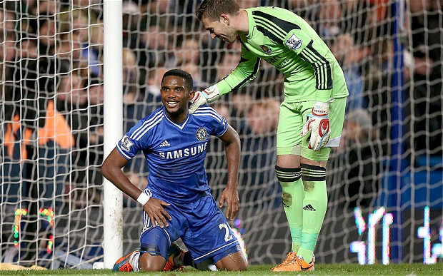
School/Teacher - Home Relationship Building
GOAL: The # of positive contacts with the home is greater than the # of negative contacts

Slide 154
Why are school/teacher - home relationships important?
7 BIG Advantages of working with parents
(guardians, other adults serving parental role):
Students’ attitudes, self-esteem, and behavior are greatly influenced home-school relationship
Parental involvement is often necessary to truly change a student’s behavior
    Efforts to increase student’s engagement lead to improved achievement
Parents gain greater understanding of how school works
    Increased involvement with students’ learning at home
Unquestionably, parents can be valuable resources

Slide 155

How can school/teacher - home relationships be supported?
Parents as team members; two-way communication with parent(s) on routine basis
School-wide PBS information shared to support understanding
  Brochure, open house presentation, newsletter, website
Promoting positive contacts home as part of acknowledgement system
  Positive Behavioral Referrals, phone calls regarding positive behavior, positive post cards

Slide 156
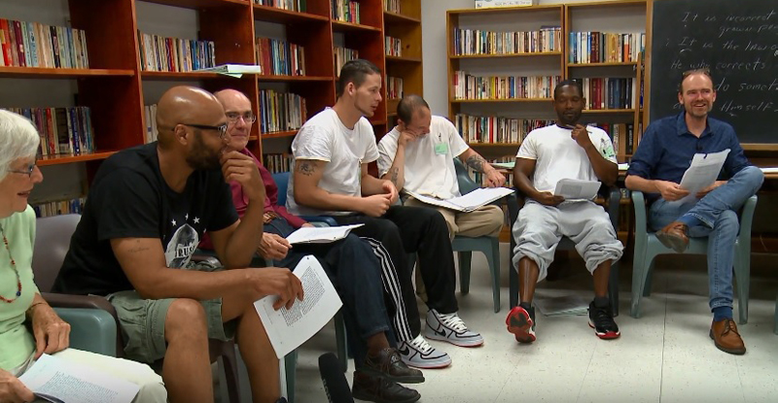
Measures Used for
Relationship Building
Delaware Assessment of Strengths & Needs
School Climate Survey
  Teacher-Student Relations
  Student-Student Relations
  Teacher-Home Communications
  Respect for Diversity
  Staff Relations
Other Ideas?

Slide 157
School Climate Online Resources
Module Components
Defining Focus Area
Area
Importance
Contributing Factors
Research-based Strategies
Resources & Tools

Slide 158

School Climate Online Training Modules
Current Modules Available:
  Teacher-Student Relationships
  Student-Student Relationships
  Bullying Victimization
  School-Wide Student Engagement
Coming soon:
  School Safety
  Family-School Collaboration
Schoology – Resources and/or Credit
“School Climate Professional Development” group
Access code = 2P5NM-F56JT

Slide 159
Points to Ponder – Relationships
New Team
1. Using the given PPT presentation slides, how might you help your staff discuss the link between behavior and relationship-making?
2. Make a list of your current initiatives related behavior and social-emotional learning and map out how they explicitly build relationships.
Existing Team
3. In what ways have you used your Delaware School Climate Data to discuss the importance of relationships in shaping positive student and staff behavior?
4. How have you make the link between that data and the words PBS and/or MTSS for behavior?
5. Who can review the relationship modules and related resources and help determine what staff-wide initiatives that we want to try?
Check out resources on Schoology
“School Climate Professional Development” group
Access code = 2P5NM-F56JT

Slide 160
Correcting Problem Behaviors
Tab 3 – Workbook & Examples

Slide 161
DE-PBS MTSS Framework Components
Program Development & Evaluation
  Problem-Solving/Leadership Team
  Data
  Professional Development & Resources
Developing SW and Classroom Systems to Prevent Problem Behavior
  Expectations and Teaching
  Positive Relationships
Correcting Problem Behaviors
  Consistent and clear procedures
  Disciplinary encounters used as learning opportunities to teach problem solving strategies
Developing Self-Discipline

Slide 162


“When everyone handles infractions with instructional correction procedures, students learn that what happens when they misbehave is procedure not personal”
Bob Algozzine

Slide 163
System for Responding to/
Correcting Problem Behaviors
Responding to Problem Behavior
Referral System
Clear & Consistent Procedures
Disciplinary Learning Opportunities

Slide 164
DE-PBS School-wide Framework
System for Correcting Problem Behaviors
  Referral system
    ODR form is clear – defines specific behavior problem, location, time (WHY – think about big 5)
    Data entered in school system w/in 24 hours – ideal goal
  Consistent and clear procedures
    Major vs. minor
    Defining behaviors
  Disciplinary encounters used as learning opportunities to teach problem solving strategies
    Staff response (minor)
    Administrative response (major)

Slide 165
Referral System: Discipline Referral Form
Referral form/process comprehensive yet easy to complete (timely entry)
Clarity on the referral form takes the guess work out of the data entry
Defines specific behavior problem, location, time – think about big 5
Clear distinction between major (office-managed) vs. minor (classroom-managed) problem behaviors
Consistent data entry procedure

Slide 166
Consistent & Clear Procedures:
Classroom vs. Office Managed
Staff need to know what problem behaviors are major vs. minor (office-managed vs classroom–managed)
This process must be defined, taught/re-taught, and agreed upon with all staff, and must include definitions for:
  major discipline incidents
  minor discipline incidents
  a continuum of discipline procedures

Slide 167
Learning Opportunities: Response to Problem Behaviors include problem solving/skill building
Observe problem
behavior
No
Yes
Find a place to talk
with student(s)
Is the behavior
major?
Ensure safety
Write referral &
Escort student to
office
Problem Solve
Determine
consequence
Problem solve
Follow procedure
documented
Determine
consequence
Etc.
Follow documented
procedure
Adapted from procedure 2.0 A. Todd U of Oregon
Etc.

Slide 168
Recommendation to eradicate disparities in school discipline
Problem-solving approach to discipline
  Understanding the context
  Why the student is engaging in behavior and understanding the teachers response
  Providing opportunity for reflection and restoration
  Providing additional interventions or services for students with complex support needs
Russell J. Skiba, director of Discipline Disparities Research-to-Practice Collaborative

Slide 169
Disciplinary encounters: 2-part problem solving process
Part 1 focuses how the student might think & act differently. How they can monitor their behavior.
  Student centered: Guided by problem solving & skill building with student.
Part 2 focuses on what the teacher or school should do, beyond punishment, to prevent the problem behavior from recurring and to foster self-discipline, perseverance, and resilience.
  Teacher (or school) centered: Guided by changes in the student’s environment.

Slide 170
Problem Solving with Students
Goal is to help students:
  Determine possible solutions to solve the problem
  Evaluate the options and select the best one
  Develop a plan to follow through with the solution
    How can they self-monitor to ensure they are following the plan?
    How can they continue following this plan over time?
  Consider obstacles that may develop
    How can they be resilient and bounce back from obstacles?
  Are there skills they are lacking that need to be taught in order to solve the problem?

Slide 171
Example Problem Solving Questions
What is the problem in this situation? How do you know that there is a problem?
What should you do? What is the right thing to do?
What did you do the last time there was a problem like this one?
What do you do when what you want to do is not the same as what you ought to do?
Do you need a plan to do what you decided to do? If so, what might it look like?
How will you keep track of this plan and how you’re following it?
What obstacles might get in the way of your doing what you ought to do and intend to do? What might you do to avoid or overcome these obstacles?

Slide 172
Strategies to Support Consistency
Clearly defined major vs. minor behaviors
Clearly/operationally defined response process for minor and major behaviors
Staff feedback loop
Communication through:
  PLC discussions (cross grade-level discussions – what works?)
  Full staff presentation
  Flow chart in classrooms
  Handbooks
Administrator & Staff monitoring and conversations (preventative & corrective)

Slide 173
Points to Ponder
How are opportunities for reflection and problem-solving systematically incorporated in disciplinary practices?
How do you consider the context for the problem behavior in disciplinary decisions?
  Inconsistency is not the same as thoughtfully contextualizing discipline practices

Slide 174
Developing Self-Discipline
Tab 4 – Workbook & Examples

Slide 175
DE-PBS MTSS Framework Components
Program Development & Evaluation
  Problem-Solving/Leadership Team
  Data
  Professional Development & Resources
Developing SW and Classroom Systems to Prevent Problem Behavior
  Expectations and Teaching
  Positive Relationships
Correcting Problem Behaviors
  Consistent and clear procedures
  Disciplinary encounters used as learning opportunities to teach problem solving strategies
Developing Self-Discipline

Slide 176
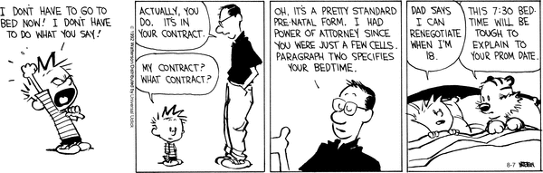
What is Self-Discipline?
It is…the ability to take responsibility and ownership for one’s behavior.
  (Dennis Knapczyk, 2004)
It is not…
(Bill Waterson)

Slide 177
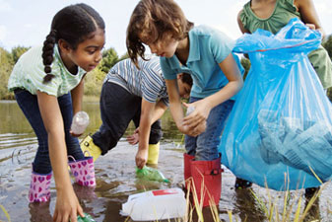
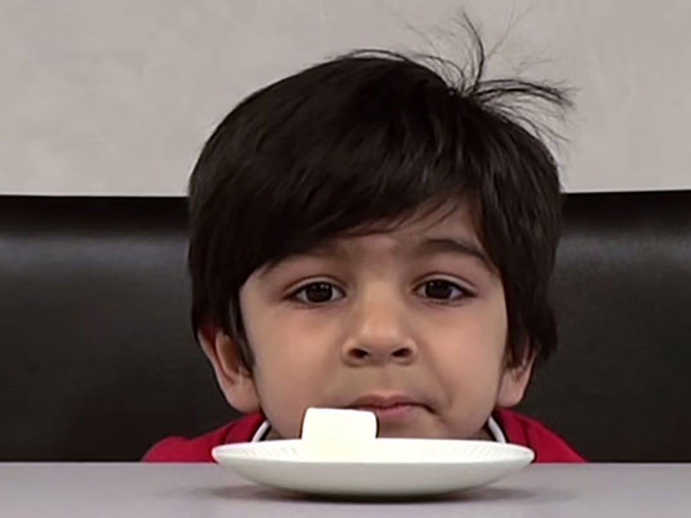
What is Self-Discipline?
Consists of the range of social and emotional skills, but especially:
  Responsible decision making at school, home, and in the community
  Self-management of emotions and behavior, and doing so under one’s own volition.

Slide 178
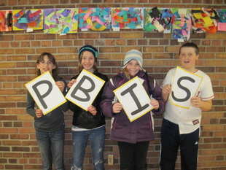
What is Self-Discipline?
Connotes the critical notion of internalization,
as seen in: committed compliance or willing
compliance.

Slide 179
  Self-Discipline is…
  used to remind educators that there is more to school discipline than the use of discipline.
  …the LONG-TERM goal!
How students behave in your [absence] is more important than how they behave in your presence or when punishment and rewards are not highly salient.

Slide 180
DE-PBS Key Feature
Schools recognize the importance of developing self- discipline, implementing evidence based programs in character education and social and emotional learning, and/or infuse lessons throughout the curriculum that teach social-emotional competencies.
In integrating these two popular approaches (SEL & PBIS), the primary goal of DE-PBS is to create safe and caring learning environments that promote the social-emotional and academic development of all children.

Slide 181
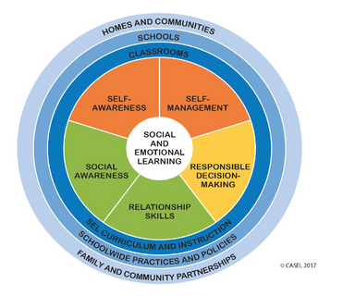
CASEL Model for SEL

Slide 182
Components of Comprehensive School Discipline | Approaches
 | Traditional SWPBS | SEL
Developing the social and emotional competencies of self-discipline | Weakness | Strength
Preventing behavior problems | Strength (more so for immediate environment) | Strength (more lasting effects)
Correcting behavior problems (short-term goal) | Strength | Weakness
Addressing Tier 2 and 3 Needs | Strength | Weakness

Slide 183
Model for PREVENTION
PBIS
(Structure)
SEL
(Support)
Positive School Climate
Internalizing Problems
Externalizing Problems

Slide 184
What does the research say regarding integrating the two approaches?
For school discipline, classroom management, and childrearing: Authoritative Discipline (combination of structure and support), which blends strategies of SEL and SWPBIS is the best approach.
  Best for achieving compliance
  Best for promoting self-discipline and resilience
  Best for effective prevention and correction
  Best for school climate
  Best for preventing bullying

Slide 185
Delaware School Climate Survey
Social Emotional Competency Scale Student Survey
Responsible Decision-making/Responsibility E.g., “I feel responsible for how I act.”
Social Awareness/Understanding how others think and feel E.g., “I think about how others feel.”
Self-management of Emotions and Behavior E.g., “I can control how I behave.”
Relationship Skills E.g., “I am good at solving conflicts with others.”

Slide 186

Incorporating Self-Discipline in Your SW PBS/MTSS Framework
  Relationship building
  Corrective Procedures
  Strategic Use of Praise and Rewards
  School-wide policies and activities
  Student decision making
  Social and Emotional Curriculum

Slide 187
School-wide Policies & Activities
Mission Statement & SW behavioral expectations include the goal of developing self-discipline (character education, social & emotional learning, caring, or social responsibility)
Self-discipline is emphasized in behavioral expectations and rules. At the SW and classroom levels, the importance of self-discipline is highlighted, such as the importance of regulating and accepting responsibility for one’s actions, respecting others, helping others, and exerting one’s best effort.

Slide 188
Student Involvement in Decision Making
The school principal meets regularly with students to discuss current school-wide issues and involves them in decisions about the welfare of the school.
  Student council/government, SWPBS student group, other groups representing the student body
Teachers across grade levels create opportunities for students to be active decision makers.

Slide 189
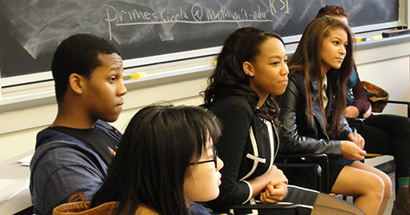
Student Involvement in Decision Making
Involve students in reviewing school data, generating solutions, and monitoring outcomes.

Slide 190
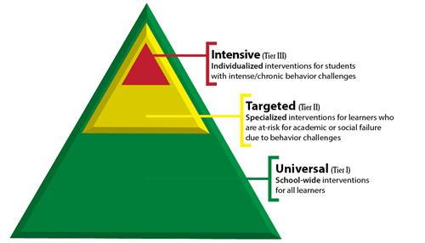
Social and Emotional Curriculum
  Specific SEL lessons are regularly provided to all students (e.g., Second Step, www.casel.org lessons) and can be used for double-dosing
    Are staff aware of what is taught in these lessons? If not, how can they be included?
    How can these lessons be tied into daily classroom activities?

Slide 191
Social and Emotional Curriculum
  Specific SEL lessons are regularly provided to all students (e.g., Second Step, www.casel.org lessons)
    Are staff aware of what is taught in these lessons? If not, how can they be included?
    How can these lessons be tied into daily classroom activities?
Social Emotional Lessons are infused throughout the school curriculum to promote the development of:
    thoughts,
    feelings,
    and behaviors
associated with responsible behavior.
These lessons encourage students to be resilient and teach how to problem-solve and persevere when obstacles arise.

Slide 192
Points to Ponder – Self-Discipline
New and Existing Team
1. What are your SEL activities at the Tier 1, 2, 3 level?
2. How does your teams and/or administration provide an explicit message about the link(s) between SEL competencies and teaching with behavior interventions/PBS/MTSS?
Hint: Be careful talking about AUTHORITATIVE vs. AUTHORITARIAN – consider skipping the words all together and talk about high structure and strong relationships.

Slide 193


Relationships
SEL
Behavior
PBS/MTSS
Climate

Slide 194
Tier 1: SWPBS Monitoring Tool
Key Feature Status Tracker
Status
  Discuss as a team if components are:
  In Place, Partially in place, Not in Place
Action Plan
  Discuss as a team the items Partially in place or Not in Place
  Prioritize focus areas
  Note activities to be completed, who will do them and when

Slide 195

Evaluation: We value your feedback!
Please share what assistance you and your team need to move forward
We will use this information for our follow up with you and your district coaches

Slide 196
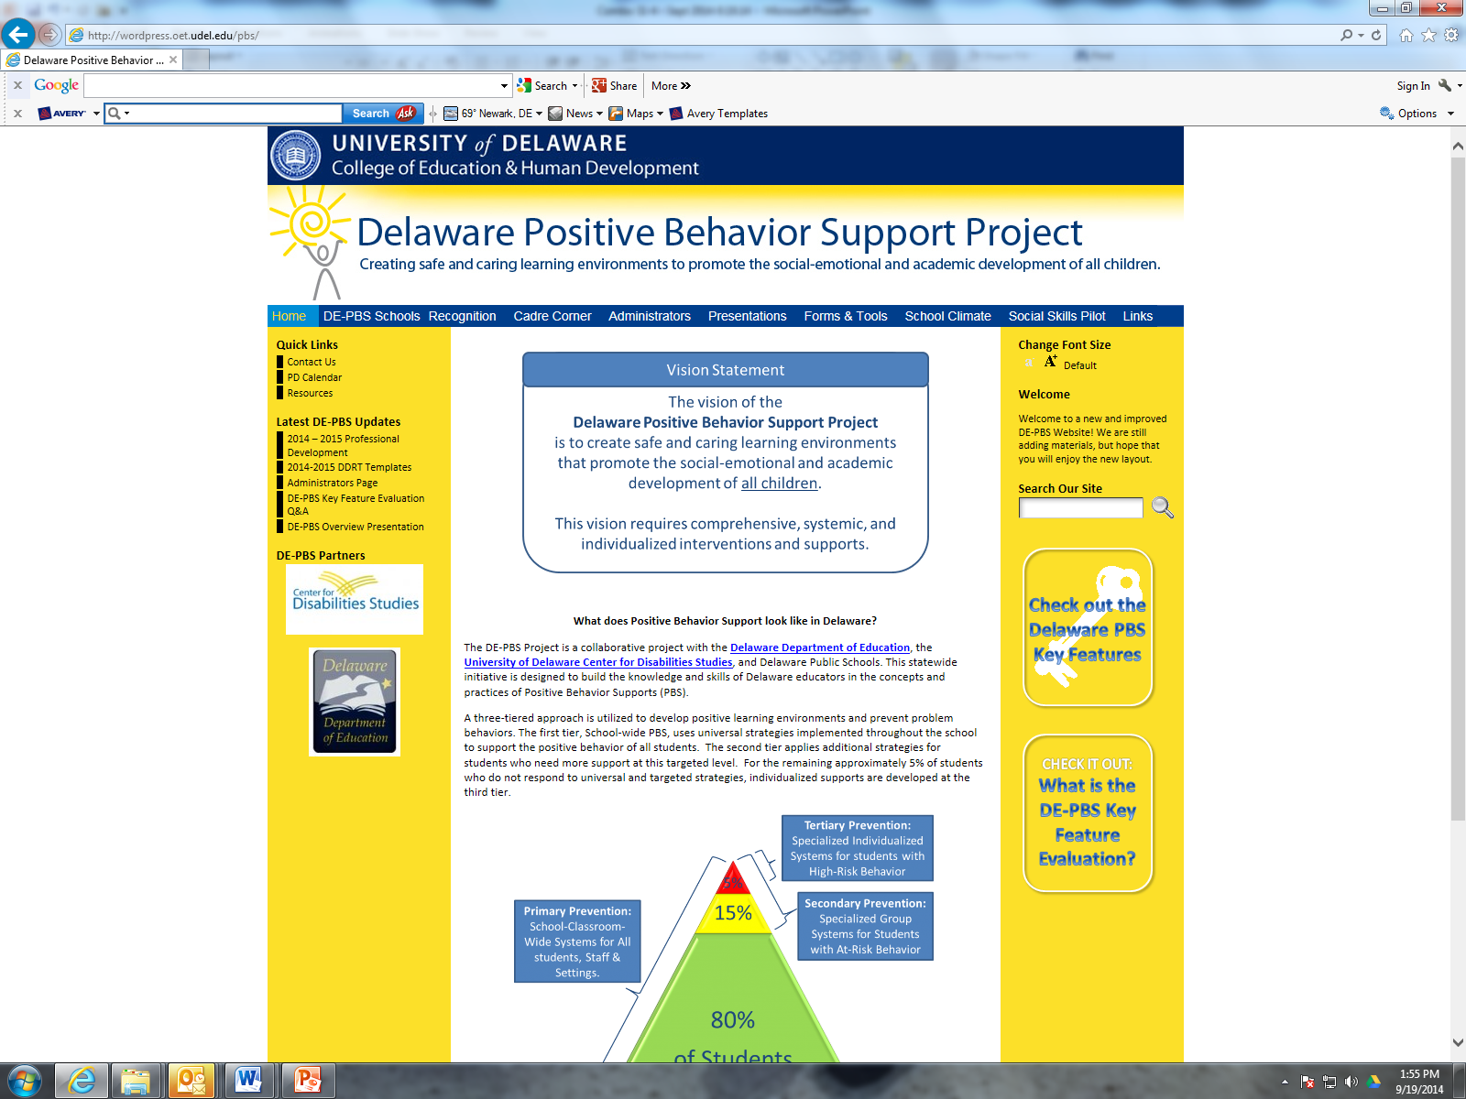
Thank you!
WWW.DELAWAREPBS.ORG
Schoology Groups:
  School Climate
  DE-PBS resources

