Slide 1
DE-PBS Secondary Forum
Fall 2014
October 22, 2014

Slide 2
This is how other schools include students
in their PBS initiatives…
They Shape SW Acknowledgement Systems
Determining Acknowledgement Events and Reinforcers
Black History Month
Quarterly Celebrations
They Reinforce SW Expectations
Modeling Expectations
Fashion Show
SW Videos
They Provide Feedback Regarding SW PBS Data
Commenting on Office Discipline Referral (ODR) Data Trends
They Encourage Peer Buy-In
Creating Video Advertising Campaigns
Tracking Student Participation in Events
Facilitating Staff Fidelity
They Speak With Peer Student Groups
Peer Mentor Groups
SGA Visits
They Share with Us and Each Other
High School Forums
Middle School Forums
Email, calls, and school visits

Slide 3
Agenda
Introductions
Bullying
Minor vs. Major Behaviors
Break
Social Emotional Learning
Updates from the DEPBS Project and YOU!
Notes:
Updated 9.9.14
Introductions (20 min)
Bullying (1 hr with planning time, info-Megan)
Minor vs. Major Behaviors (1 hr with planning time, Info-Eileen))
Break (15 min)
Social Emotional Learning (1 hr with planning time, info-Megan)
Updates from the DEPBS Project and DEDOE (15 min)

Slide 4
Topic 1: Bullying
We’d like to share:
Results from the DSCS – Bullying Subscales (Secondary Schools, 2013-14)
Results from the “Youth Voice Project” (Davis & Nixon, 2014)
Bullying Action Planning
Overall, we’d like to know:
Where is your school in regard to bullying prevention?
Notes:
MEGAN
Added by MP 10.06.14 so we can see all the topics to be discussed in this section.

Slide 5
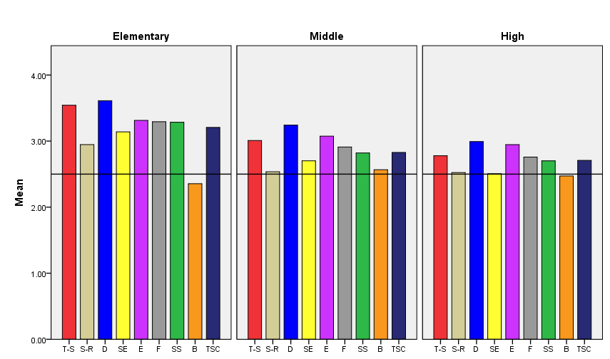
Grade Level Differences: Student Survey 2014
Teacher-Student Relations
Respect for Diversity
Clarity of Expectations
School Safety
Total School Climate
Student Relations
Student Engagement
School-wide
Bullying School-wide
Fairness of Rules
Fairness of Rules
Notes:
MEGAN
Updated 9.29.14
Example items [taken from 13-14 DSCS Workshop]
Verbal Bullying
“A student said mean things to me.”
Physical Bullying
“I was pushed or shoved on purpose.”
Social/Relational Bullying
“A student told or got others to not like me.”
Cyberbullying (grades 6-12)
“A student sent me a mean or hurtful message about me using email, text messaging, instant messaging, or similar electronic messaging.”

Slide 6
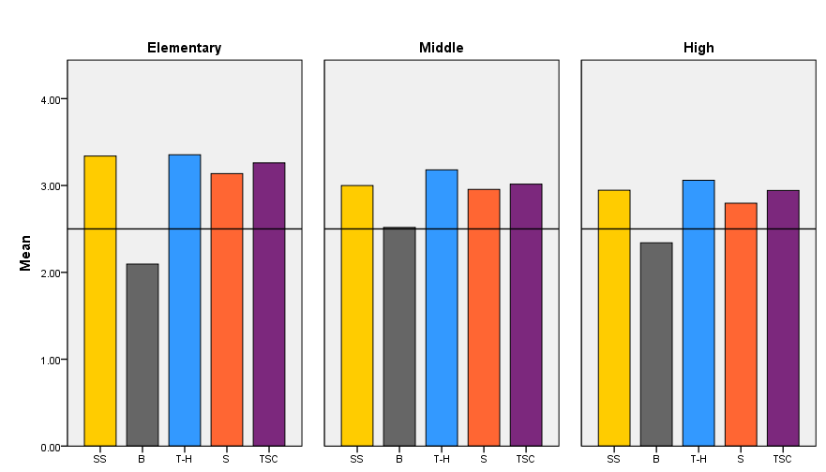
2014 Teacher Survey Results, K-12
School Safety
Teacher-Home
Communication
Total School Climate
Bullying School-wide
Staff Relations
Notes:
MEGAN
Updated 9.29.14
Example items [taken from 13-14 DSCS Workshopt]
Verbal Bullying
“A student said mean things to me.”
Physical Bullying
“I was pushed or shoved on purpose.”
Social/Relational Bullying
“A student told or got others to not like me.”
Cyberbullying (grades 6-12)
“A student sent me a mean or hurtful message about me using email, text messaging, instant messaging, or similar electronic messaging.”

Slide 7
Sample subscale responses associated with teacher/staff scores (Part I: School Climate) | Percent who Agreed or Agreed a lot
 | Elem School | Middle School | High School
Teacher-Student Relations 7. Teachers care about their students. | 99.3 | 98.0 | 97.5
Student–Student Relations 11. Students are friendly with each other. | 92.4 | 82.2 | 85.1
Student Engagement School-wide 29. Most students work hard to get good grades. | 88.1 | 69.4 | 54.9
Clarity of Expectations 10. Students know how they are expected to act. | 96.9 | 91.1 | 87.8
Bullying School-wide* 9. Students threaten and bully others in this school. | 31.8 | 59.7 | 46.2
School Safety 19. Students feel safe in this school. | 96.6 | 86.7 | 84.1
* = A high score on this subscale is negative because items are negatively worded.
Notes:
MEGAN
Updated 9.29.14
[see handout made by MP regarding particular subscales, made from slides #44-52 of DSCS workshop materials 13-14]
Questions from Bullying SW subscale: 9. Students threaten and bully others in this school.
14. Students worry about others bullying them in this school.
24. In this school, bullying is a problem.
35. Students bully one another in this school.

Slide 8
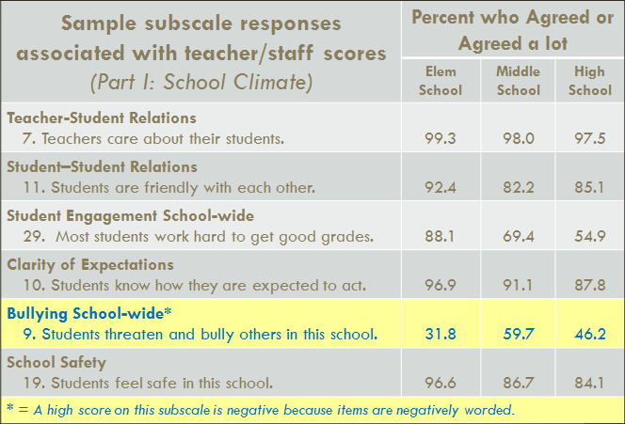
Now, let’s look at the questions
specifically related to:
Verbal Bullying
Physical Bullying
Social/Relational Bullying
Cyberbullying
Notes:
MEGAN
Updated 9.29.14
[see handout made by MP regarding particular subscales, made from slides #44-52 of DSCS workshop materials 13-14]
Questions from Bullying SW subscale: 9. Students threaten and bully others in this school.
14. Students worry about others bullying them in this school.
24. In this school, bullying is a problem.
35. Students bully one another in this school.

Slide 9
Verbal Bullying Items
1. I was teased by someone saying hurtful things to me.
 |  | Never | Sometimes | Once or Twice a Month | Once a Week | Several Times a Week | Everyday
Grade Level | Elementary | 48.9% | 35.2% | 4.9% | 3.0% | 3.6% | 4.4%
 | Middle | 47.9% | 32.5% | 5.1% | 4.1% | 5.3% | 5.1%
 | High | 59.0% | 26.2% | 4.9% | 3.4% | 3.2% | 3.3%
Total |  | 51.2% | 31.8% | 5.0% | 3.5% | 4.2% | 4.4%
4. A student said mean things to me.
 |  | Never | Sometimes | Once or Twice a Month | Once a Week | Several Times a Week | Everyday
Grade Level | Elementary | 47.6% | 34.3% | 5.2% | 3.6% | 3.5% | 5.7%
 | Middle | 47.7% | 31.8% | 5.1% | 4.2% | 4.8% | 6.4%
 | High | 58.2% | 26.4% | 4.4% | 3.8% | 3.2% | 4.0%
Total |  | 50.4% | 31.3% | 4.9% | 3.9% | 3.9% | 5.5%
Notes:
MEGAN
Updated 9.29.14
[tables taken from 13-14 DSCS Workshop, highlighted for the forum]
MS = 14.5
HS =9.9
4. MS = 11.62
HS = 11

Slide 10
Verbal Bullying Items
7. I was called names I didn’t like.
 |  | Never | Sometimes | Once or Twice a Month | Once a Week | Several Times a Week | Everyday
Grade Level | Elementary | 56.6% | 29.0% | 3.7% | 2.8% | 2.9% | 5.1%
 | Middle | 54.7% | 28.0% | 4.1% | 3.3% | 3.9% | 6.0%
 | High | 63.2% | 23.2% | 4.1% | 2.9% | 2.6% | 3.9%
Total |  | 57.7% | 27.1% | 4.0% | 3.0% | 3.2% | 5.1%
10. Hurtful jokes were made up about me.
 |  | Never | Sometimes | Once or Twice a Month | Once a Week | Several Times a Week | Everyday
Grade Level | Elementary | 69.2% | 20.0% | 2.9% | 2.0% | 2.1% | 3.9%
 | Middle | 67.5% | 19.7% | 3.0% | 2.8% | 2.7% | 4.3%
 | High | 73.0% | 16.4% | 3.3% | 2.1% | 2.0% | 3.1%
Total |  | 69.6% | 18.9% | 3.0% | 2.3% | 2.3% | 3.9%
Notes:
MEGAN
Updated 9.29.14
[tables taken from 13-14 DSCS Workshop, highlighted for the forum]
7. MS =13.2
HS =9.4
10. MS =9.8
HS =7.2

Slide 11
Physical Bullying Items
2. I was pushed or shoved on purpose.
 |  | Never | Sometimes | Once or Twice a Month | Once a Week | Several Times a Week | Everyday
Grade Level | Elementary | 62.9% | 26.1% | 4.0% | 2.4% | 2.3% | 2.3%
 | Middle | 60.6% | 26.4% | 4.4% | 3.0% | 2.8% | 2.8%
 | High | 71.4% | 17.7% | 3.9% | 2.6% | 1.7% | 2.6%
Total |  | 64.3% | 24.0% | 4.1% | 2.7% | 2.3% | 2.6%
5. I was hit or kicked and it hurt.
 |  | Never | Sometimes | Once or Twice a Month | Once a Week | Several Times a Week | Everyday
Grade Level | Elementary | 75.2% | 16.6% | 2.3% | 2.1% | 1.6% | 2.3%
 | Middle | 77.5% | 13.7% | 2.8% | 2.1% | 1.6% | 2.2%
 | High | 86.2% | 6.8% | 2.0% | 1.8% | 1.2% | 1.9%
Total |  | 79.0% | 12.9% | 2.4% | 2.0% | 1.5% | 2.2%
Notes:
MEGAN
Updated 9.29.14
[tables taken from 13-14 DSCS Workshop, highlighted for the forum]
2. MS =8.6
HS =6.9
5. MS =5.9
HS =4.9

Slide 12
Physical Bullying Items
8. A student stole or broke something of mine on purpose.
 |  | Never | Sometimes | Once or Twice a Month | Once a Week | Several Times a Week | Everyday
Grade Level | Elementary | 72.9% | 18.2% | 3.3% | 1.9% | 1.4% | 2.2%
 | Middle | 73.2% | 17.4% | 3.4% | 2.3% | 1.7% | 2.0%
 | High | 80.3% | 12.2% | 2.7% | 2.0% | 1.1% | 1.7%
Total |  | 75.0% | 16.3% | 3.2% | 2.1% | 1.4% | 2.0%
11. A student threatened to harm me.
 |  | Never | Sometimes | Once or Twice a Month | Once a Week | Several Times a Week | Everyday
Grade Level | Elementary | 77.6% | 14.0% | 2.5% | 1.8% | 1.4% | 2.8%
 | Middle | 77.7% | 13.0% | 2.8% | 2.0% | 1.8% | 2.6%
 | High | 82.4% | 9.6% | 2.4% | 1.9% | 1.5% | 2.3%
Total |  | 78.9% | 12.4% | 2.6% | 1.9% | 1.6% | 2.6%
Notes:
MEGAN
Updated 9.29.14
[tables taken from 13-14 DSCS Workshop, highlighted for the forum]
8. MS =6
HS =4.8
11. MS =6.4
HS =5.7

Slide 13
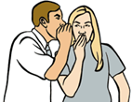
Social/Relational Bullying Items
3. Students left me out of things to make me feel badly.
 |  | Never | Sometimes | Once or Twice a Month | Once a Week | Several Times a Week | Everyday
Grade Level | Elementary | 63.4% | 23.8% | 4.2% | 2.7% | 2.3% | 3.6%
 | Middle | 69.6% | 18.4% | 3.5% | 2.8% | 2.6% | 3.1%
 | High | 75.2% | 14.6% | 3.6% | 2.4% | 1.7% | 2.5%
Total |  | 68.9% | 19.3% | 3.8% | 2.6% | 2.3% | 3.1%
6. A student told or got others not to like me.
 |  | Never | Sometimes | Once or Twice a Month | Once a Week | Several Times a Week | Everyday
Grade Level | Elementary | 70.0% | 18.8% | 3.1% | 1.9% | 2.2% | 4.0%
 | Middle | 70.1% | 18.0% | 3.2% | 2.4% | 2.2% | 4.2%
 | High | 73.4% | 16.1% | 3.4% | 2.3% | 1.9% | 3.0%
Total |  | 70.9% | 17.8% | 3.2% | 2.2% | 2.1% | 3.8%
Notes:
MEGAN
Updated 9.29.14
[tables taken from 13-14 DSCS Workshop, highlighted for the forum]
3. MS =14.2
HS =6.6
6. MS =8.8
HS =7.2

Slide 14
Social/Relational Bullying Items
9. A student got others to say mean things about me.
 |  | Never | Sometimes | Once or Twice a Month | Once a Week | Several Times a Week | Everyday
Grade Level | Elementary | 73.5% | 17.0% | 2.7% | 1.8% | 1.7% | 3.3%
 | Middle | 72.2% | 16.2% | 3.0% | 2.4% | 2.4% | 3.8%
 | High | 76.6% | 13.9% | 3.4% | 2.0% | 1.7% | 2.5%
Total |  | 73.8% | 15.9% | 3.0% | 2.1% | 2.0% | 3.3%
12. Students told another student not to be friends with me because the other students didn’t like me.
 |  | Never | Sometimes | Once or Twice a Month | Once a Week | Several Times a Week | Everyday
Grade Level | Elementary | 72.4% | 18.0% | 2.5% | 1.9% | 1.8% | 3.5%
 | Middle | 73.6% | 15.8% | 2.9% | 2.1% | 2.0% | 3.7%
 | High | 76.9% | 13.7% | 2.7% | 2.2% | 1.6% | 2.9%
Total |  | 74.1% | 16.0% | 2.7% | 2.0% | 1.8% | 3.4%
Notes:
MEGAN
Updated 9.29.14
[tables taken from 13-14 DSCS Workshop, highlighted for the forum]
9. MS =8.6
HS =6.2
12. MS =7.8
HS =6.7

Slide 15
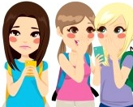
Cyberbullying Items
14. A student sent me a mean or hurtful message about me using email, text messaging, instant messaging, or similar electronic messaging.
 |  | Never | Sometimes | Once or Twice a Month | Once a Week | Several Times a Week | Everyday
Grade Level | Middle | 84.8% | 9.9% | 2.0% | 1.2% | .9% | 1.2%
 | High | 83.5% | 10.2% | 2.0% | 1.6% | 1.0% | 1.7%
Total |  | 84.3% | 10.0% | 2.0% | 1.3% | .9% | 1.4%
15. A student sent to others a mean or hurtful message about me using email, text messaging, instant messaging, or similar electronic messaging.
 |  | Never | Sometimes | Once or Twice a Month | Once a Week | Several Times a Week | Everyday
Grade Level | Middle | 82.4% | 11.2% | 2.1% | 1.5% | 1.1% | 1.6%
 | High | 80.5% | 11.6% | 2.6% | 1.9% | 1.2% | 2.1%
Total |  | 81.6% | 11.4% | 2.3% | 1.7% | 1.2% | 1.8%
Notes:
MEGAN
Updated 9.29.14
[tables taken from 13-14 DSCS Workshop, highlighted for the forum]
14. MS =3.3
HS =4.3
15. MS =4.2
HS =5.2

Slide 16
Cyberbullying Items
16. A student posted something mean or hurtful about me on a social media website, such as Facebook, Twitter, or Myspace.
 |  | Never | Sometimes | Once or Twice a Month | Once a Week | Several Times a Week | Everyday
Grade Level | Middle | 87.0% | 8.1% | 1.6% | 1.3% | .7% | 1.3%
 | High | 83.6% | 9.3% | 2.5% | 1.8% | 1.1% | 1.8%
Total |  | 85.6% | 8.6% | 2.0% | 1.5% | .9% | 1.5%
17. A student pretending to be me sent or posted something hurtful or mean about me or others using text messaging, a social media website, email, or a similar method.
 |  | Never | Sometimes | Once or Twice a Month | Once a Week | Several Times a Week | Everyday
Grade Level | Middle | 91.2% | 5.1% | 1.0% | 1.0% | .7% | 1.0%
 | High | 91.0% | 4.1% | 1.3% | 1.3% | .9% | 1.5%
Total |  | 91.1% | 4.7% | 1.1% | 1.1% | .7% | 1.2%
Notes:
MEGAN
Updated 9.29.14
[tables taken from 13-14 DSCS Workshop, highlighted for the forum]
16. MS =3.3
HS =4.7
17. MS =2.7
HS =3.7

Slide 17
Cyberbullying Items
18. A student sent me a mean or hurtful text message, email, or posting for me to see about another student.
 |  | Never | Sometimes | Once or Twice a Month | Once a Week | Several Times a Week | Everyday
Grade Level | Middle | 84.4% | 9.5% | 1.8% | 1.5% | 1.2% | 1.6%
 | High | 82.3% | 9.3% | 2.9% | 1.8% | 1.5% | 2.2%
Total |  | 83.5% | 9.4% | 2.3% | 1.6% | 1.3% | 1.9%
Notes:
MEGAN
Updated 9.29.14
[tables taken from 13-14 DSCS Workshop, highlighted for the forum]
18. MS =4.3
HS =5.5

Slide 18
Get to Know Your 13-14 DSCS Bullying Data Really Well
13-14 DSCS Part III: Bullying
Climate Sub-Scale | Student Survey Results Report | Home Survey Results Report
Bullying SW* | School-Wide (Pgs. 1, 2, 7, 11) | N/A
Bullying Victimization | Physical Bullying (Pgs. 4-5, 8, 12) | Physical Bullying (Pgs. 2, 4-5)
 | Verbal Bullying (Pgs. 4-5, 8, 12) | Verbal Bullying (Pgs. 2, 4-5)
 | Social/Relational Bullying (Pgs. 4-5, 8, 12) | Social/Relational Bullying (Pgs. 2, 4-5)
 | Cyberbullying (Pgs. 4-5, 8, 12) | N/A
* A higher score represents an unfavorable response to items on the Bullying School-Wide subscale and the Use of Punitive Techniques subscale.
Notes:
MEGAN
Updated 9.29.14
Questions on the sheet: When you look at your DSCS what are your students’ and families’ biggest concerns regarding bullying? It is a type of bullying? Is it a certain bullying action under a particular type of bullying?
How is your school addressing these concerns at this time? If it isn’t, how could it address these concerns? Brainstorm and/or ask others at your table.
Looking more carefully at your data, are their particular groups of students (by grade, gender, race) who are especially concerned about particular types of bullying?
How is your school addressing these concerns at this time? If it isn’t, how could it address these concerns? Brainstorm and/or ask others at your table.
Example items [taken from 13-14 DSCS Workshop]
Verbal Bullying
“A student said mean things to me.”
Physical Bullying
“I was pushed or shoved on purpose.”
Social/Relational Bullying
“A student told or got others to not like me.”
Cyberbullying (grades 6-12)
“A student sent me a mean or hurtful message about me using email, text messaging, instant messaging, or similar electronic messaging.”

Slide 19
Your School Data…
What kind of story does it tell?
What have your students told you about the data?
Let’s find out what students across the
United States told researchers about bullying and
other forms of peer mistreatment…
Notes:
MEGAN
Updated 9.29.14
Questions on the sheet: When you look at your DSCS what are your students’ and families’ biggest concerns regarding bullying? It is a type of bullying? Is it a certain bullying action under a particular type of bullying?
How is your school addressing these concerns at this time? If it isn’t, how could it address these concerns? Brainstorm and/or ask others at your table.
Looking more carefully at your data, are their particular groups of students (by grade, gender, race) who are especially concerned about particular types of bullying?
How is your school addressing these concerns at this time? If it isn’t, how could it address these concerns? Brainstorm and/or ask others at your table.
Example items [taken from 13-14 DSCS Workshop]
Verbal Bullying
“A student said mean things to me.”
Physical Bullying
“I was pushed or shoved on purpose.”
Social/Relational Bullying
“A student told or got others to not like me.”
Cyberbullying (grades 6-12)
“A student sent me a mean or hurtful message about me using email, text messaging, instant messaging, or similar electronic messaging.”

Slide 20
Bullying What Was This Research About?
Survey Study Participants:
31 schools in 12 states in the USA, 13,177 students
45 minute online questionnaires, 45 questions,
33 multiple choice, 12 open-ended
Topics
School connection *
Prevalence of peer mistreatment
Focus of mistreatment
Perceived trauma
Self-actions *
Adult actions *
Peer actions *
Additional Mini-Study of 2 Middle School
Notes:
MEGAN
Updated 9.29.14
TOPIC 1: Bullying (1 HOUR: 30 – Project, 20 – Sharing, 10 Planning)
“Our voices” (Debby’s Book)
31 schools in 12 states in the USA, 13,177 students
45 minute online questionnaires, 45 questions, 33 multiple choice, 12 open-ended
* These are the topics that we’ll discuss in more detail.
In terms of results, the authors explain “Our survey results are both encouraging and disturbing” (p.1).”

Slide 21
Bullying Recommended Activities to Strengthen Students’ School Connection :
Greet and Welcome Youth
Listen to, Get to Know, and Share Oneself with Students
A Collaborative Schoolwide Approach to Decision-Making and Reinforcing Ethics
Notes:
TOPIC 1: Bullying (1 HOUR: 30 – Project, 20 – Sharing, 10 Planning)
“Our voices” (Debby’s Book)
31 schools in 12 states in the USA, 13,177 students
45 minute online questionnaires, 45 questions, 33 multiple choice, 12 open-ended
Greeting and Welcoming Youth (p.26-27)
youth and make them feel welcomed daily (see pg.26, research by Lieber (2002) and Allday & Pakurar (2007) for more information about how to greet and the impact teacher greetings cn have on student on-task behavior at the secondary level)
Listening to, Getting to Know, and Sharing Oneself with Students (p.27)
“Model persistence in the face of frustration and disappointment” (p.27)
“Students are more likely to become passionate learners when the see adults they respect voluntarily fousing time and energy on learning.” (p.27)
“…we caution adults to limit some types of sharing” (p.27)
A Collaborative Approach (p.27-28)
See Whitlock (2006) research regarding “how we might enhance students’ feelings of school connectedness” (p.27)
SW approaches to communication is stressed, “[SW] community building brings students, parents, and school staff together to create new school traditions” (p.28)
[Add surprising findings if there is time….]

Slide 22
Bullying Recommended Actions to Build Students’ Self Action:
Support student self-efficacy
Building positive narratives
Cognitive restructuring (with filtering destructive criticism)
Teaching young people to solve problems
Means-end thinking
Weighing pros/cons
Alternative solution thinking
Giving feedback that emphasizes effort over ability [growth mindset]
Notes:
MEGAN
Updated 9.29.14
TOPIC 1: Bullying (1 HOUR: 30 – Project, 20 – Sharing, 10 Planning)
“Our voices” (Debby’s Book)
31 schools in 12 states in the USA, 13,177 students
45 minute online questionnaires, 45 questions, 33 multiple choice, 12 open-ended
Self-actions
See tables
Help students develop resiliency through:
1. Self-efficacy
2. Building positive narratives
3. Cognitive restructuring (with filtering destructive criticism)
4. Teaching young people to solve problems
(p.55, akin to ICPS curriculum (Shure) and Second Step
Means-end thinking
Weighing pros/cons
Alternative solution thinking
5. Giving feedback that emphasizes effort over ability (growth mindset)
[Add surprising findings if there is time….]

Slide 23
Bullying Recommended Actions for Addressing Adult Actions:
“When adults at school listened to them, they reported less trauma related to their peer mistreatment”
“Our listening breaks down the loneliness of social isolation and gives youth a sense of belonging, value, and hope” (p.98)
Stop telling students to “Stop Tattling”
Notes:
MEGAN
Updated 9.29.14
TOPIC 1: Bullying (1 HOUR: 30 – Project, 20 – Sharing, 10 Planning)
“Our voices” (Debby’s Book)
31 schools in 12 states in the USA, 13,177 students
45 minute online questionnaires, 45 questions, 33 multiple choice, 12 open-ended
Adult actions
“When adults at school listened to them, they reported less trauma related to their peer mistreatment” (p.96, regardless of school level or gender).
“Our listening breaks down the loneliness of social isolation and gives youth a sense of belonging, value, and hope” (p.98)
“It is often helpful to summarize what young people have told us to show them that we have heard and understand them.” (p.98).
“It is also important to express graittude when yhoung people choose to bring their concerns to us” (p.98).
“It is a good idea to maintain a ‘notes of concern’ box in the classroom or in the schoo” (p.98).
“When young people talk with us about negative events, we can help support their autonomy by using open-ended questions such as…” (p.99)
Stop telling students to “Stop Tattling”
Disproportion advice
Shuts down potentially important information from students (sense of traumatization, potential violence)
Idea: “Blue Dot” campaign (p.101)
Find other ways to address concerns that are often associated with the use of “tattling” language (p.103)
[Add surprising findings if there is time….]

Slide 24
Bullying Recommended Actions for Addressing Peer Actions:
Use the Social Norms Approach for promoting positive behaviors (Perkins & Berkowitz, 1996)
Use theater and student-created video to model positive peer actions
Using observational feedback to encourage kind and inclusive behavior
Student leadership programs
Notes:
MEGAN
Updated 9.29.14
TOPIC 1: Bullying (1 HOUR: 30 – Project, 20 – Sharing, 10 Planning)
“In fact, not only is confrontation likely to be unsafe for bystanders, it is also not the most effective way to help mistreated youth” (p.72).
Use instead:
Social norms approach (Perkins & Berkowitz, 1996)
“Successful social norms interventions rely on a set of core elements. These elements include collecting nad presenting valid, reliable, and relevant data; avoiding negative messages that contradict positive youth norms; and using both quantitative and qualitative data” (p.75).
PR campaign using student narratives
“avoid scare tactics” (p.76)
Think about “Going Good Does Good” (p.76)
Using theater and student-created video to model positive peer actions
Using observational feedback to encourage kind and inclusive behavior
See “Empowerment Triangle” (p.78)
Student leadership programs
[Add surprising findings if there is time….]

Slide 25
Bullying What Davis and Nixon Also Noticed in the Mini-Study
The following also “contributed to positive school functioning” and a “culture of helpfulness” (p.135):
Peer partners (8th with 6th )
Advisor-advisee program (advisory time was to be together and have fun)
After-school programming (more than athletics)
Districtwide code of ethics (consistent across grade-level, ES-HS)
Notes:
MEGAN
Updated 9.29.14
TOPIC 1: Bullying (1 HOUR: 30 – Project, 20 – Sharing, 10 Planning)
[Add surprising findings if there is time….]
[Bring up also these global recommendations:
First, we should strive to reduce the frequency of thoughtless, mean actions carried out by youth who do not intent to harm others.
Third, we should reduce the frequency of mean behavior by a very small group of young people who truly enjoy hurting others.

Slide 26
Bullying The Bottom Line from Davis and Nixon (2014)
Effectively addressing bullying
and other peer mistreatment requires
“a shift toward a focus on
school culture”.
Notes:
MEGAN
Updated 10.14
At end, ask them about their impressions of the book.
Focus should be a “shift toward a focus on school culture” (p.2).
What Doesn’t Work
“First, we see significant evidence from our experience and research that the common practice of teaching youth the difference between “tattling” and “telling” has long-lasting negative results.
“Second, our research and professional experience over the past decades convince us that it is time to abandon the idea that mistreated youth have somehow caused their mistreatment by their lack of assertion or annoying behavior.
From old [now deleted slide]: Primary Goals for Schools (Adapted from authors, p.3):
First, we should strive to reduce the frequency of thoughtless, mean actions carried out by youth who do not intent to harm others.
Second, we should seek to reduce the frequency of mean actions committed by youth who have deficits in conscience, self-control, or empathy. [
Third, we should reduce the frequency of mean behavior by a very small group of young people who truly enjoy hurting others.
Fourth, we should build cognitive and emotional resiliency in all youth to prepare them to cope with others’ negative actions and with the inevitable losses…
Fifth, we should build connectedness and relationships for all within the school community…
Sixth, we should strengthen our community’s responses to mistreatment and trauma…

Slide 27
Bullying: DE-PBS Action Planning Initiative with Chad Rose
Step 1: Confirm how you are defining “bullying” in your school (see district policy)
Step 2: Develop plan for teaching definition & establish clear reporting protocol (for staff, students, & families)
Step 3: Establish a protocol for responding to bullying reports
Consider these 4 components of bullying in developing the definition.
Imbalance of physical or emotional power
Repeated across time or individuals/victims
Intent to cause physical or emotional harm
Unequal levels of affect
Consider these 4 steps in establishing protocol:
Create
Teach
Practice
Monitor
Consider these 3 perspectives when establishing a protocol:
Bully
Victim
Bystander
Notes:
MEGAN
Updated 9.29.14
[Ask them to flip over their worksheet with the DSCS information]
Text from Shearn Sept 2014: PS DuPont Middle School – Initial Steps for DE-PBS Bully Prevention and Intervention Action Plan
Step 1: Define “bullying” for PS DuPont Middle (reflecting on BSD district policy)
Goal is to thoroughly and clearly define what bullying is so that all students, staff, and families are on the same page. This will support the school’s preventative and response procedures.
Consider 4 components of bullying in developing the definition.
Imbalance of physical or emotional power
Repeated across time or individuals/victims
Intent to cause physical or emotional harm
Unequal levels of affect
Example standard definition:
“A negative and often aggressive or manipulative act or series of acts by one or more people against another person or people usually over a period of time. It is abusive and is based on an imbalance of power.” Sullivan, Cleary, and Sullivan (1998) (pp. 4-­‐5)
Step 2: Develop plan for teaching definition and establish clear protocol for reporting for school community (staff, students, families)
Goal is to make a plan to share and teach PS duPont’s definition of bullying school-wide so that all students, staff, and parents are on the same page and able to identify and respond according to the plan when bullying is seen/experienced and reported.
e.g., include procedure for use of BSD’s online “Bullying Anonymous Reporting Form” by students and parents
Consider: 4 steps in establishing protocol
Create
Teach
Practice
Monitor
Step 3: Establishing protocol for responding to bullying reports
Goal is that when bullying is reporting, the staff responding will be able to compare the report to the school’s definition of bullying, and based on match will follow a well-defined response process (think crisis plan). The students, staff, and parents are all aware of what the response protocol entails.
Consider 3 avenues included in response protocol
Bully - Beyond the punitive measures, plan for necessary conversations and skill building opportunities
Victim – Consider supports needed for victim, who will provide and monitor supports
Bystander – assurance that report was taken seriously, school is supporting bystander (esp. if reporter), communication that school will address bullying situation by supporting the students involved

Slide 28
Why do we need Major Versus Minor ?
Consistent way of dealing with behaviors
Same consequence in different classes
Same expectations in all parts of the building with all teachers
Give teachers tools to respond to various types of behaviors
Cut down on lost instructional time due to inappropriate referrals to office

Slide 29
Topic 2: Minors vs. Majors
We’d like to share:
Developing appropriate definitions of problem behaviors
Developing behavior tracking forms
ODR Forms & Classroom Behavior Tracking Forms
De-Escalation Strategies
Overall, we’d like to know:
How do you define and reinforce the M&Ms in your school?
How and when does your school use behavior tracking forms?
How do you promote de-escalation strategies?
Notes:
Eileen
Added by MP 10.06.14 so we can see all the topics to be discussed in this section.

Slide 30
Appropriate Definitions of Problem Behaviors
What one teacher may consider disrespectful, may not be disrespectful to another teacher. For that reason, problem behaviors must be operationally defined.
Notes:
EILEEN

Slide 31
Appropriate Definitions of Problem Behaviors
Clear set of definitions for all categories on the office discipline referral form exists and is in line with the SWIS definitions
Once behaviors are defined, all faculty, staff, administration, students and families will need to be trained on the definitions
Notes:
EILEEN

Slide 32
Definitions of Problem Behaviors
All problem behaviors are covered and none of the definitions overlap
Consistent definitions make data collection much more accurate and reliable
The addition of minor problem behaviors assists in the summary of minor infractions
Notes:
EILEEN

Slide 33
Compatible Definitions
A complete list of problem behaviors, as well as, locations, possible motivations, others involved, and administrative decisions are all operationally defined on www.swis.org.
Notes:
EILEEN
Copy list for everyone of SWIS definitions

Slide 34
Characteristics of a Compatible Referral Form
A clear distinction must exist between problem behaviors that are staff-managed (minor) versus problem behaviors that are office-managed or crisis (major)
Notes:
EILEEN

Slide 35
Major Discipline Incidents
Defined
Discipline incidents that must be handled by the administration.
These may include but are not limited to: physical fights, property damage, drugs, weapons, tobacco, etc.
Purpose
Once problem behaviors are operationally defined, it is essential that the team distinguish the major discipline incidents from the minor to determine the appropriate consequence
Notes:
EILEEN

Slide 36
Minor Discipline Incidents
Defined
Discipline incidents that can be handled by the classroom teacher and usually do not warrant a discipline referral to the office*.
These may include but are not limited to: tardiness to class, lack of classroom material, incomplete classroom assignments, gum chewing, etc.
Purpose
To determine appropriate consequence and where the consequence should be delivered
* These incidences are still tracked but the consequence is delivered in the classroom
Notes:
EILEEN

Slide 37
Emergency or Crisis Incidents
Defined*
Discipline incidents that require immediate response from administration and/or crisis response team.
These incidences may cause short-term change to a school’s PBS Plan and may include, but are not limited to: bomb threats, weapons alerts, intruder, fire evacuations, etc.
*These incidents do not necessarily result in an ODR
Purpose
Maintain order and safety during emergency situations
* Each school is urged to consult their district and school policies for emergency/crisis incidents
Notes:
EILEEN
Ask Eileen about the astrisks.

Slide 38
Office Discipline Referral (ODR) Forms
Be sure to answer the following 5 questions on each referral form:
Who?
Why?
What?
When?
Where?
Clarity on the referral form takes the guess work out of the data entry person’s job
Data will be more reliable and accurate as judgment calls are minimized
Notes:
EILEEN

Slide 39
Characteristics of a SWIS Compatible Referral Form
Student’s Name
Date
Time of Incident
Student’s Teacher (optional)
Student’s Grade Level
Referring Staff
Location of Incident
Problem Behavior
Possible Motivation
Others Involved
Administrative Decision
Other Comments
No more than 3 extra info.
Notes:
EILEEN

Slide 40
Developing the ODR
Challenges:
The form is not filled out correctly
Solutions:
Re-train faculty or return to faculty to fill out completely before processing
Notes:
EILEEN

Slide 41
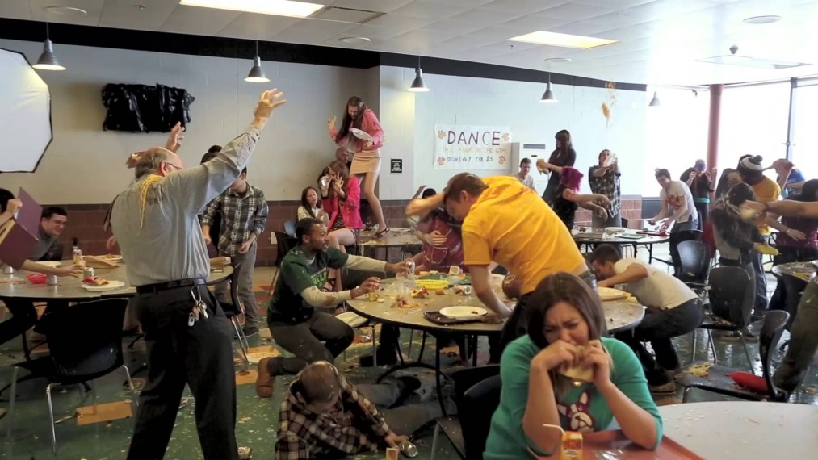
Goal of the Tracking Form
Collect data that are necessary to identify effective ways of changing inappropriate classroom behavior (minor) before it results in an office discipline referral (major)
Notes:
EILEEN

Slide 42
Classroom Tracking Forms
Classroom behaviors take up considerable amounts of teacher time that could be better spent on instruction
Forms assist in identifying the pattern of behavior and determining interventions that will be most effective for the student(s)
Notes:
EILEEN

Slide 43
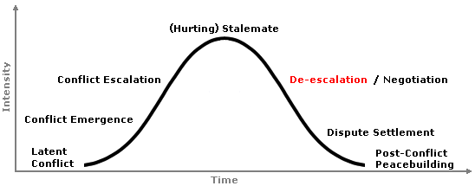
De-Escalation Strategies: Making Sure a Minor Doesn’t Turn into a Major
Notes:
EILEEN

Slide 44
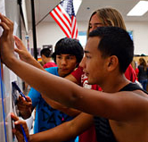
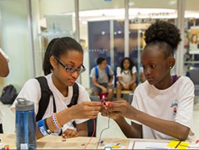
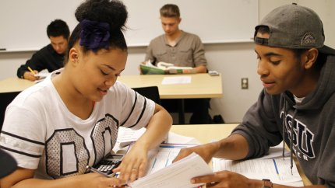
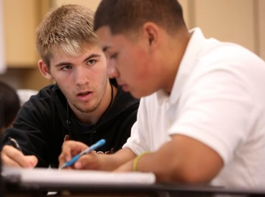
Topic 3: Social Emotional Learning
We’d like to share:
Current CASEL and DEDOE framework
Definitions of 3 SEL skills of focus to DEDOE
3 Strategies for developing SEL in classrooms and schools
The DSCS items related to these SEL skills
Overall, we’d like to know:
Which of these SEL strategies are being reinforced in your school and how?
What does your DSCS results tell you about the SEL at your school?
Notes:
Megan
Added by MP 10.06.14 so we can see all the topics to be discussed in this section.

Slide 45
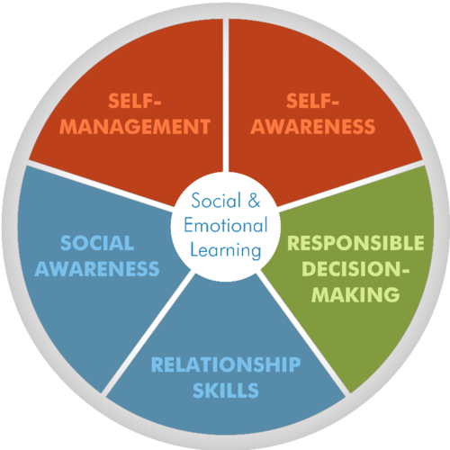
Social Emotional Learning (SEL)
The CASEL Model
Current DELAWARE SEL Areas of Focus
Self-Awareness
Self-Management
Responsible Decision-Making
http://www.casel.org/

Slide 46
Self-Awareness
The ability to accurately recognize one’s emotions and thoughts and their influence on behavior.
This includes:
accurately assessing one’s strengths and limitations
possessing a well-grounded sense of confidence and optimism.
http://www.casel.org/social-and-emotional-learning/core-competencies/

Slide 47
Self-Management
The ability to regulate one’s emotions, thoughts, and behaviors effectively in different situations.
This includes:
managing stress
controlling impulses
motivating oneself
setting and working toward achieving personal and academic goals.
http://www.casel.org/social-and-emotional-learning/core-competencies/

Slide 48
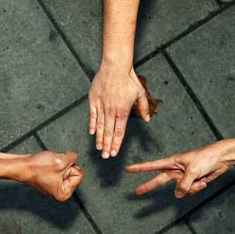
Responsible Decision-Making
The ability to make constructive and respectful choices about personal behavior and social interactions.
These decisions are based on:
consideration of ethical standards
safety concerns
social norms
the realistic evaluation of consequences of various actions
the well-being of self and others.
http://www.casel.org/social-and-emotional-learning/core-competencies/

Slide 49
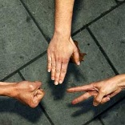
SEL: Related Intervention #1
Classroom Level
Self-Awareness | Self-Management | Responsible Decision-Making
Research-Based Intervention Name: Relevance Writing Exercise (Hulleman and Harackiewicz, 2009) Finding: ”In a randomized field experiment with high school students, we found that a relevance intervention, which encouraged students to make connections between their lives and what they were learning in their science courses, increased interest in science and course grades for students with low success expectations. ”

Slide 50
SEL: Related Intervention #1
Classroom Level
Self-Awareness | Self-Management | Responsible Decision-Making
Relevance Writing Exercise Methods: In science, present summarization activities that instruct students to describe “My application to life” How might this information be useful to you, or a friend/relative? How does learning about this topic apply to your future plans? Additional Notes: This intervention seemed to work most for students who expected low-success in science, but it did not harm students who came in initially expecting high success. Authors believe this intervention may work in any class. See handouts for more information.

Slide 51
SEL: Related Intervention #2
Classroom Level
Self-Awareness | Self-Management | Responsible Decision-Making
Research-Based Intervention Name: Self-Affirmation Writing (Cohen, et al., 2009) Finding: ”Over 2 years, the grade point average (GPA) of African Americans was, on average, raised by 0.24 grade points. Low-achieving African Americans were particularly benefited. Their GPA improved, on average, 0.41 points, and their rate of remediation or grade repetition was less (5% versus 18%). Additionally, treated students' self-perceptions showed long-term benefits. ”

Slide 52
SEL: Related Intervention #2
Classroom Level
Self-Awareness | Self-Management | Responsible Decision-Making
Self-Affirmation Writing Methods: Students are asked to complete a neutral (no right/wrong answer) writing assignment that related to questions about “your ideas, your beliefs, and your life” and how they rated the importance of personal values such as athletic ability, being good at art, being smart or getting good grades, etc. Additional Notes: This intervention seemed to work most for students who were African American and low-achieving in school, but it did not harm students who came in initially expecting high success. See handouts for more information.

Slide 53
SEL: Related Intervention #3
Intensive
Tier 2 Level
Self-Awareness | Self-Management | Responsible Decision-Making
ALAS (1995) used Social Thinking Skills Training (Larson) to remediate the student’s deficient social and task-related problem solving skills See handout for more information about ALAS. Even more information can be found at: http://www.ncset.org/publications/essentialtools/dropout/part3.3.01.asp http://ies.ed.gov/ncee/wwc/pdf/intervention_reports/WWC_Project_ALAS_100506.pdf http://raiseinspiredkids.com/files/alas_program/ALASFinalReportPart1.pdf http://raiseinspiredkids.com/files/alas_program/ALASFinalReportPart2.pdf

Slide 54
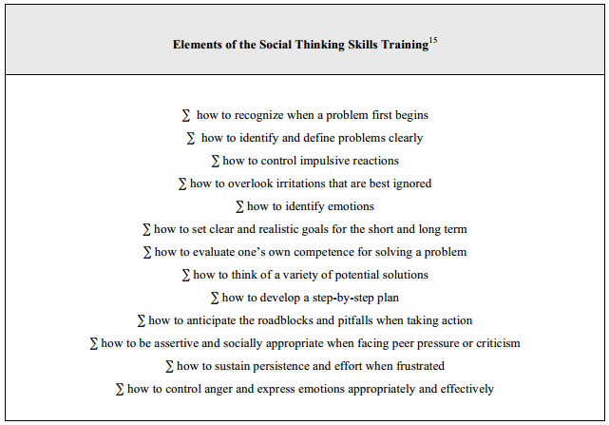
SEL: Related Intervention #3
Intensive
Tier 2 Level

Slide 55
SEL: Items in the DSCS
Use of SEL Techniques
Student Engagement
SW Student Engagement
Cognitive and Behavioral Engagement
Emotional Engagement

Slide 56
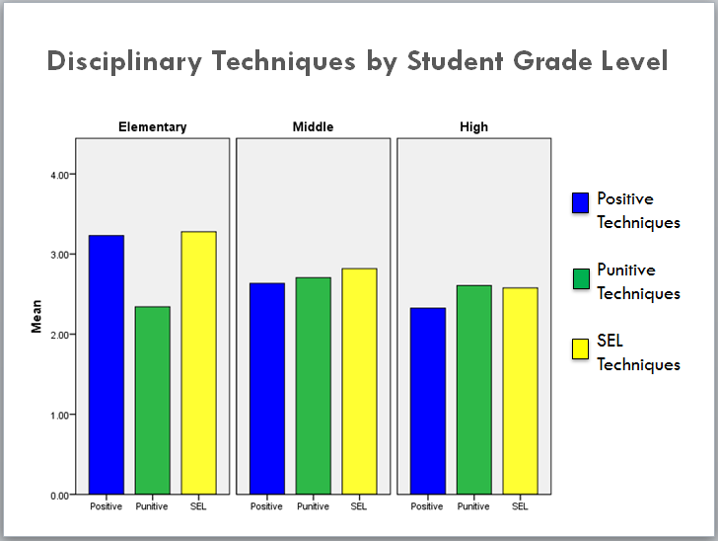
SEL: Items in the DSCS Use of SEL Techniques
Notes:
Updated 5.7.14
Crop in use of pos from es – to MS-HS

Slide 57
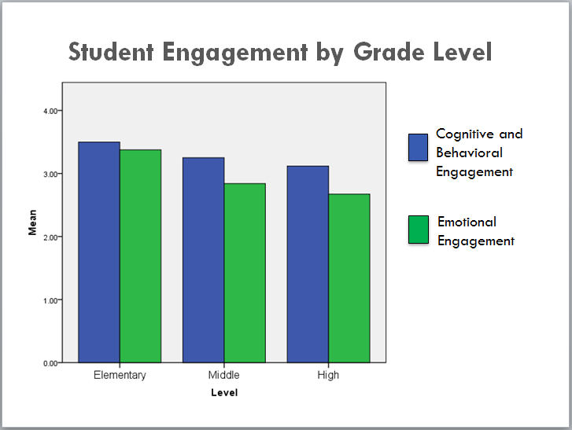
SEL: Items in the DSCS Student Engagement: Cognitive, Behavioral, Emotional
Notes:
Updated 5.6.14
Decline from ES to secondary
MS – HS – scores tend to be comparable

Slide 58
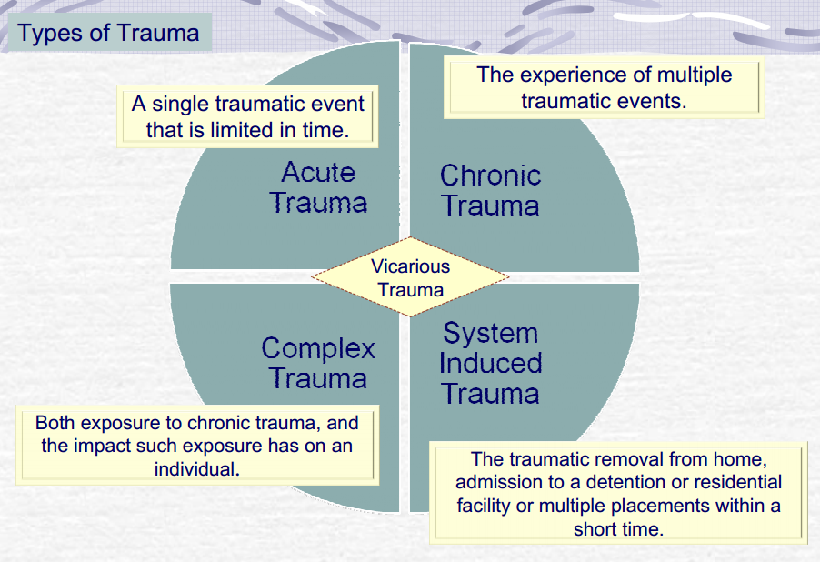
Trauma-Sensitive Practice: A Definition
Trauma-sensitive schools acknowledge the prevalence of traumatic occurrence in students’ lives & create a flexible framework that provides universal supports, is sensitive to unique needs of students, & is mindful of avoiding re-traumatization.
From http://sspw.dpi.wi.gov/team-keyword-categories/trauma-sensitive-schools-0
And From http://www.oregon.gov/oha/amh/trauma-policy/trauma-its.pdf/

Slide 59
PEERS Social Skills: 14-15 Pilot Schools
Brandywine: Mount Pleasant HS, PS DuPont MS
Red Clay: Seaford: Appoquinimink: Redding MS
Caesar Rodney: HS/MS
Seaford: HS/MS
Charter Schools: Gateway
Notes:
4:01 YouTube video

Slide 60
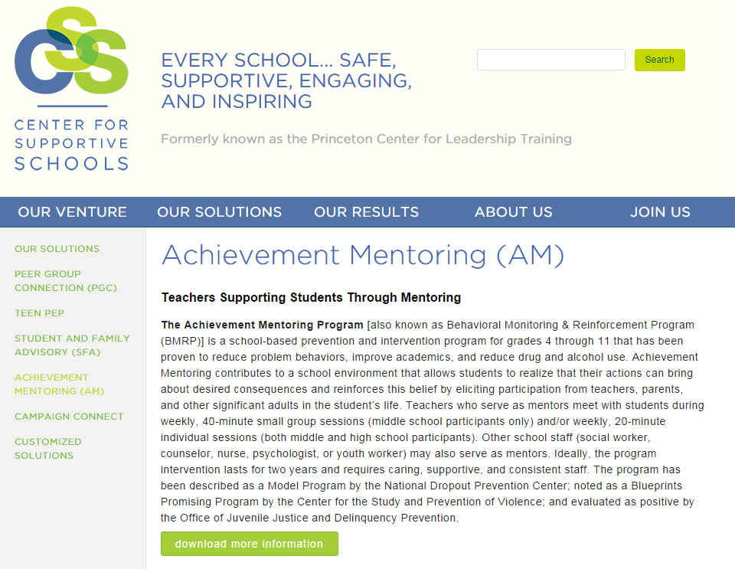
Other Updates: Achievement Mentoring (Dover HS)
http://supportiveschools.org/solutions/achievement-mentoring/

