Slide 1
DE-PBS Cadre
February 12, 2013

Slide 2

Praise Cards
Pick a “praise card” from the basket
Think of a person/team you would like to acknowledge and fill out the card
Be prepared to share your praise with group
Send to the person/team when you get back to work

Slide 3

Reinke, W.M., Herman, K.C., & Stormont, M.
(2003). Classroom level positive behavior
supports in schools implementing SW-PBIS:
Identifying areas for enhancement.
Journal of Positive Behavior Interventions,
15(1), 39-50.
Staying Up-to-Date with Current Research
http://pbi.sagepub.com/

Slide 4
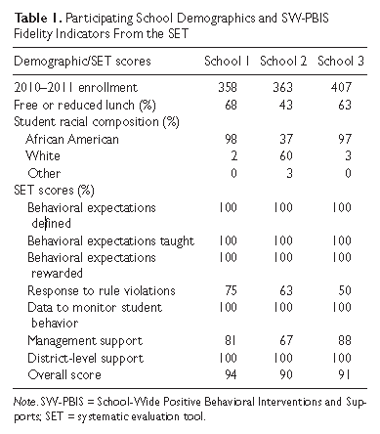
Participating Schools
Location:
3 Elementary Schools with high SW-PBS fidelity (SET)
33 elementary classrooms in those schools

Slide 5

Teacher Participants
Teacher Demographics:
Grades Teaching: K-3rd
Gender: 97% female
Race/Ethnicity: 27% African-American, 73% white
Experience range: 2-29 years (average 12.7 years)
Credentials: 61% undergraduate degrees

Slide 6

Measurement Tools
Mooses *
Classroom Ecology Checklist *
The Teacher Sense of Self-Efficacy Scale**
Maslach Burnout Inventory**
  Sub-section: Emotional Exhaustion

Slide 7
Study Findings and Implications
Implications:
  Positively worded signage regarding expectations does not automatically translate into positive verbal language and/or interactions between teachers and students.
  The practice of providing 4 praises to 1 reprimand is not an inherent practice for teachers. It must be learned.
Possible application of this information:
  Increase the use of coaches and team leaders (and/or peers?) to help teachers to look at their use of praise and reprimands
  Share the research that teacher praise seems to be negatively correlated with teacher use of reprimands
  Encourage teachers to break-down their instruction (and/or routines?) into smaller steps to provide themselves with more opportunities to give specific praise and precorrections.
  Provide teachers with models of ways to document their use of praise and reprimands and student progress.
“Findings indicate that classrooms had posted positively stated classroom rules at high rates, whereas teacher use of specific praise and the ratio of positive to negative interactions were less than optimal.”

Slide 8
Study Findings and Implications
Implications:
  Students are receiving a lower quality of praise.
  Teachers may need support providing specific praise
Possible application of this information:
  Again, encourage teachers to break-down their instruction (and/or routines?) into smaller steps to provide themselves with more opportunities to give specific praise and precorrection.
  Give teachers more examples of specific praise and research that supports this type of praise.
  Provide teachers with visual reminders regarding praise to reference during the day
  Coaches and team leaders should support the above activities related to teaching teachers how best to use praise.
When praise was observed in the classroom, it was much more likely to be general praise than specific praise.

Slide 9
Study Findings and Implications
Implications:
  Teachers need more support regarding classroom management
  Teacher shortages will continue and might threaten student success.
Possible application of this information:
  Professional development activities related to classroom management should be provided to teachers, especially new teachers.
  Schools might want to target their work with the teachers feeling most inefficient and/or exhausted by using existing tools to identify these teachers. These tools could be part of a more systematic process of providing and monitoring interventions to these teachers.
In addition, teachers with lower rates of positive to negative interaction, who used higher rates of harsh reprimands and had higher rates of disruptions, reported higher levels of emotional exhaustion.

Slide 10


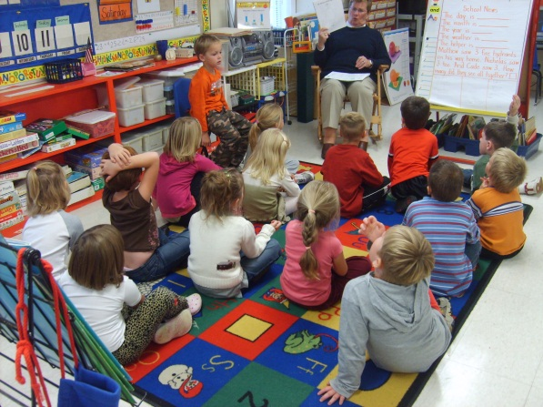

Additional Implications?
Thoughts?
Strategies to Share?
Cadre Conversations

Slide 11

DE-PBS Key Feature Evaluation Updates
Scheduling
Rubrics
Scoring
Reports

Slide 12
DE-PBS Key Feature Evaluation Purpose:
Understand where schools are in implementation of SWPBS
Guidance on need for staff development
Technical assistance for schools through comprehensive report
Evaluate change at the school level and state level
Tool matches our DE-PBS Key Features

Slide 13
Scheduling
October – January – 18 School Visits Completed
February – 6 School Visits Scheduled
Focus on schools:
  trained in 2005-2006 SY or prior
  identified in districts with non-compliance
Draft schedule shared with coaches
Goal of 6-7 per month

Slide 14
Q | SW Tier 1: Prog Dev & Eval | 3 | 2 | 1 | 0 | Source/Notes
1.4 EI | KF9. Office Discipline Referral data is pulled by a designated person, reviewed monthly by the School-wide team (Big Five: average referrals per day per month; # of referrals by behavior, location, time of day, by student), and shared with entire staff. | Team Leader reports all of the following are done: 1. Team has a designated data person to pull ODR data monthly, 2. ODR data are reviewed monthly by team, and 3. ODR data are shared at least 3 times with staff during the school year. | Team Leader reports 2 of 3 items listed in Column 1 are done. | Team Leader reports 1 of 3 items listed in Column 1 are done. | Team Leader reports none of the items listed in Column 1 are done. | Team Leader Interview TL-3-Does the PBS team have a designated data person who is able to pull/print reports for monthly meetings that include the Big 5 data summaries? Who does this? TL-4- Are ODR data collected and reviewed in summary form monthly by the PBS team? TL 5- How often are the Big 5 data summaries (average/month, behavior, location, time of day, by student) shared with all staff during the school year? How are they shared?

Slide 15
SW-PBS Implementation Levels
Level | Parameters | Name | Definition
1 | 0-50% of 2s and 3s earned on Essential Items | Exploring | Few elements of implementation
2 | 51%-75% of 2s and 3s earned on Essential Items | Developing | Early phase of implementation; some elements adequately in place
3 | 75-99% of 2s and 3s earned on Essential Items; No 0s earned | Proficient | Elements in place and implemented
4 | 100% of 2 and 3 earned on Essential Items | Exemplary | Implementation shows evidence of innovation and sustainability

Slide 16
SCHOOL-WIDE PBS TIER 1: Program Development & Evaluation
STRENGTHS
As a team: Review noted strengths of Program Development & Evaluation implementation
Anticipate possible barriers to continuation of these program strengths and how to overcome them
Problem solving for barriers | Target area | Activity/intervention | Person(s) responsible |  | By when

Slide 17
SCHOOL-WIDE PBS TIER 1: Program Development & Evaluation
RECOMMENDATIONS
Review provided recommendations for Program Development & Evaluation implementation
Prioritize these recommendations | 1
 | 2
 | 3
Problem solving for recommendations | Target area |  | Activity/ Intervention | Person(s) responsible | By when

Slide 18

Data & Survey Support
What surveys are out there? What’s required?
What’s the purpose/utility of surveys?
What’s the timing of surveys?
What’s the survey audience?

Slide 19
DE School Climate Survey
164 School Enrolled in 2012-2013
Student & Home survey window closes 3/1/13
Home Survey – Materials for 100%
Weekly updates
  Follow up on 0s
Data workshop – Tuesday, May 7, 2013

Slide 20
DE Assessment of Strengths & Needs for PBS
Part A – School-wide Tier 1 DASNPBS available
Purpose:
  Self-Assessment and Reflection
  Schoolwide Assessment and Reflection
  Action Planning
  Professional Development Plans
Considerations for teams
  Exploring different sections
  Encourage schools not having a KF-PBS Evaluation to participate

Slide 21
Other Surveys
TELL Delaware Survey
Youth Risk Behavior Survey
District specific
Others?

Slide 22

DE-PBS Phase Recognition
2012-2013 Phase 1 & 2 Available
Materials:
  Application
  Frequently Asked Questions
  Reflection Question Guide
Due in full by Friday, June 28, 2013

Slide 23
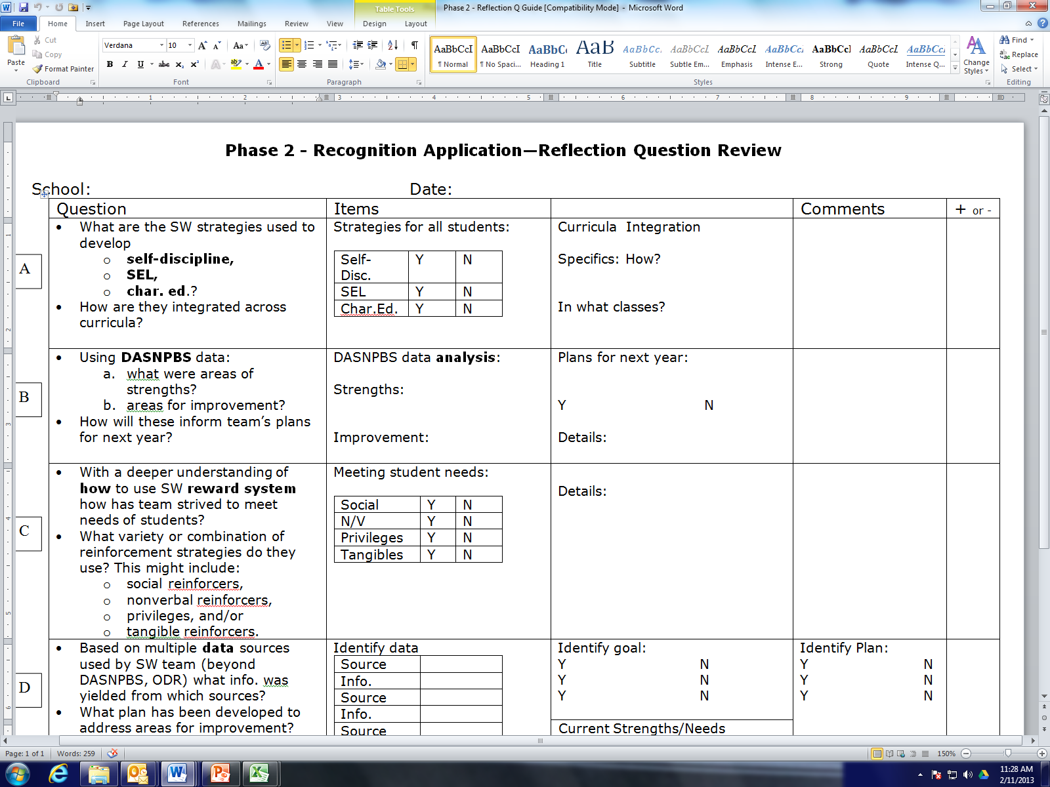
Remind schools to use the Reflection Question Review sheet when teams are selecting, creating, and reviewing their reflection questions.

Slide 24
Phase 1 Program Components
Staff completed 2 sections of the “Delaware Assessment of Strengths and Needs for Positive Behavior Supports-Part A” SW Tier 1- Program Development and Evaluation and Implementing School-wide & Classroom Systems are required for 1st time applicants. All other schools complete 2 sections chosen by team based on data.
OR
Staff completed the 2012 Delaware School Climate Survey- Staff Version.

Slide 25
Phase 2 Program Components
Staff completed at least 1 section of “Delaware Assessment of Strengths and Needs for Positive Behavior Supports-Part A”

Slide 26
Phase 2 Program Components
Met criteria on External Evaluation (Meeting or Exceeding Criteria on DE-PBS Key Feature Evaluation or 80/80% on SET-D) *Schools participating in Key Feature Evaluation in 2012 & 2013 should contact project regarding eligibility for Phase Recognition.

Slide 27
Phase 2 Products for Submission
SWPBS information shared with all staff. Identify a minimum of 2 specific methods in which SWPBS information was shared with all staff. Information sharing may include presentations at meetings or inservice days, or it may also include distributing information electronically. Provide the following information:
    Topic
    Approximate dates(s)/times
    Audience
    Delivery Format
    Follow up

Slide 28
Phase 2 – SW Info with Staff
Topic | Dates/Times | Audience | Delivery Format | Follow up
Major vs. minor expectations/ procedures | 8/27/2012 – ½ day PD session | Full staff | In person - Powerpoint, flow chart, think about it form | Team members solicit questions at September PLC meetings

Slide 29
Phase 3 Brainstorming

Slide 30
School-wide PBS Recognition System
 | SWPBS 1: Basic SW Tier 1 | SWPBS 2: Advanced SW Tier 1 | SWPBS 3: Basic Targeted Tier 2 | SWPBS 4: Advanced Targeted Tier 2 | SWPBS 5: Intensive Tier 3
Strengths & Needs Assess | Prevention & Evaluation sections | Self-Discipline & Correction sections | Targeted & Intensive Sections
Phase/Recognition | Phase 1 | Phase 2 | Phase 3 | Phase 4 | Phase 5
External Evaluation |  | SWPBS Key Features Eval |  | Future: Tier 2&3 Key Features Eval
PD | SW Team Training | Developing Self-Discipline Family-School Collaboration | Targeted Team Training | Advanced Targeted Team Training | FBA/BSP Person-Centered Planning

Slide 31
Celebrating Secondary Successes with DE-PBS
Lights, Camera, DE-PBS Action!
Tuesday, April 23, 2013
Del-tech – Dover, DE
Who Cares About Kelsey?
  Keynote guests: Kelsey Carroll & Kathy Francouer

Slide 32
Celebration Audience
DE-PBS Coaches
Staff from any PBS school (invite all DE-PBS schools, but would be clear about secondary focus)
Students in 7th grade or above
Coaches may extend invitation to their non-PBS middle/high schools who are interested in PBS. Participants to include an administrator.

Slide 33
Draft Agenda
Morning
Afternoon
  Keynote guests: Kelsey Carroll & Kathy Francouer
View Film – Who Cares About Kelsey? (whole group)
Q & A (whole group)
Breakout 1 – 2 session options
Lunch – onsite
  Students with Kelsey
Breakout 2 – 2 session options
Action Planning – whole group

Slide 34
Breakouts
Morning Session
Afternoon Session
1. Students and interested educators meeting with Kathy & Kelsey
  Deeper film discussion, student empowerment
2. Educators & PBS students meeting with secondary school panel of students and staff
  Schools sharing program highlights and challenges; time for Q&A with schools
1. Educators meeting with Kathy
  Overview of RENEW process
2. Students with project staff and Kelsey
  Participating in person-centered action planning

Slide 35
Logistics
See handout
  Discussion Points to share and/or include on invitation/permission slips
Confirming school supervision responsibilities
  Breakout session are interactive.
  Do we set a ratio?
Registration for students and staff
  Single and/or group registration?
Any last minute questions or details to address today?

Slide 36
Professional Development
Part 2 Sessions
New Sessions
Family-School Collaboration
  March 1, 2013
Preventing Bullying by Promoting a Positive School Climate & Self-Discipline
  April 19, 2013
Prevent Teach Reinforce
  May 1, 2013
DE School Climate Survey Workshop
May 7, 2013
Middle School Forum
May 30, 2013???

Slide 37
DE Inclusion Conference
19th Annual Inclusion Conference
Shared Responsibilities = Shared Benefits
Thursday, March 14, 2013
Sheraton Hotel - Dover, Delaware
Keynote: Universal Supports: Laying the Foundation for Inclusion, Laura Riffel
Behavior strand: Behavioral Interventions for Struggling Learners with Attention Deficit Hyperactivity Disorder, Autism Spectrum Disorders, Learning Disabilities and Oppositional Defiant Disorder

Slide 38
Next Cadre – Wednesday, May 8, 2013

